Slide 1


Rural Poverty & Social Isolation: Measuring the Impact of a National Initiative in NI.
Ryan Mcguire:
- FdSc: Energy, Environment and Sustainability, Distinction.
- BSc (Hons): Land Use & Environmental Management, 2:1
- MSc: Leadership for Sustainable Rural Development, Distinction.
- PhD: Rural Development Policy.

Slide 2
Introduction
Rural Poverty & Social Isolation in NI:
Rural have less access to transportation, social and health services, whilst education and employment opportunities are more difficult to access and are more costly. (Brown & Schaff, 2011 pg. 209).
One in 5 children in NI live below the poverty line.
In NI, 25% of people admitting that they don't even know their neighbours' names, moreover, 66% of people admit to feeling lonely (Leonard, 2018).
81,000 rural households in NI suffer from fuel poverty.
33,000 homes spend 25% of their income on heating and lighting their homes.

Slide 3
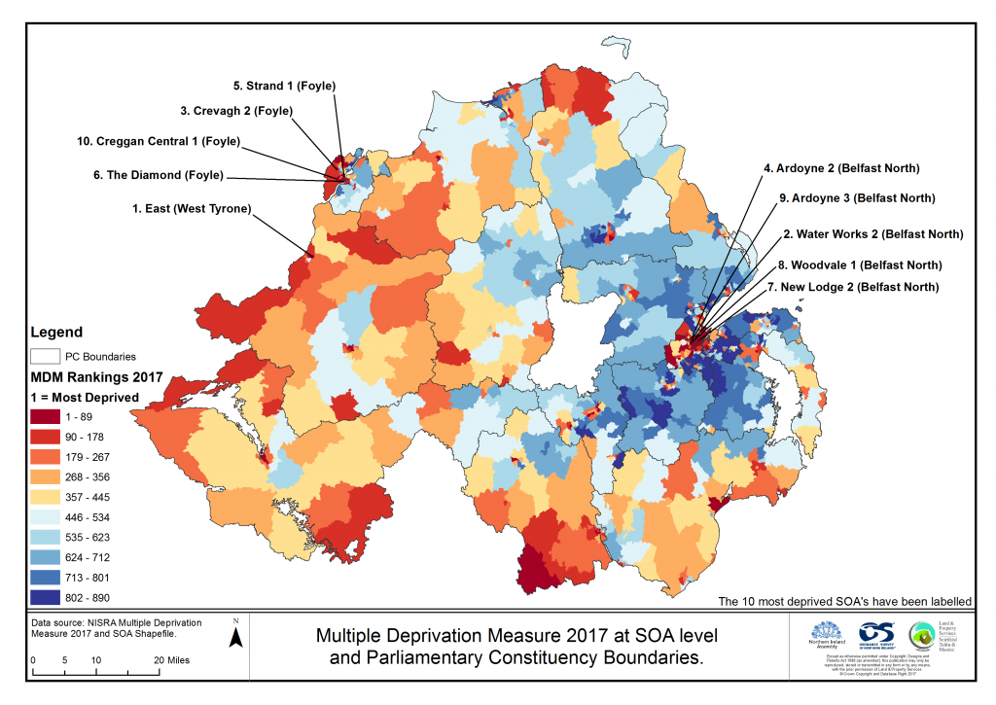
Levels of Deprivation in NI
Measures of deprivation: health, income, access to services, education, crime rate etc. (NISRA, 2017)

Slide 4
MARA (Maximising Access In Rural Areas)
MARA (2012-2014):
Funding: £3,009,000 (DAERA & PHA)
Delivered through 12 rural organisations.
12,085 homes (13,784 individuals) visited.
Target groups: lone parents, older people, disabled people, etc.
Six forms of support/treatment:
Benefit entitlement checks.
Home energy improvements.
Home safety improvements.
Transport.
Local services.
Occupational therapy.

Slide 5
MARA (Maximising Access In Rural Areas)
Table 1: MARA Target, Performance & Outcome:
Treatment | Target | Performance | Outcome
Occupational therapy. | 15% (1,788) | 17% (2,027) | Exceeded (2%)
Benefit Entitlement Checks (BECs). | 35% (4,200) | 53% (7,460) | Exceeded (18%)
Home safety improvements. | No target | 51% (6,081) | N/A
Local services. | 20% (2,385) | 28% (3,339) | Exceeded (8%)
Transport (CRTP/smartpass). | 25% (2,981) | CRTP = 18% (2,504) Smartpass = 4% (477) | Not exceeded (-3%)
Home energy improvements. | 20% (2,385) | 53% (6,320) | Exceeded (33%)

Slide 6
Research Aims
Aim & Objectives:
Evaluate the impact of MARA and identify which MARA supporting mechanism(s) has had the biggest impact on health and social isolation.
Analyse the spatial Impact of MARA, with specific emphasis on NI/ROI border areas.
Measure the relationship between social isolation and rural poverty, are they a product of each other?

Slide 7
Descriptive Statistics
Health:
Figure 2: changes in self-rated health:
Social isolation:
Figure 3: changes in levels of social isolation:

Slide 8
Results (Health)
Model 1:
Table 2: Impact of MARA on rural health
Health | Coef. | Robust Std. Err. | Odds Ratio | Marginal Effects
Male | -.3048845 | .1546918 | .7372085 | -.0658095
Home_Safety | 1.498124 | .161965 | 4.473288 | .3042948
Local_Service | 1.045517 | .218254 | 2.844869 | .2123626
Warm_Homes | 1.044581 | .1984469 | 2.842207 | .2121724

Slide 9
Results (Social Isolation)
Model 2:
Table 3: Impact of MARA on rural social isolation
Social Isolation | Coef. | Robust Std. Err. | Odds Ratio | Marginal Effects
Transport | .9158585 | .2296948 | 2.49892 | .2076665

Slide 10
Results (Aim 2)
Impact of MARA in NI/ROI border areas:
Table 4: Impact of MARA on border area health
Table 5: Impact of MARA on border area social isolation
BorderArea_Health | Coef. | Robust Std. Err. | Odds Ratio | Marginal Effects
Local_Service | 0.5079045 | 0.2682359 | 1.661805 | .0297019
BorderArea_Isolation | Coef. | Robust Std. Err. | Odds Ratio | Marginal Effects
Transport | .479131 | .2046003 | 2.008063 | .0819983

Slide 11
Results (Aim 3)
Relationship between rural poverty & social isolation:
Table 6: Impact of social isolation on health.
Table 7: Impact of health on social isolation.
Health | Coef. | Robust Std. Err. | Odds Ratio | Marginal Effects
Social_Isolation | 1.038782 | .2066285 | 2.825773 | .5342503
Social Isolation | Coef. | Robust Std. Err. | Odds Ratio | Marginal Effects
Health | .7722965 | .1928768 | 2.164732 | .6103202

Slide 12
Key Messages
Drivers of health:
Home safety, local services & home energy improvements.
Drivers of social inclusion:
Transport – smart pass and CRTP membership
The winners:
The elderly, unemployed and low income individuals.
Massive impact in western NI and NI border areas.
Rural poverty & social isolation:
Extremely interrelated: rural health is reliant on one’s social connectivity, and poor health accelerates isolation.

Slide 13
Conclusions
MARA was a huge success.
MARA should incentivize similar programmes.
More care with target group selection.
Large investment not always necessary – national funded programme gives confidence when facing Brexit!
Loss of rural transport will skyrocket levels of social isolation in NI – CRTPs need more funding!

Slide 14
Special Thanks
DAERA.
Professor Alberto Longo & Dr Erin Sherry.
Ecosystem, Biology & Sustainability Cluster.
The Gibson Institute.
Friends and family.

