Slide 1
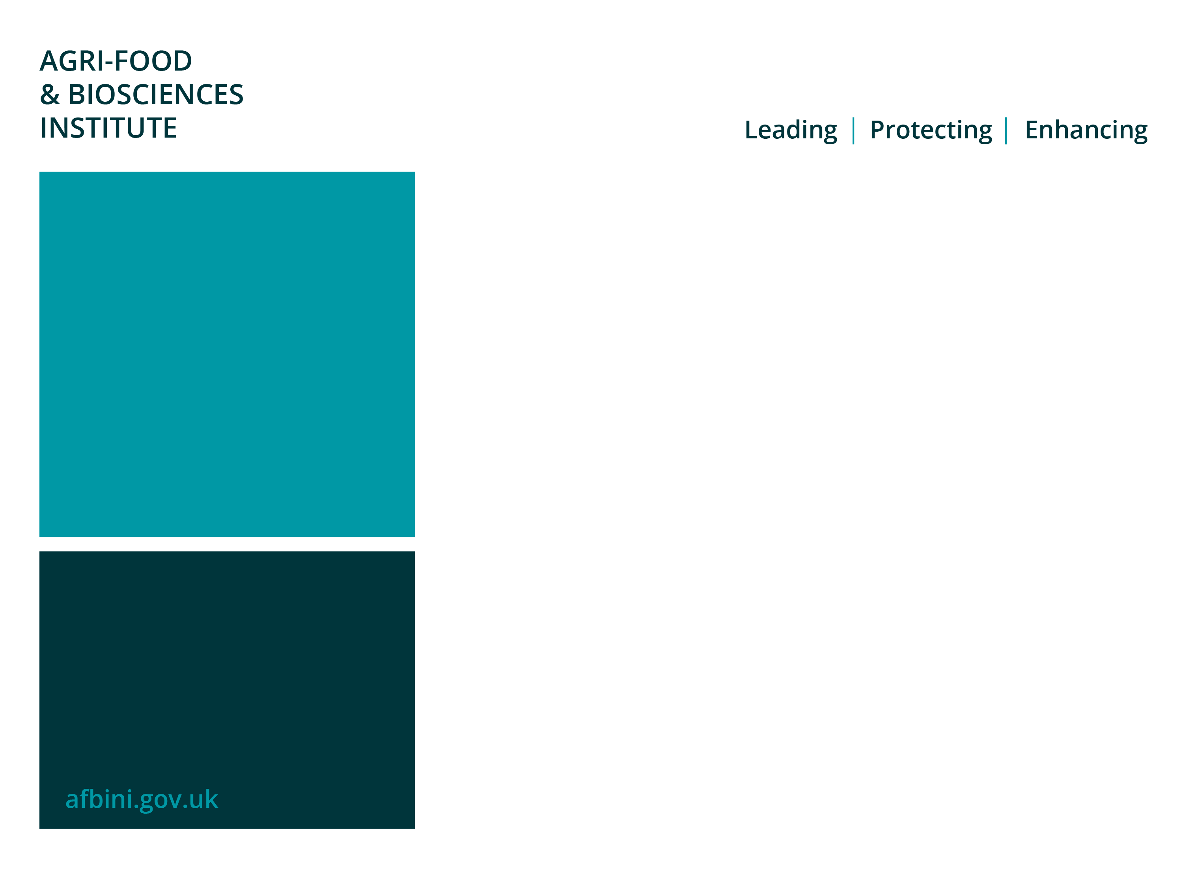
The development of systems to improve the health and performance of dairy-origin beef young stock
N Rutherford^{1,2}
F Lively¹
G Arnott²
¹ Agri-Food and Biosciences Institute, Hillsborough, NI
² School of Biological Sciences, Queen’s University Belfast, NI

Slide 2
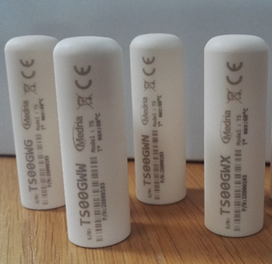
Evaluating rumen temperature during the pre-slaughter phase as a novel welfare indicator and predictor for meat quality
N Rutherford^{1,2}
F Lively¹
G Arnott²
¹ Agri-Food and Biosciences Institute, Hillsborough, NI
² School of Biological Sciences, Queen’s University Belfast, NI

Slide 3
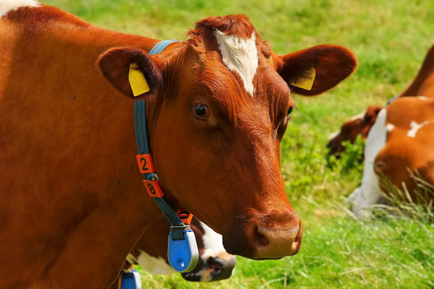
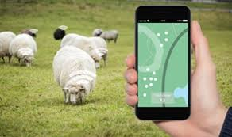
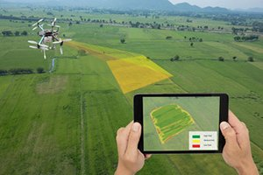
Precision Livestock Farming
Utilising technology to increase efficiency, sustainability and profitability
Targeted
Controlled
Accurate
Notes:
Precision livestock farming – involves utilising technology to increase efficiency, sustainability and profitability
Allows for a more accurate, controlled and targeted approach, while reducing the associated labour.
Approaches commonly focus on optimising animal health and performance. However, many of these technologies also have the potential to be used in the assessment and enhancement of animal welfare.

Slide 4
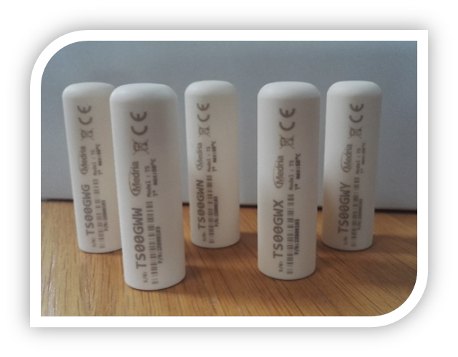
Rumen temperature boluses
Used for the detection of:
  Ill health
  Estrus
  Calving
Non-invasive
Record rumen temperature at five minute intervals
Data automatically downloaded
No human contact required
Notes:
Rumen temperature boluses are a relatively new novel technology which are marketed primarily for the detection of ill health in cattle, other uses include the detection of estrus and calving. However they may be able to provide broader insights into stress induced hyperthermia, and thus be used as a novel welfare indicator.
Rectal temperature is the most common method of assessing core body temperature, however it does have its limitations. Rumen temperature sits around 0.57oC higher than rectal temperature.
Rumen temperature boluses are relatively non-invasive being administered using an applicator and then swallowed by the animal. Unlike other dataloggers which are surgically implanted into the animal.
They record rumen temperature at 5 minute intervals, so the data is continuous, unlike the traditional method of measuring rectal temperature using a thermometer.
Data is automatically downloaded, when the bolus is within 50m of the radiobase. so there is no need for any human contact or need to restrain the animal to obtain data.

Slide 5
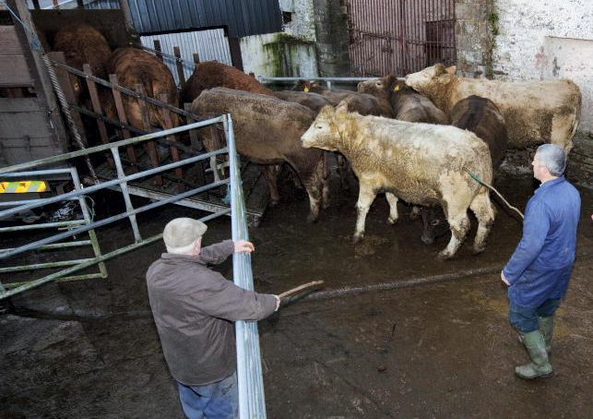
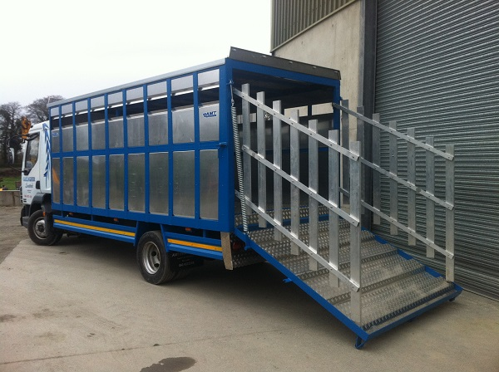
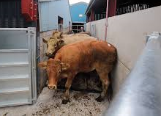
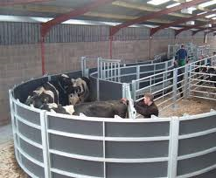
The pre-slaughter phase
Handling
Pre-slaughter
stressors
Transport
Mixing
Novel environment
Notes:
The pre-slaughter phase, consists the timeframe from an animal leaves its pen until it’s slaughtered at an abattoir.
This exposes the animal to a number of unfamiliar events – such as handling, transport, mixing or re-grouping and exposure to a novel environment. Which collectively can be labelled pre-slaughter stressors.

Slide 6
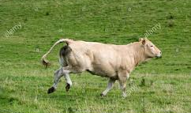
Stress response
Previous experiences
Duration of stressor
Intensity of stressor
Physiological changes
Notes:
The animals previous experience of such events, together with the intensity and duration of each stressor will largely determine the magnitude of the stress response, which can be characterised by a number of physiological changes. Including an increase in respiratory rate, heart rate, body temperature, changes in the metabolic, inflammatory and steroid hormone components of serum.
These physiological changes are often used as welfare indicators.

Slide 7
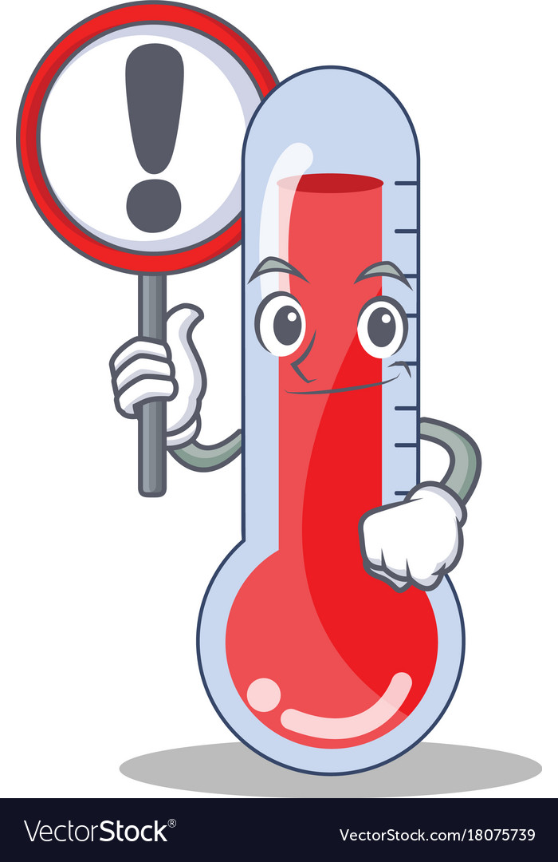
Stress induced hyperthermia
Occurs when the thermoregulatory system is altered by the autonomic nervous system
Causes a short term elevation in core body temperature in response to a stressor
Notes:
Stress-induced hyperthermia occurs when the thermoregulatory system is altered by the autonomic nervous system; causing a short-term elevation in core body temperature in response to a stressor

Slide 8
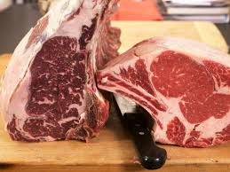
Impact on meat quality
Stressor
Fight or flight response
Release of catecholamine's
Poor meat quality
Glycogenolysis
High ultimate pH (>5.8)
Pre-slaughter stress has implications for:
animal welfare
red meat industry
Notes:
On exposure to a stressor, muscle glycogen is depleted in order to generate the energy required for a stress response. As a results there is reduced glycolysis post-mortem. Therefore, meat pH remains high and meat quality is compromised.
Poor meat quality is often characterised by its dark, firm, dry appearance in addition to a number of instrumental measurements. Furthermore, colour is the primary characteristic which will influence consumer purchasing.
Thus pre-slaughter stress is not only a welfare consideration but is also important from a commercial meat quality perspective. With DFD incidence rates reported in GB at 8.8%
Thus with over 38000 prime cattle slaughtered in the UK each week it is vital that stress is minimised during the pre-slaughter phase.

Slide 9
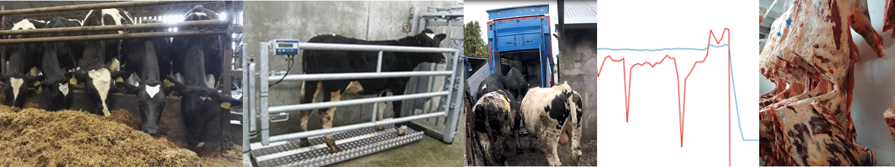
Objective
The objective of this study was to investigate the relationship between pre-slaughter rumen temperature, existing welfare measures and instrumental meat quality.
Notes:
Thus the objective of this study was to investigate the relationship between pre-slaughter rumen temperature, existing welfare measures and instrumental meat quality.

Slide 10
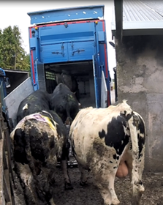
Materials and methods
40 Holstein bulls (15.8 months and 576kg live weight)
Transported to a commercial abattoir (42km & 46mins)
Space allowance 1.53m²
Mean lairage duration of 86 minutes
Notes:
This was an observational study involving 40 HOL bulls transported to a commercial abattoir in June 2018
Mean age 15.8 months, weight 576kg
Bulls were transported on a double decker lorry at a space allowance of 1.53m²
Journey time was 46 minutes; distance 26miles (42km).
Stationary waiting time of 38 minutes prior to unloading
Mean time spent in the lairage was 86 minutes (range 56-117 mins)
Bulls were all unloaded into one pen during lairage and thus mixing occurred

Slide 11
Materials and methods
Measurements
Rumen temperature
Blood sampling (-24, 0 hrs relative to transport & at slaughter)
  Creatine Kinase - Cortisol
  Lactate dehydrogenase
Stock person actions & animal behaviour
Meat quality
  Ultimate pH - Warner Bratzler shear force
  Colour - Cooking loss
Notes:
Measurements:
Rumen temperature recorded at 5 minute intervals using a rumen temperature bolus
The mean rumen temperature during the 24 hours prior to transportation was considered as the basal temperature. Pre-slaughter temperature was from leaving the pen until slaughter
Blood samples were taken at -24 and 0 hours relative to transportation and again at slaughter
Bloods samples were tested for cortisol, creatine kinase, and lactate dehydrogenase.
Stock person actions were recorded during bleeding and loading
Animal behaviour and interactions were recorded during loading to identify any slips, stumbles or falls.
Instrumental meat quality was assessed on day 7 and day 14 for ultimate ph, colour, warner bratzler shear force and cooking loss.
Stats – blood and temperature – linear mixed model with repeated measures
Meat quality (split by ph) – oneway ANOVA with fishers protected LSD
All done on Genstat 19th edition

Slide 12
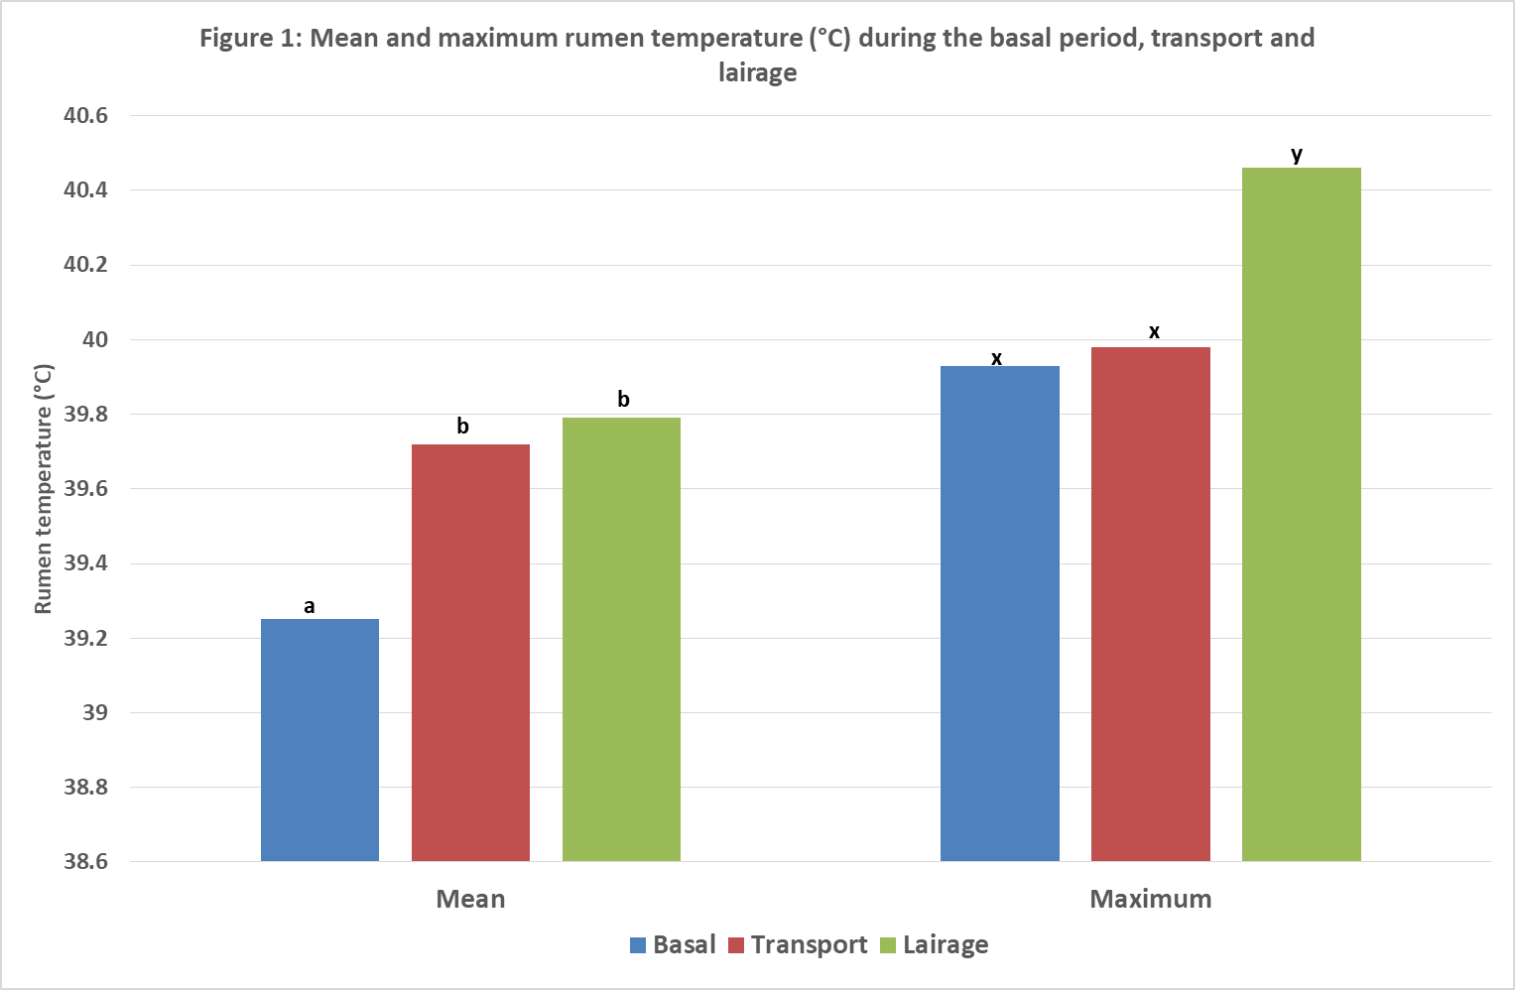
Results
Mean temperature increased 0.54ºC (P<0.001)
Maximum temperature increased 0.53ºC (P<0.001)
Notes:
Basal is the 24 hour period prior to transport

Slide 13
Results
Figure 2: Haematological variables of bulls during the basal period and at slaughter
P<0.001
P<0.001
P<0.001

Slide 14
Results
Table 1: Rumen temperature and haematological variables according to ultimate pH
 | Ultimate pH
 |  | <5.8 | 5.8-6.2 | >6.2 |  | SED | F pr.
Number of bulls (n) |  | 19 | 11 | 10
Basal RT (°C) |  | 39.24 | 39.24 | 39.26 |  | 0.079 | ns
Mean transport RT (°C) |  | 39.65 ª | 39.64 ª | 39.94 ^{b} |  | 0.103 | <0.05
Mean lairage RT (°C) |  | 39.55 ª | 39.63 ª | 40.43 ^{b} |  | 0.262 | <0.01
Maximum basal RT (°C) |  | 39.83 ª | 39.80 ª | 40.25 ^{b} |  | 0.143 | <0.01
Maximum transport RT (°C) |  | 39.87 ª | 39.90 ª | 40.28 ^{b} |  | 0.132 | <0.01
Maximum lairage RT (°C) |  | 40.06 ª | 40.52 ^{b} | 41.16 ^{c} |  | 0.194 | <0.001
Slaughter Cortisol (nmol/l) |  | 62.1 | 76.5 | 72.1 |  | 14.15 | ns
Slaughter CK (ui/l) |  | 559 ª | 982 ^{b} | 1458 ^{c} |  | 211.0 | <0.001
Slaughter LDH (ui/l) |  | 3596 | 3829 | 3949 |  | 214.2 | ns
RT = Rumen temperature
Notes:
Ph split into three thresholds – optimum, high, very high
Maximum basal – greatest for bulls >6..2 – these bulls must have been more excitable/easily stressed even within an environment that they were acclimatised to
Cortisol – dynamic nature of this hormone – so NS
CK – rises with ph – indicates muscle damage/exercise – likely linked to fighting caused by mixing in lairage.

Slide 15
Results
Table 3: Prediction of meat quality based on rumen temperature and post-slaughter haematological variables
Y | Model (X₁+X₂+X₃) | R²
pH_{ult} | Max lairage RT + T3Cortisol + T3CK | 53.1
L* | Max lairage RT | 14.3
a* | Max lairage RT + T3CK | 47.2
b* | Max lairage RT + T3CK | 45.4
Cooking Loss D7 | Max lairage RT + T3CK | 33.4
Cooking Loss D14 | Max lairage RT + T3Cortisol | 9.2
WBSF D7 | Mean lairage RT + T3CK | 17.5
WBSF D14 | Mean lairage RT + T3CK | 23.2
RT = rumen temperature; T3CK = creatine kinase at slaughter; T3Cortisol = cortisol at slaughter
Notes:
Table 3 shows the factors that could be used to predict each of the above meat quality measurements together with the associated R2 values
Ultimate Ph had the strongest r2 of 53.1 – and could be predicted using maximum RT during lairage, and cortisol and CK concentrations at slaughter

Slide 16
Conclusion
Rumen temperature rose significantly during the pre-slaughter phase
This technology may provide insights into stress-induced hyperthermia & meat quality prediction

Slide 17
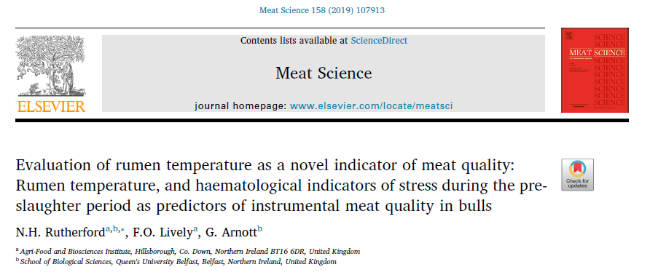

Slide 18



Acknowledgements

Slide 19
References
FERGUSON, D. M. & WARNER, R. D. 2008. Have we underestimated the impact of pre-slaughter stress on meat quality in ruminants? Meat Science, 80, 12-19.
PONNAMPALAM, E. N., HOPKINS, D. L., BRUCE, H., LI, D., BALDI, G. & EL-DIN BEKHIT, A. 2017. Causes and Contributing Factors to "Dark Cutting" Meat: Current Trends and Future Directions: A Review. Comprehensive Reviews in Food Science and Food Safety, 16, 400-430.
BOOTH-MCLEAN, M. E., SCHWARTZKOPF-GENSWEIN, K. S., BROWN, F. A., HOLMES, C. L., SCHAEFER, A. L., MCALLISTER, T. A. & MEARS, G. J. 2007. Physiological and behavioural responses to short-haul transport by stock trailer in finished steers. Canadian Journal of Animal Science, 87, 291-297.
BURDICK, N. C., CARROLL, J. A., HULBERT, L. E., DAILEY, J. W., WILLARD, S. T., VANN, R. C., WELSH JR., T. H. & RANDEL, R. D. 2010. Relationships between temperament and transportation with rectal temperature and serum concentrations of cortisol and epinephrine in bulls. Livestock Science, 129, 166-172.
PASCUAL-ALONSO, M., MIRANDA-DE LA LAMA, G. C., AGUAYO-ULLOA, L., VILLARROEL, M., MITCHELL, M. & MARIA, G. A. 2017. Thermophysiological, haematological, biochemical and behavioural stress responses of sheep transported on road. J Anim Physiol Anim Nutr (Berl), 101, 541-551.
LOSADA-ESPINOSA, N., VILLARROEL, M., MARIA, G. A. & MIRANDA-DE LA LAMA, G. C. 2018. Pre-slaughter cattle welfare indicators for use in commercial abattoirs with voluntary monitoring systems: A systematic review. Meat Science, 138, 34-48.

Slide 20
Thank you for listening
Any questions?

