Slide 1
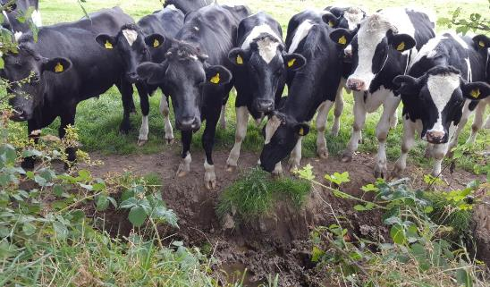
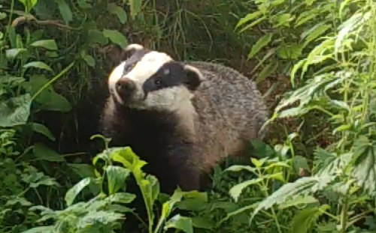
Cattle & badger interactions in relation to the potential transmission of bovine tuberculosis (bTB)
Emma Campbell, Dr. Fraser Menzies (DAERA), Dr. Andrew Byrne (AFBI), Dr. Michael Scantlebury & Dr. Neil Reid.

Slide 2
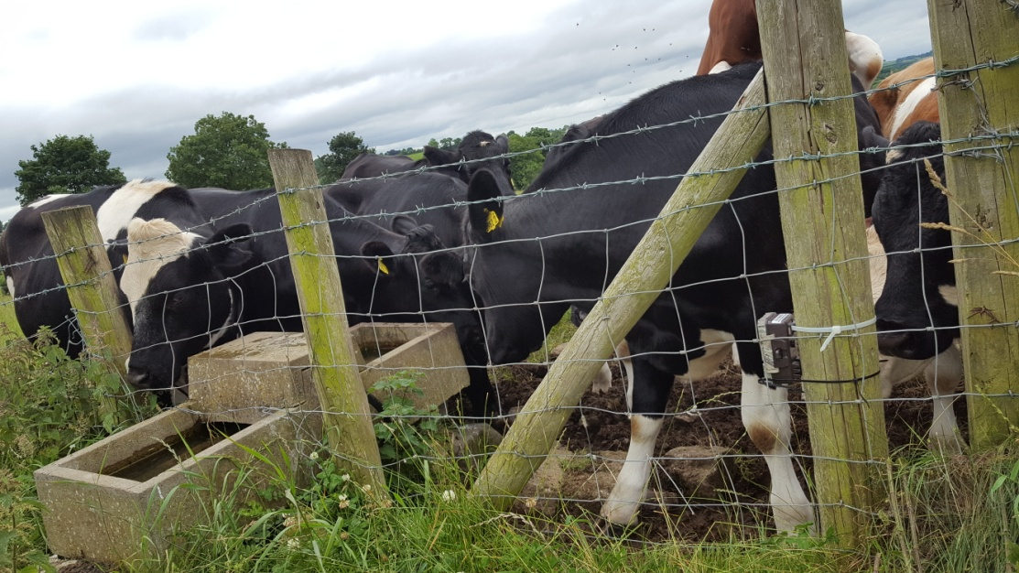
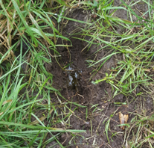
Introduction/Background to bTB
bTB caused by Mycobacterium bovis
Endemic in NI. Herd prevalence = 10.3%
National Eradication Programme includes:
- Annual herd testing
Post-mortems of animals for human consumption
Badgers are a ‘wildlife reservoir’
17% of roadkill badgers test +ve
Badgers & cattle share the same strains of bTB locally
Direct contact between badgers and cattle is thought to be very rare
Indirect contact via faecal or urine-contaminated fomites
The mechanism of transmission between cattle and badgers is unknown

Slide 3
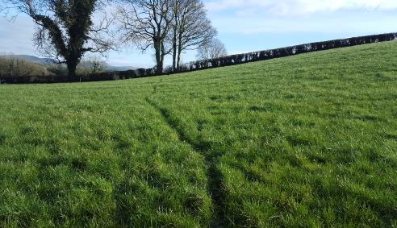
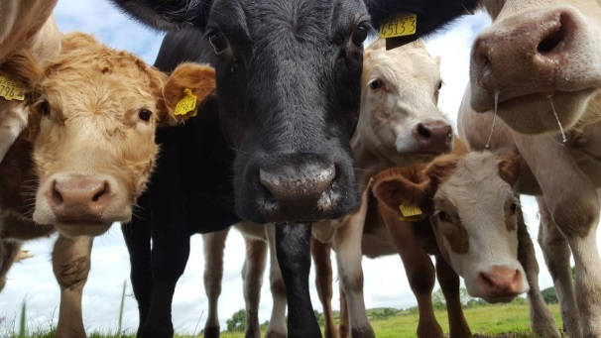
Methods For PhD
Study area was a bTB hotspot in Co. Down, within DAERA’s ‘Test-Vaccinate-Remove’ (TVR) Project
Camera Study
34 farms = 20 beef + 14 dairy
Cameras in-situ for 1 week (Summer and Winter)
Badger sites Cattle sites
Latrines 4. Farm buildings
Runs (track-ways) 5. Feed Stores
Setts 6. Water troughs
Grazing Studies/Badger GPS locations
18 farms = 11 beef + 7 dairy
All cattle grazing locations recorded from 2nd May to 30th November 2016
Number of cattle and batch type recorded
Any cattle grazing neighbouring adjacent fields recorded
Sett and latrine locations in fields recorded
Badger GPS locations recorded by DAERA

Slide 4
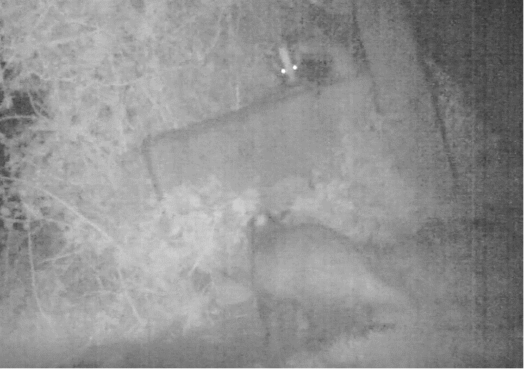
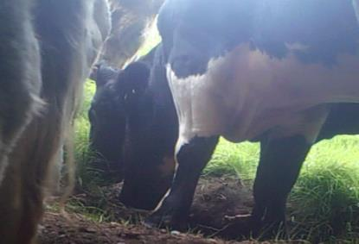
Results
364 cameras for 158 hrs each = 57,512 hours of observation
380 hrs of video
68,320 detections
157 hrs with animals present
28,189 animal detections
1,220 badger detections
894 unique badger detections
4,566 cattle detections
974 unique cattle detections
5,289 farmer detections
2470 unique farmer detections
= LARGE sample sizes (n)

Slide 5
Cattle and badgers never detected in the same clip
Badgers were never detected in farmyards
Cattle visit badger locations (setts and latrines) three times more frequently than badgers visited cattle locations (water troughs)
All farms had badgers recorded (1 – 69 records)
Model Results
Badgers found more frequently with recordings of: Foxes, sheep and rabbits and on farms with larger herd sizes
Badgers found more frequently at Setts > Latrines > Runs > Water Troughs
Badgers found less frequently when cattle present

Slide 6
Overview of Farm Grazing Records
18 farms - 7 dairy (39%) and 11 beef (61%)
Median farm size - 50 hectares (range 11 to 141)
Median of 34 fields per farm (range 11 to 266)
Total of 697 fields included in study (360 beef and 337 dairy)
411 (59%) of fields use for cattle
Beef cattle spent 96% longer in fields than dairy cattle (median 96
days vs 49 days)

Slide 7
 | Beef | Dairy | Total | Test of association
 |  |  |  | χ² | df | p
a) Sett
Fields Absent | 353 (98%) | 322 (96%) | 675 (97%) | 3.58 | 1 | 0.059
Fields Present | 7 (2%) | 15 (4%) | 22 (3%)
Sub-total | 360 | 337 | 697
b) Latrine
Fields Absent | 351 (98%) | 322 (96%) | 673 (97%) | 1.99 | 1 | 0.158
Fields Present | 9 (2%) | 15 (4%) | 24 (3%)
Sub-total | 360 | 337 | 697
c) Neighbouring herd(s)
Days Absent | 8065 (84%) | 7786 (83%) | 15851 (83%) | 1.98 | 1 | 0.160
Days Present | 1553 (16%) | 1584 (17%) | 3137 (17%)
Sub-total | 9618 | 9370 | 18988
Notes:
no difference in the proportion of days that cattle grazed fields with badger setts (15%) compared to fields without (22%; p=0.117)
no difference in the proportion of days that cattle grazed fields with badger latrines (16%) compared to fields without (22%; p=0.423)

Slide 8
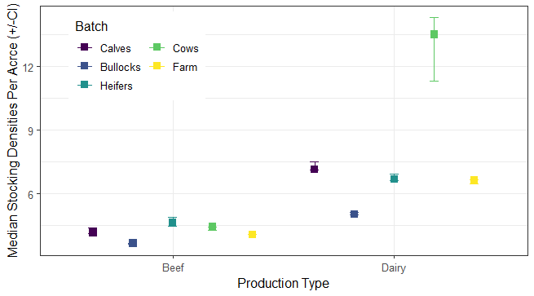
Notes:
There was a statistical difference between the stocking densities of different batches of cattle (Kruskal-Wallis χ² = 1990.1, df = 3, p-value <2.2e-16).
There was also a significant difference between the stocking densities between dairy and beef herds (Wilcoxon rank sum test W=33221000, p-value < 2.2e-16).

Slide 9
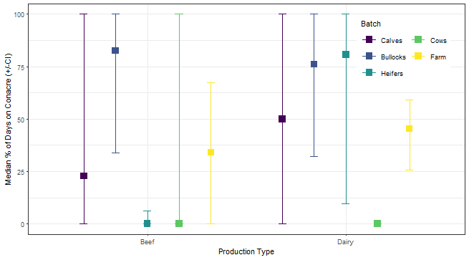
Notes:
16 farms had conacre (88.9%) and only 2(11.1%) (both beef farms) had all fields within the home/main farm
14 of the 18 farms (77.8%) had cattle grazing on conacre with the remaining 4 herds (22.2%) (all beef) only grazing at the home
Dairy cows never grazed conacre

Slide 10
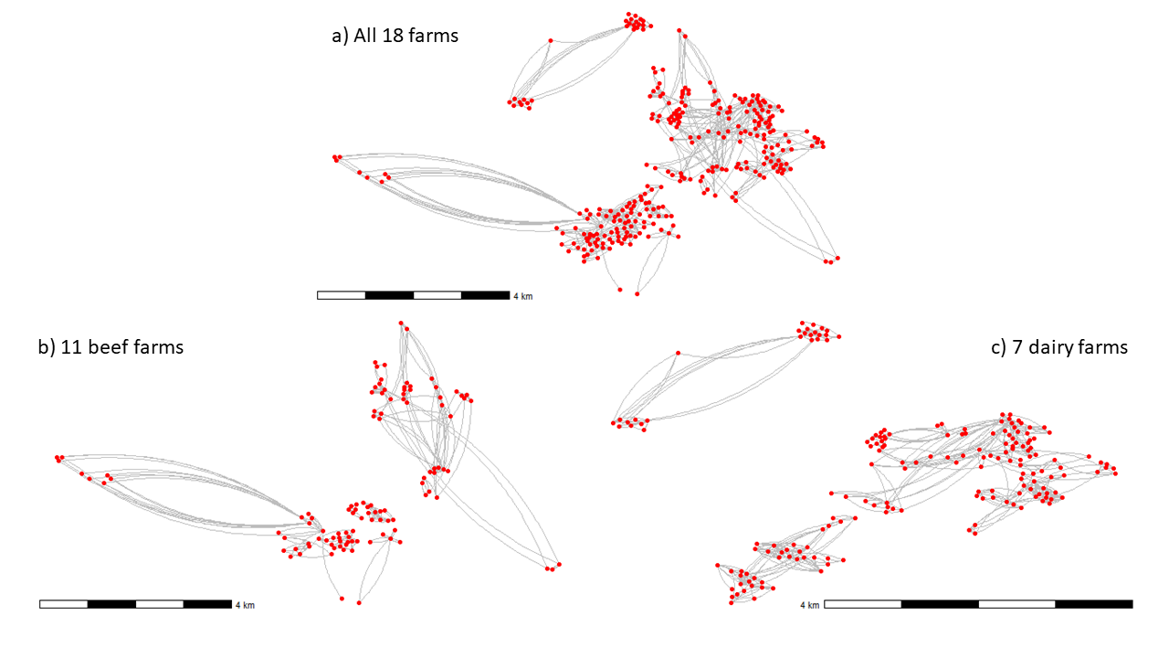
Notes:
Total of 987 moves across all farms, with a median of 44 moves per farm
There was a significant difference in the number of moves between beef and dairy farms as can be seen in b) and c)
No relationship between the number of moves and the bTB history of the farm
Median distance of 27.5km of moves on the farms, no significant diff between production types but p = 0.1
Median individual move was 240metres

Slide 11
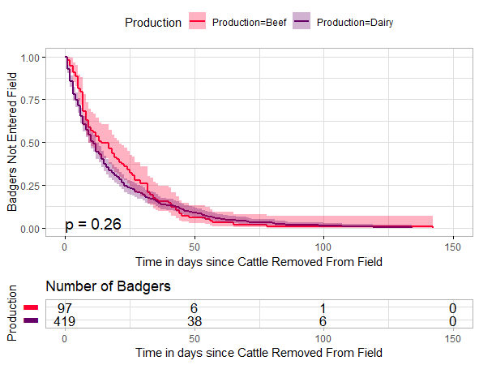
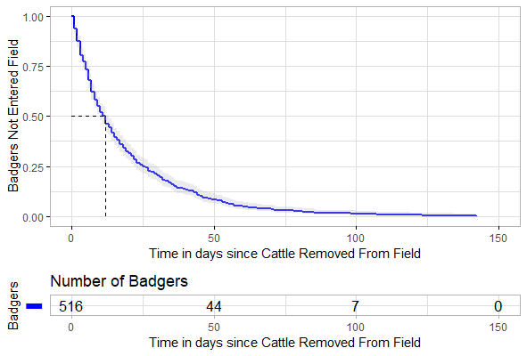
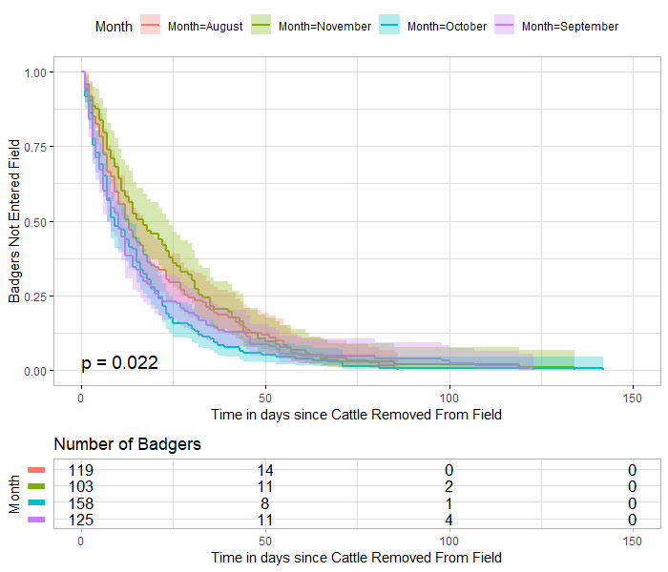
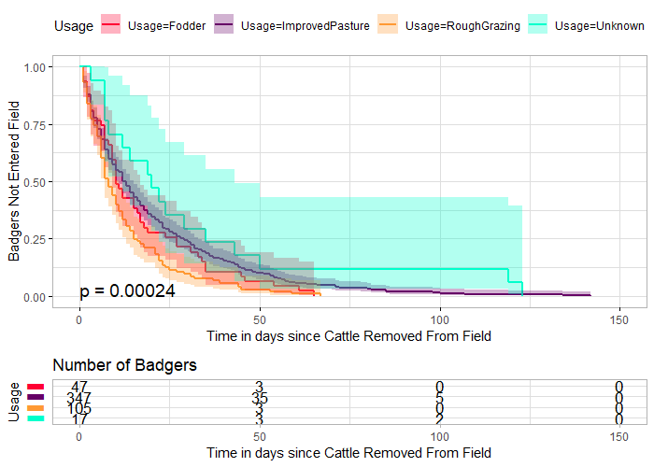
Notes:
Top left image shows the number of days it took badgers to start using fields after cattle where removed, 50% of badgers had re-entered fields by approx. day 12
Top right shows the number of days it took badgers to return to fields by production type. There was no statistical difference in the number of days by production type.
Bottom left shows the days taken to return to a field by month with badgers returning earlier in October – September – August – November, could be due to silage, badger behaviour or weather further work could be performed
Bottom Right shows when badgers returned to field by field use. They returned quickest to rough grazing – fodder – Improved Pasture – Unknown. This is likely to be due to food availability but more work would be required to know for certain.

Slide 12
Conclusions
Badgers try to avoid cattle
Cattle investigate badger locations
Fields with setts and latrines are not actively avoided when choosing where to graze cattle
17% of grazing days are spent beside neighbouring cattle
Dairy herds have a higher stocking density than beef herds
Conacre is frequently used in N. Ireland herds
Cattle move frequently during the grazing season with dairy herds moving more than beef herds

Slide 13
Thank You
Special thanks to the farmers who helped complete this study as it would not have been possible without them
And to my supervisors: Dr. Andrew Byrne (AFBI), Dr. Fraser Menzies (DAERA), Dr. Mike Scantlebury (QUB) & Dr. Neil Reid (QUB)
Any questions?

