Slide 1
Development of a dynamic mathematical model to assess the spread and control of Bovine Tuberculosis (bTB) integrating both domestic and wild host dynamics.
Emma Brown^{1,2}*
Supervisors: Adele H. Marshall¹, Andrew W. Byrne^{2,3}, Hannah J. Mitchell¹
¹ Mathematical Sciences Research Centre (MSRC), Queen’s University Belfast
² Veterinary Sciences Division (VSD), AFBI Stormont
³ Department of Agriculture, Food, and the Marine, Dublin
*ebrown99@qub.ac.uk

Slide 2
Background
Bovine Tuberculosis (bTB) is endemic to Northern Ireland (NI) with incidence rate of 9.22% in 2018¹.
bTB is known to be a multifactorial disease², multiple transmission routes maintain bTB’s presence instead of one major route.
Costs related to bTB (i.e. compensation and testing) was £44.4 million in 2017-18 ³.
There has been a mandatory control programme, in line with EU guidelines, since 1964⁴.
To be considered bTB-free, NI would need to achieve an incidence of 0.1% for 3 consecutive years⁵.

Slide 3
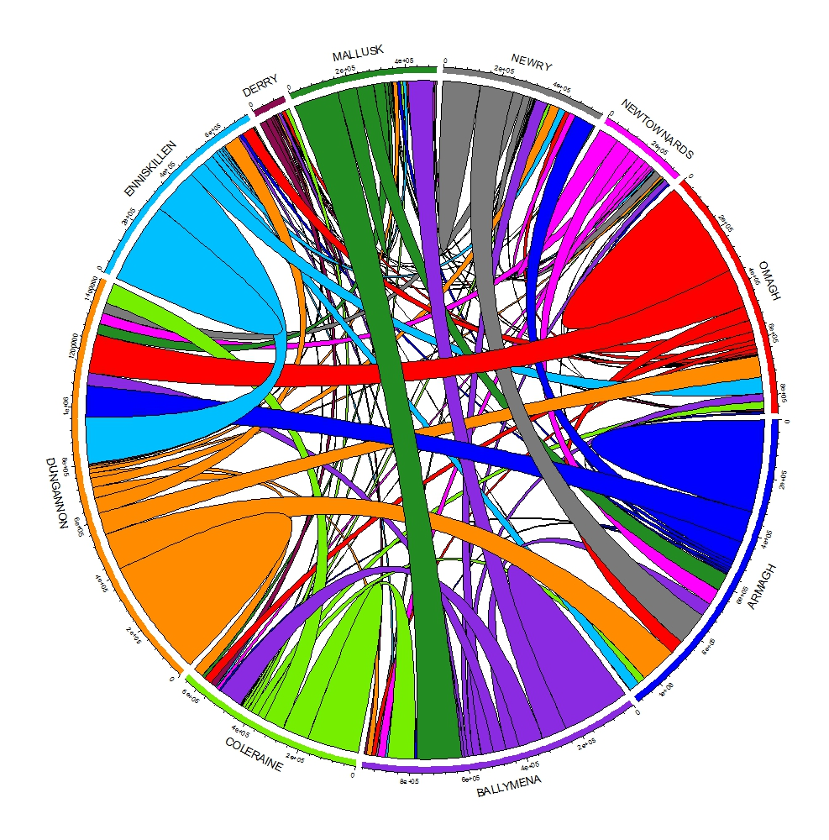
DVOs of NI
Cattle movements in NI

Slide 4
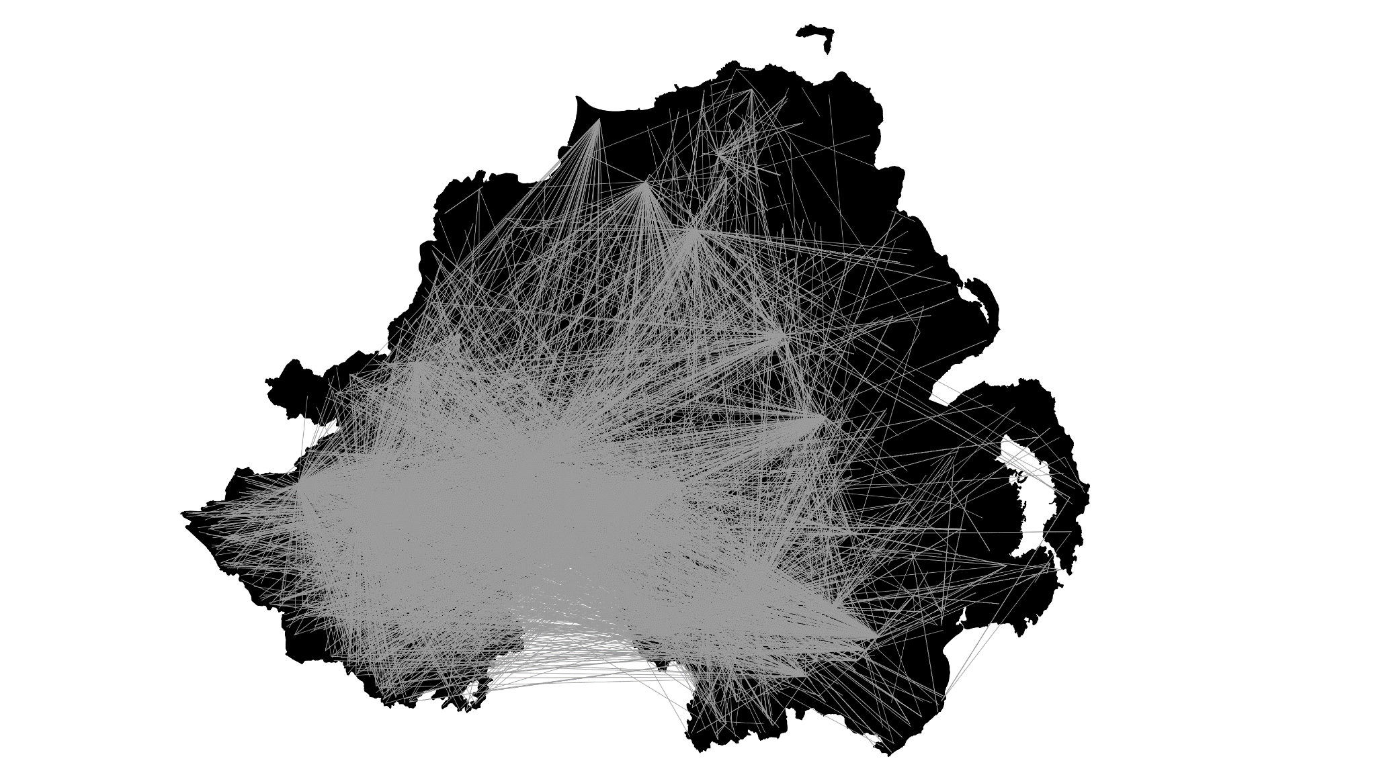
Map of cattle movements in NI
Network of cattle movements in NI

Slide 5
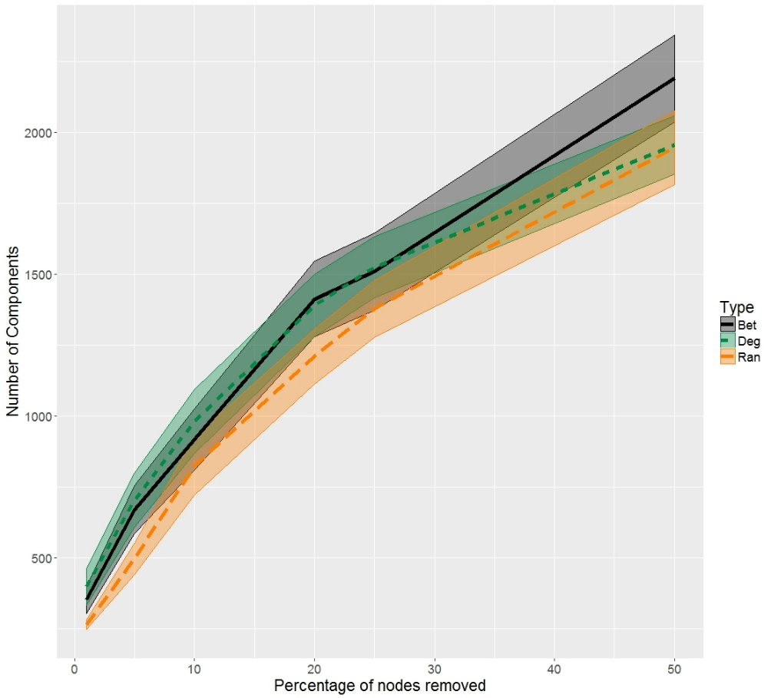
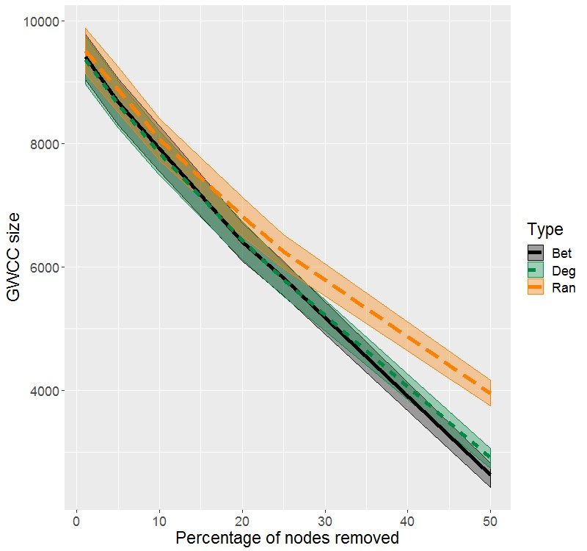
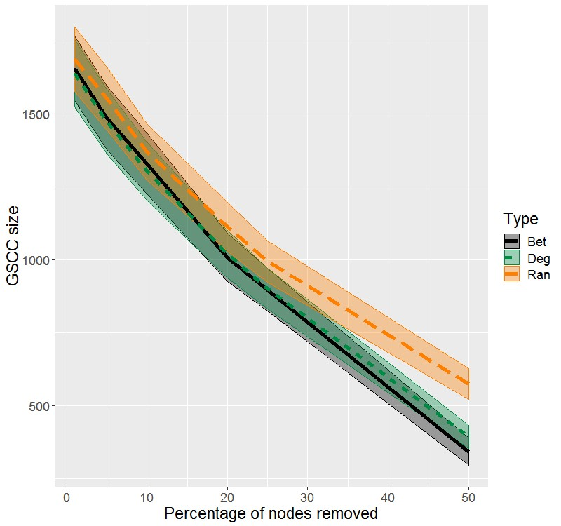
Social Network Analysis
Bet - Betweenness Centrality
Deg - Degree
Ran - Random

Slide 6
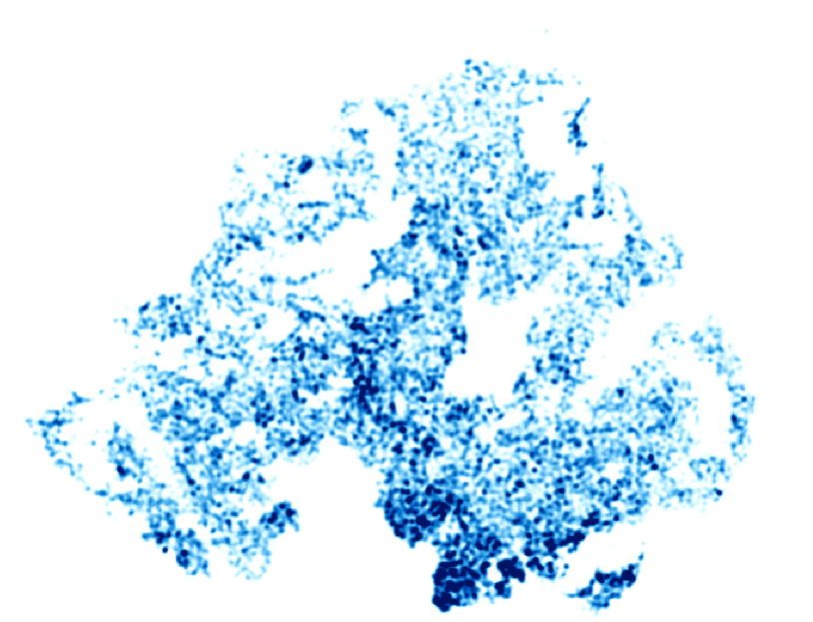
Epidemic Modelling
Figure above: Herd density of NI
Figure to right: Reactor numbers by DVO for 2010-2015

Slide 7
The Final Model
Other Herds
Susceptible
(S_{C})
Exposed
(E)
Infectious
(I_{C})
Calf photo by me, 2017.
Badger photo by kallerna - Own work, CC BY-SA 3.0, https://commons.wikimedia.org/w/index.php?curid=20438656
Susceptible
(S_{B})
Infectious
(I_{B})

Slide 8
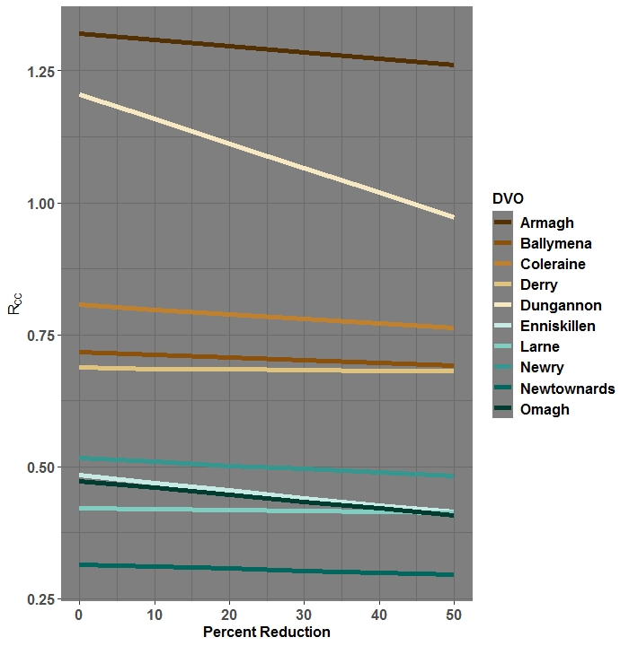
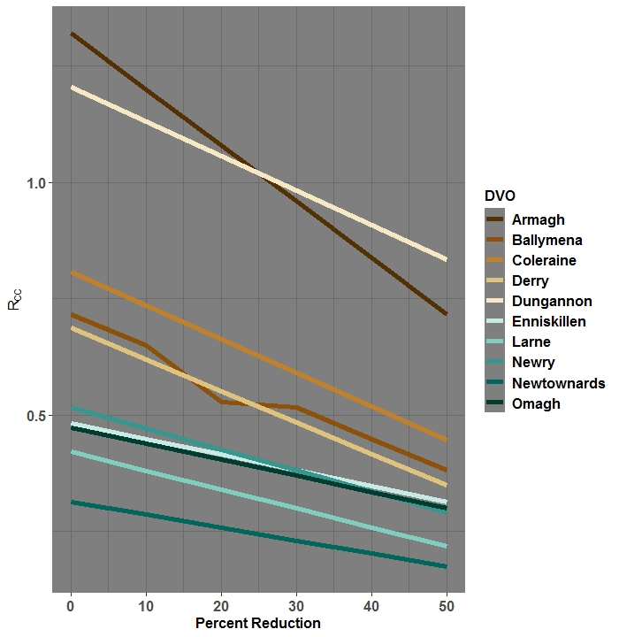
Reducing within-DVO movements
Reducing between-DVO movements

Slide 9
Conclusions
Network analysis has shown that herds in NI are highly interconnected through cattle movements.
Targeting high-risk herds (i.e. markets, beef producers) can reduce network connectivity more effectively than random restrictions when restricting $≥$25% herds.
There are differences in bTB dynamics across NI.
Some DVOs may need different strategies applied to them.
However, restricting cattle movements appears to have the largest effect.

Slide 10
References
DAERA, 2019. Official Tuberculosis Statistics, Accessed: August 2019, Last Updated: May 2019.
Allen, et al., 2018. Bovine Tuberculosis in Britain and Ireland – A perfect storm? The confluence of potential ecological and epidemiological impediments to controlling a chronic infectious disease. Fron. Vet. Sci, 5:109.
NIAO, 2018. Report: Eradicating Bovine TB in Northern Ireland.
Abernethy, et al., 2006. The Northern Ireland programme for the control and eradication of Mycobacterium bovis. Vet. Microbiol., 112 (2-4), 231-237.
EU Trade Directive, 1964. Council Directive of 26 June 1964 on animal health problems affecting the intra-community trade in bovine animals and swine (64/432/EEC).

