Slide 1
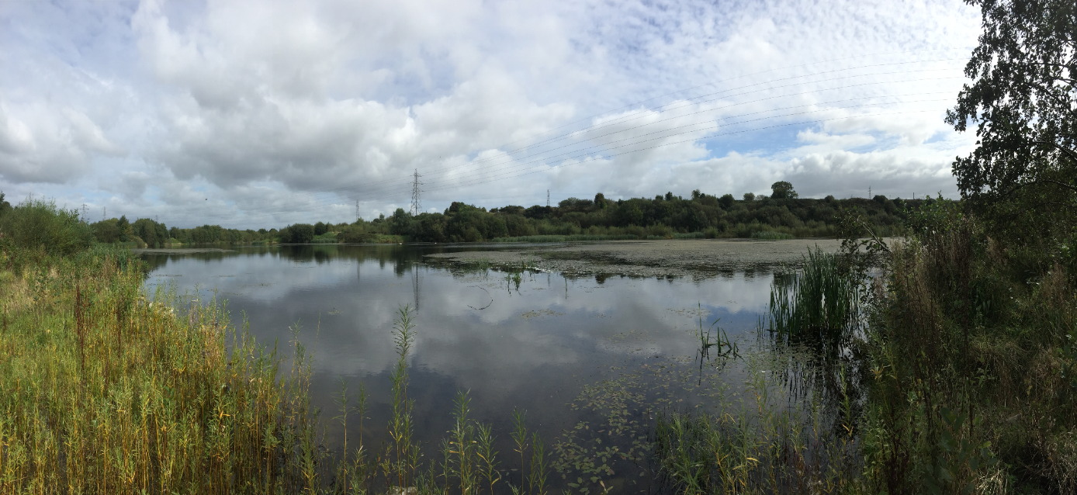
Mobuoy Remediation Project

Slide 2
Meeting Conduct
Mutual Respect
Constructive Dialogue – (One speaker at a time)
Relevance
Fairness & Transparency

Slide 3
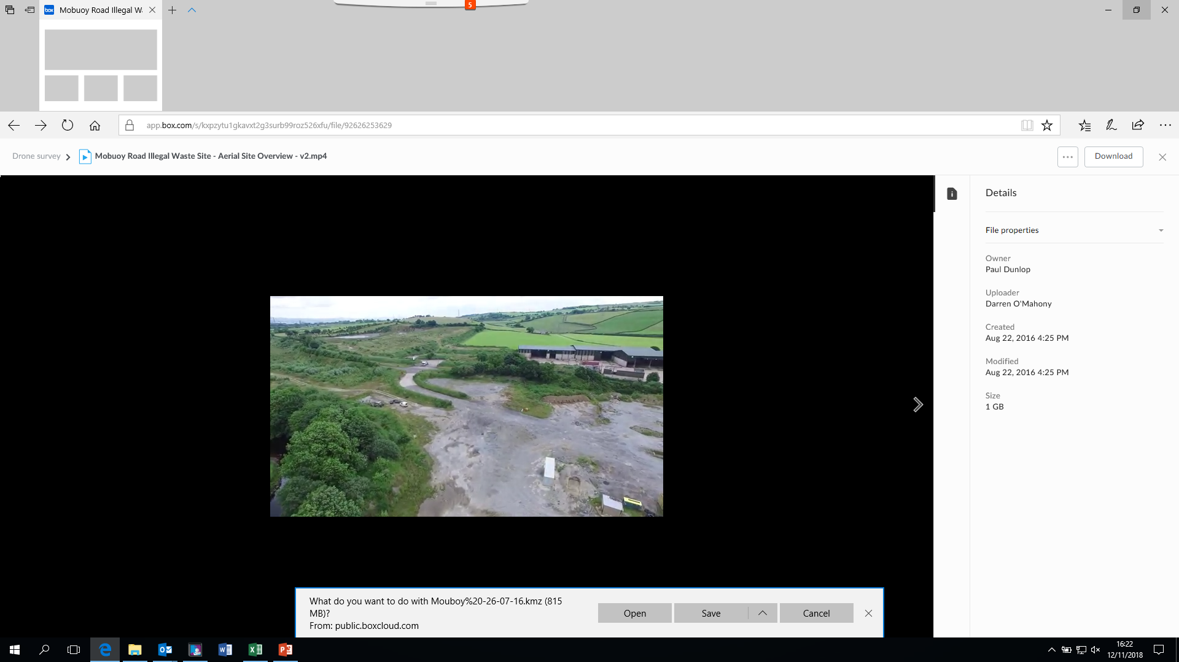
Overview
Welcome
Criminal Case / Enforcement
Update on the Remediation
Protecting Your Drinking Water- (NI Water)
Presentation on Kerdiffstown
Q&A

Slide 4
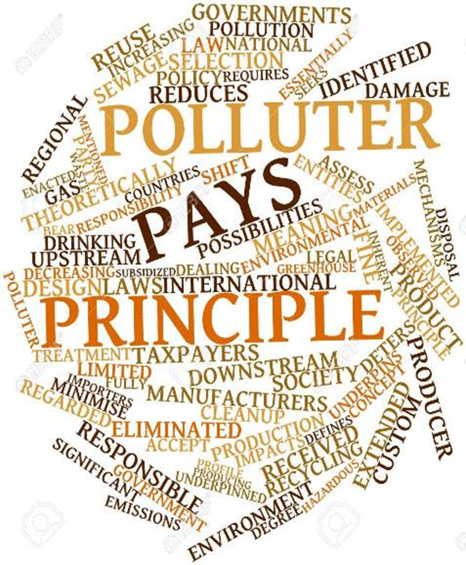
Enforcement
Ongoing criminal proceedings
Environmental Liability Regulations
Trial date 7th September 2020
Enforcement of site remediation
Notes:
NIEA Utilising all powers available-Two enforcement arms both enforcing polluter pays principle:
Criminal offence of waste deposits
Enforcement of remediation
Ongoing criminal case;
Trial date set for 7th Sept 2020;
Project information is evidence in the criminal case;
We remain limited in what information we are able to share at this point.
Remediation Enforcement Strategy
Cost Recovery Protocol and updated guidance
Enforcement Technical Advisory Group
Remediation enforcement through Environmental Liability (Prevention and Remediation) Regulations (NI) 2009 process

Slide 5
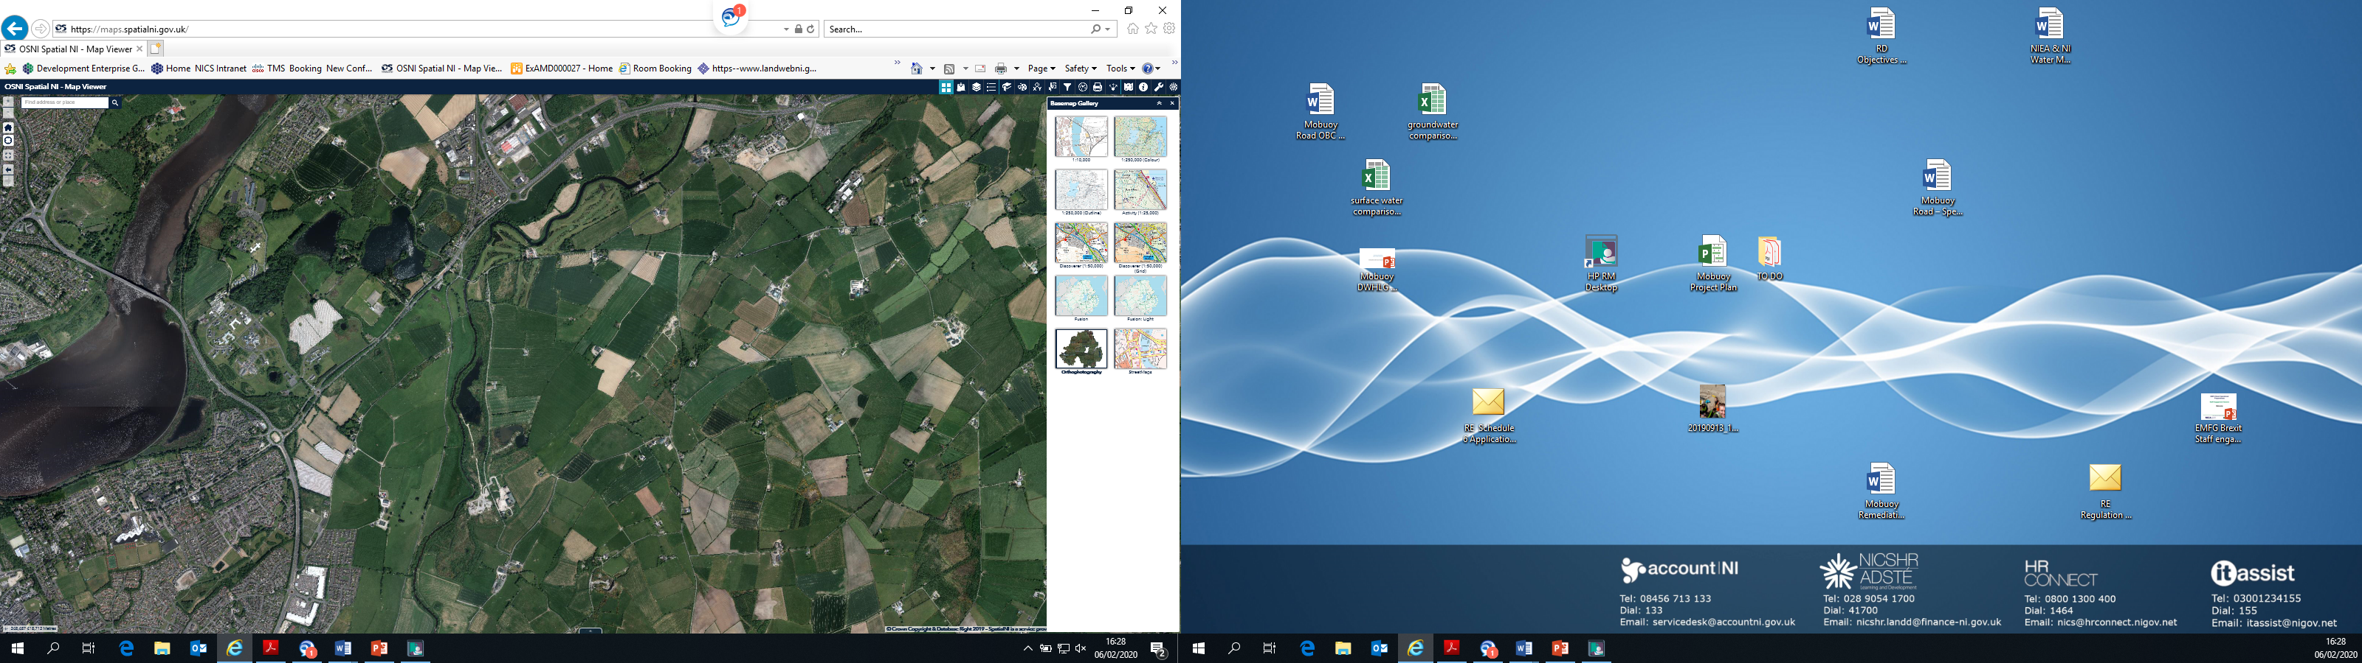
Protecting Water Quality
NIW Raw water alarms and testing
NIW Final water alarms and testing
NIW Customer taps
NIEA Mobuoy environmental monitoring programme
NIEA WFD Sampling River Faughan

Slide 6
Overview of Mobuoy Monitoring
Programme
Surface Water
Quarterly – 22 sample points
Monthly - 15 sample points
Weekly – 2 sample points
Ground water
Quarterly Monitoring
17 Leachate wells
31 Groundwater wells (20 on CSAG, 14 on CIW)
Groundwater level monitoring
Landfill gas monitoring
Emergency response
officer
Notes:
Our assessment of contamination is based on a comprehensive monitoring programme-spatial and temporal assessments carried out

Slide 7
Drinking Water Inspectorate
DWI regulates drinking water quality in NI
Protects Drinking water quality
Policy and regulation
Regulatory standards
Annual report
Detailed inspections
Enforcement
https://www.daera-ni.gov.uk/articles/duties-drinking-water-inspectorate-dwi

Slide 8
Water Quality

Slide 9
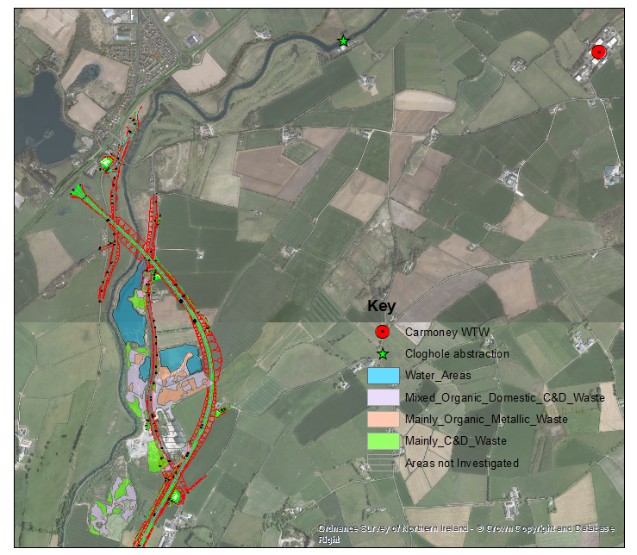
The Remediation Strategy

Slide 10
Key Targets for 2019/20 – 2020/21
2019 / 20 Actions - DAERA targets
  OBC1 Approval – Achieved
  Development of Procurement Strategy – On Target
  Effective monitoring and protection of Drinking water
2020 / 21 Actions - DAERA targets
  Complete Procurement Preparation
  Complete Tender process for ICT
  Complete Vesting Documentation
  Development of Site Vision

Slide 11
Kerdiffstown Landfill Remediation Project
Kildare County Council
Comhairle Contae Chill Dara
Notes:
Ultan Downes
Senior Executive Scientist
James Mulligan
Senior Executive Engineer

Slide 12
Next Steps
Ongoing environmental monitoring;
Develop Site Vision with community / stakeholder engagement;
Appoint an ICT to develop remediation options & plans;
Secure planning permission and further update business case; and
Implement Remediation Strategy.

Slide 13
Council Environment & Regeneration Committee
Summary of Queries
FAQ’s: https://www.daera-ni.gov.uk /publications /mobuoy-road-waste-project-documents
What happened & what type of waste is present
Public Inquiry
Polluter Pays Principle
Remediation – What; How & When
Is Water Safe to drink
Costs
Emergency Procedures
Links to A6
Carmoney Water Treatment Works

Slide 14
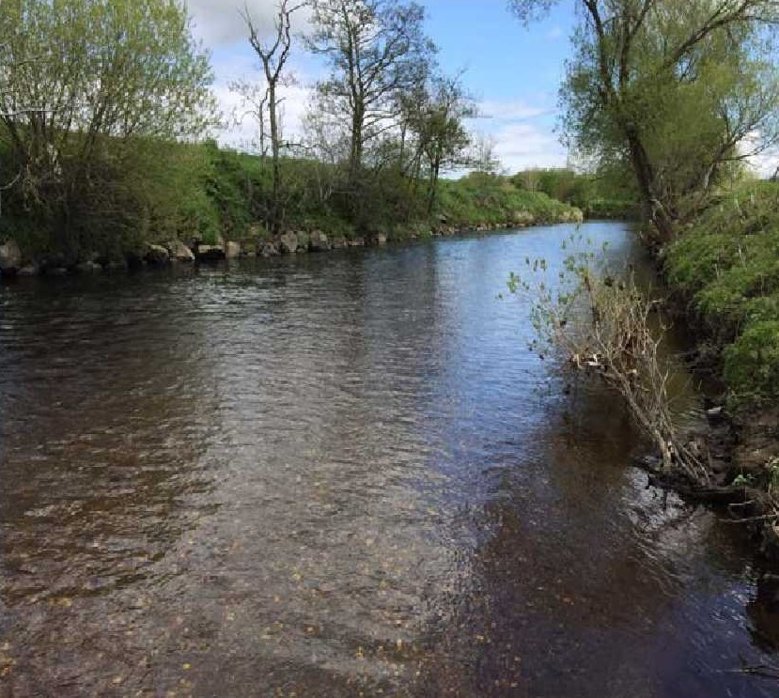
Q&A

