Slide 1
Mobuoy Remediation Project

Slide 2
Todays Ask of Council
Council Authority to proceed with Integrated Approach
An agreed programme and timetable for delivery of a robust co-designed Vision and Development/ Master Plan for the future use of the site

Slide 3
Agenda
Criminal Case
Mobouy Working Group – Follow up
Waste regulation
Site History
Protecting the drinking water
Remediation Strategy
DAERA / Council Partnership to develop Site Vision
Q&A

Slide 4
Drone Footage

Slide 5
Mobuoy Criminal Case
Ongoing criminal case;
Trial date set for 7th Sept 2020;
Some project information is evidence in the criminal case;
Remain limited in what information we are able to share at this point;

Slide 6
Council Mobuoy Working Group- Summary of Queries
1. Provide an explanation of what happened & the extent of investigation; Knowledge of extent and type of waste present;
2. Provide an update on the proposed Public Inquiry into all illegal waste in N. Ireland, but what was done?
3. How to ensure Polluter Pays Principle is adopted;
4. What are the plans to deal with waste? What decisions have been taken in respect to Remediation of the site? Has a preferred option been agreed?
5 Will water will be safe? Can this be guaranteed without removing the waste?
6. Costs estimates appear to be wide ranging; can the Department confirm the estimated costs to remediate the site?
7.What would happen if the waste starts to leach?
8. What are repercussions for the proposed A6 (Drumahoe to Stradreagh)?
9. There are reports the water treatment plant has been moved up above Mobuoy.

Slide 7
Waste Regulation Mills Report- 2013
Implementation of Mills and CJI Action plans
Remediation strategy for Mobuoy under development;
Pro-active intelligence led approach to tackling waste crime under development.
Regulatory transformation programme
Increased partnership working with Councils to manage waste
Waste promotion and development of the Circular Economy

Slide 8
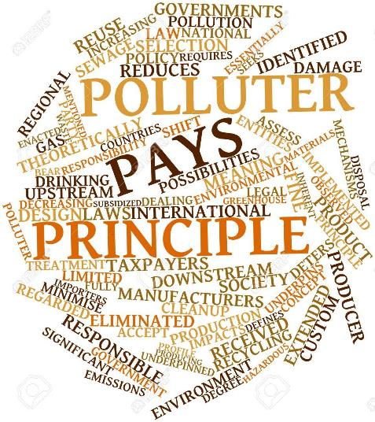
Enforcement
What's been achieved:
Remediation Enforcement strategy Cost Recovery protocol and updated guidance Enforcement Technical Advisory Group Remediation enforcement through Environmental Liability (Prevention and Remediation) Regulations (NI) 2009 process

Slide 9
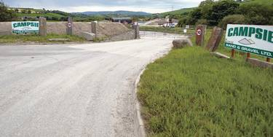
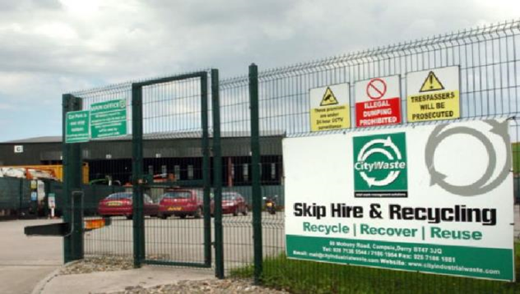
Site History
Campsie Sand and Gravel Ltd
City Industrial Waste Ltd

Slide 10
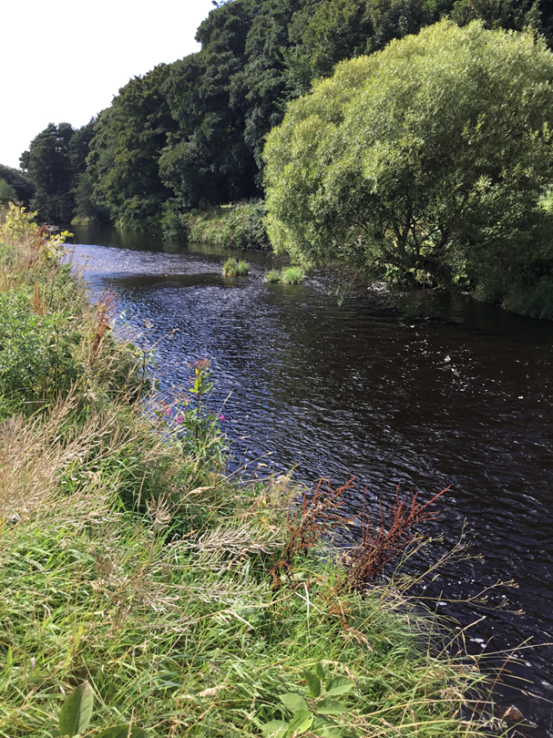
Protecting drinking water

Slide 11
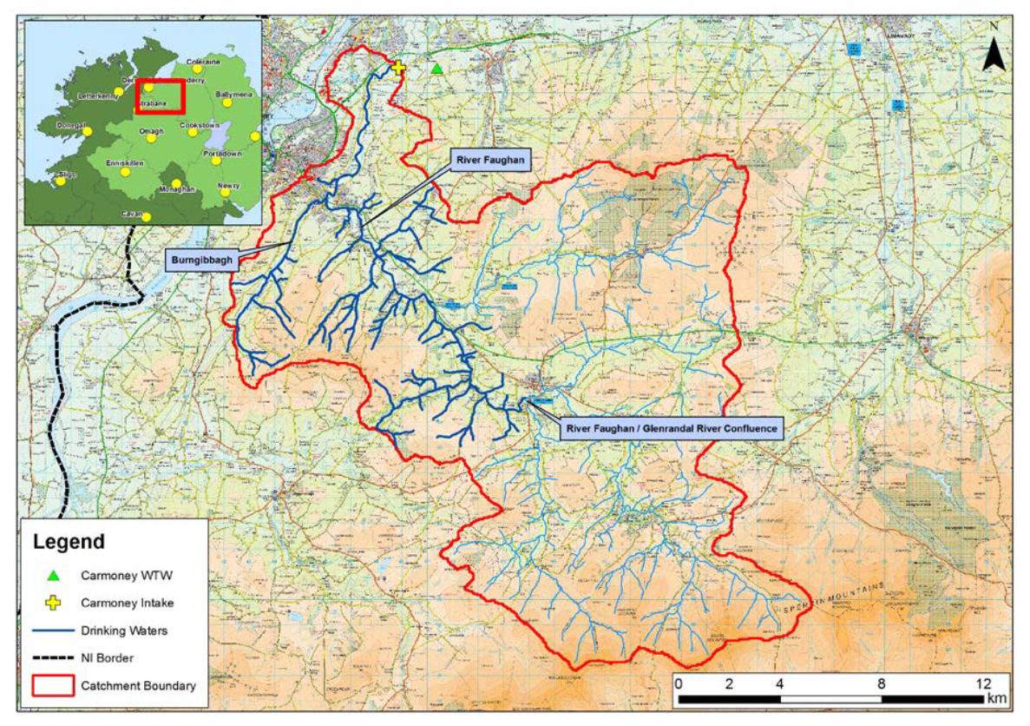
NI Water’s abstraction from the River Faughan
Raw water is abstracted from the River Faughan at approx. 2 miles downstream of the landfill site;
Oil and Ammonia monitors with alarms ensure automatic shutdown;

Slide 12
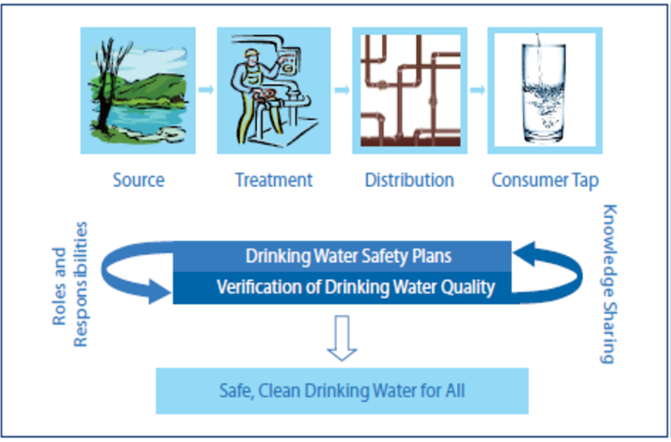
Drinking Water Quality - how do we ensure we provide safe, clean drinking water?

Slide 13
Is Our Water Safe to Drink? YES
The raw water and final water quality is monitored 24/7 at the WTW;
Daily analytical testing of raw water and final water samples
Daily samples are taken at customer taps to monitor water quality
Results are assessed against the requirements of the Drinking Water Regulations.

Slide 14
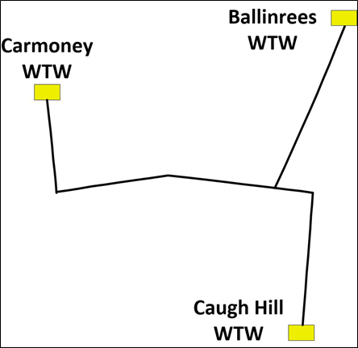
NI Water’s contingency measures
Contingency
contingency measures in place to maintain continued supply of high quality drinking water
Contingency Plans in place for all of NIW WTWs
interconnectivity to two other WTWs to maintain supply to customers.

Slide 15
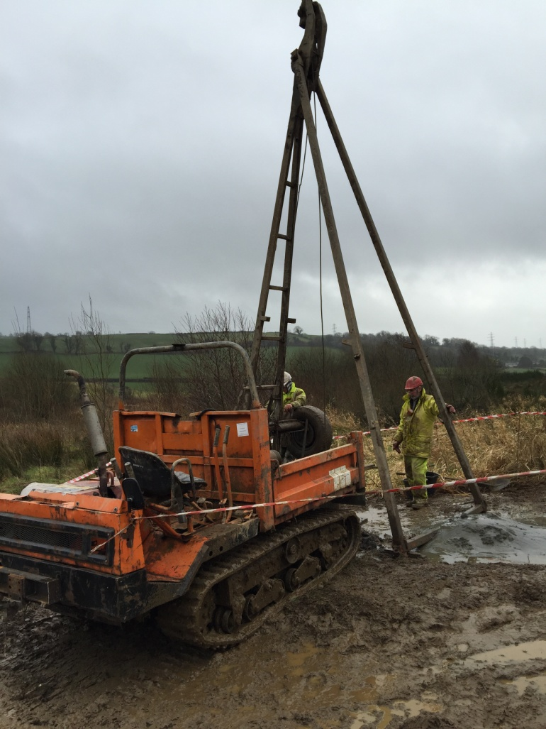
Objectives of the Mobuoy monitoring programme
To protect water quality of the River Faughan;
To determine the impacts of the waste on the underlying groundwater body and surface water bodies on site;
To update the risk assessments and support NIEA’s enforcement actions;
To inform the need for mitigation actions in advance of site remediation

Slide 16
Overview of Mobuoy Monitoring Programme
Leachate monitoring and groundwater monitoring
Surface water monitoring
Groundwater level Monitoring
Landfill gas monitoring Programme is also supported with new resources within NIEA’s laboratories

Slide 17
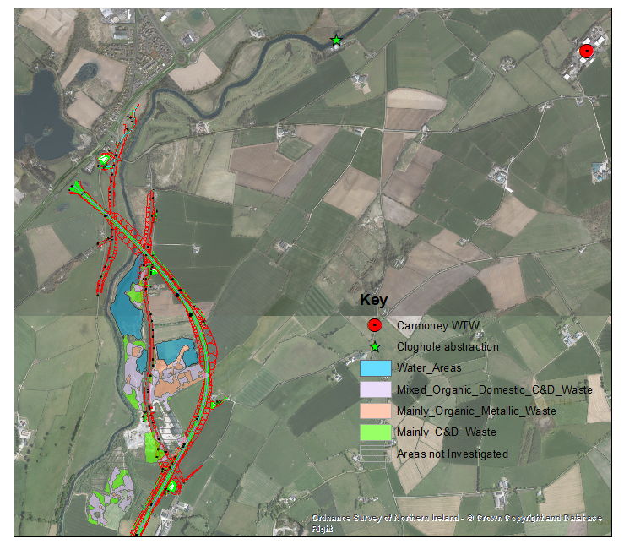
Developing the remediation strategy

Slide 18
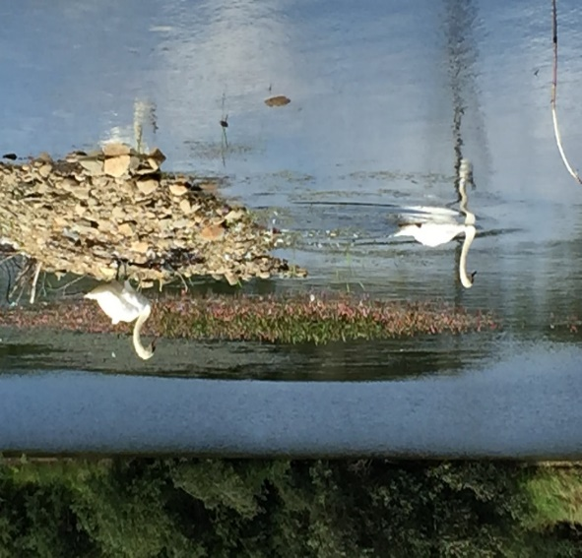
Remediation objectives
Protect NI Water’s raw water abstraction and supply;
Protect water quality of the River Faughan;
Improve and remedy environmental damage;
Reduce landfill gas risks to protect site users;
Timely and continued engagement with Stakeholders

Slide 19
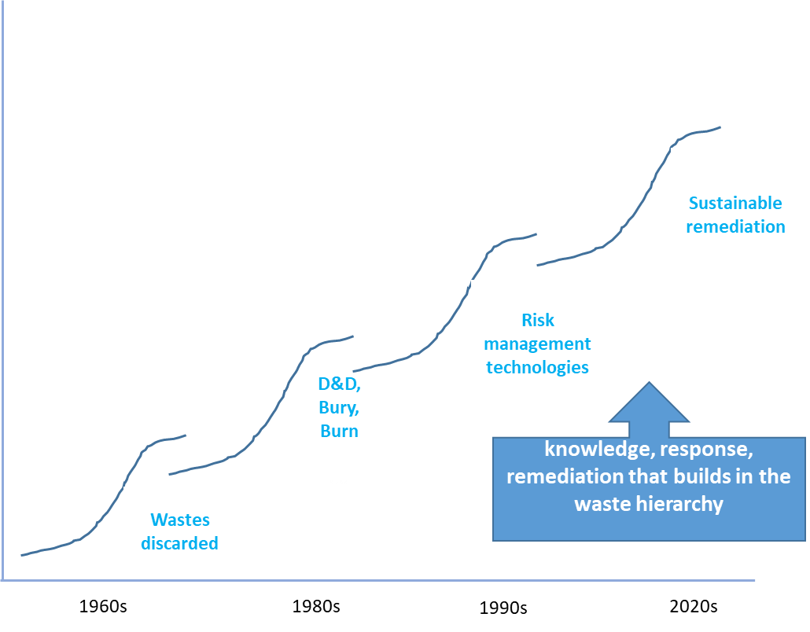
Appraisal of remediation options
SuRF – UK Sustainable Remediation Forum

Slide 20
Framing the remediation options appraisal
Options appraisal has been based on the key principles of the SuRF-UK approach; | Questionnaire survey provided an objective assessment of stakeholder views;
Local Stakeholder engagement events held on 8 February & 24 March 2016 & with Government Agencies on 25 Jan and 4 April 2017; | Obtained local industrial / regulatory knowledge;
Establishment of assessment boundaries; | Identified priorities for the selection criteria and decision making.
Site-specific decision matrix of viable remediation options;
Agreement of a system of scoring criteria for economic, environmental and social factors on an equal basis;
;

Slide 21
Sustainability Criteria

Slide 22
Stage 1: Shortlisting of options
Options screening assessment:
Presents full range of potentially applicable remediation techniques; Direct treatment of wastes Containment options Leachate management options Pathway barriers Source treatment options | Options for each waste zone and for the whole site assessed on the basis of; Applicability; Permissibility Sustainability Time Cost was not included as a decision factor at the shortlisting stage Stakeholder consultations
Small Business Research Initiative (SBRI) – funded Phase 1 of 5 potential emerging remediation technologies (Oct 16 to Mar 17)

Slide 23
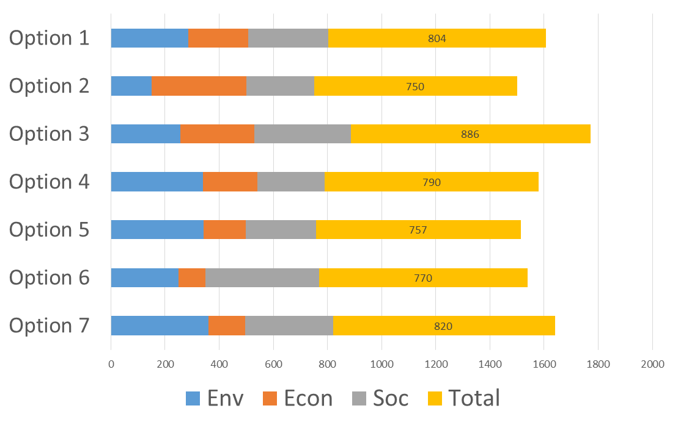
Stage 2: Detailed assessment of options
By waste source zone & for the whole site
Weighted scoring system based on stakeholder consultation;
Decision by multi-criteria analysis;
Provides for sensitivity analysis and uncertainty;
Budget costs (estimates) for each shortlisted option considered

Slide 24
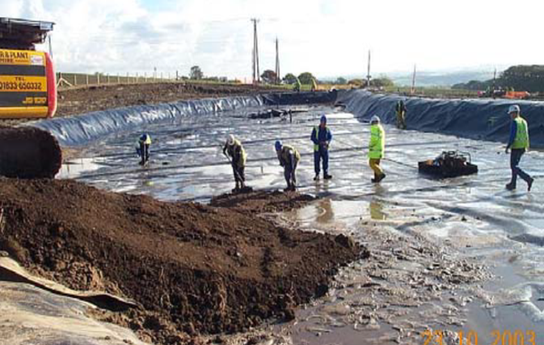
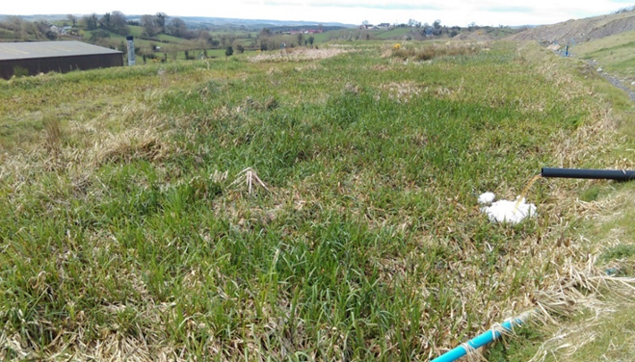
Integrated remediation
Integration of options to manage All risks across the site;
Integrated approach needed to take account of DAERA, DfI and NI Water’s interests;
contingency for failure of certain elements or impact due to climatic variability;
management of system capacity and maintenance;
addressing specific waste / site issues

Slide 25
Remediation Strategy – next steps
Remediation options appraisal
Final remediation strategy subject to:
review & update of options via the ICT contract;
agree the combination of the highest performing options to manage the risks and support site vision;
integration with NI Water’s contingency plans and the A6 scheme (Drumahoe to Stradreagh);
approval of the business case.
Identify feasible options
Detailed evaluation of options
Develop & agree the remediation strategy

Slide 26
Mobuoy Masterplan & Vision – Draft Discussion Document
A positive and lasting site legacy
A collaborative approach to a vision and Development plan
Asset on the edge of the City
Creation and development of green infrastructure
A community led approach

Slide 27
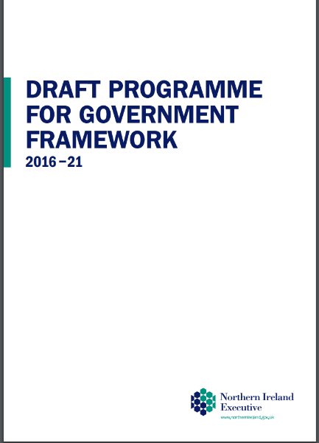
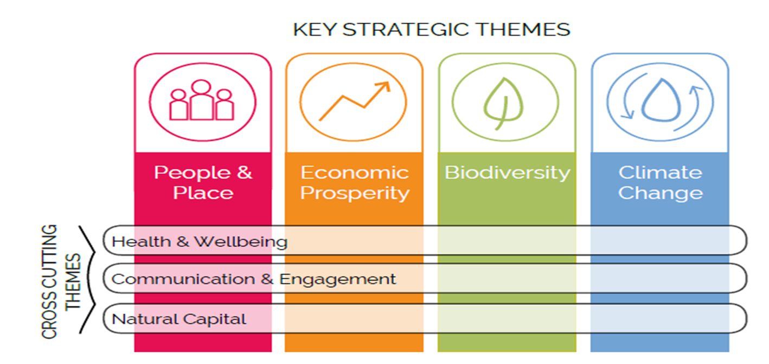
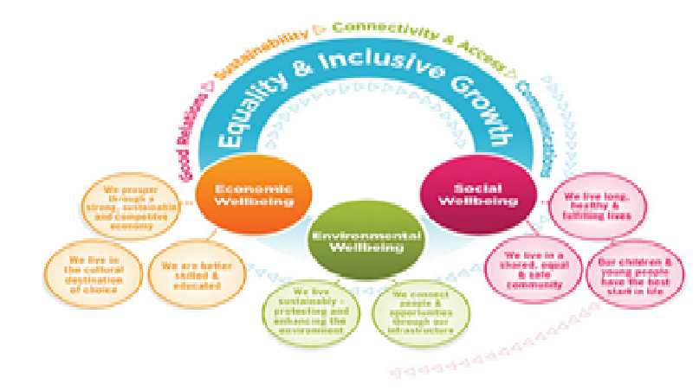
Strategic Drivers
DCSDC Green Infrastructure Plan
DCSDC Inclusive Strategic Growth Plan 2017- 2032
NIEA Business Plan
DCSDC Local Development Plan

Slide 28
Site Potential
Contribute to the outcomes of DAERA’s vision & Council’s plans
A flagship multifunctional green and blue space
Create a beacon of innovative environmental management practices
Develop a partnership between statutory, voluntary and community and interest based stakeholders
DCSDC’s experience in the restoration of former landfill sites
EU Circular Economy targets & waste management target
Creating jobs in Cleantech sector
Partner with other “Landfill to Park” projects on a world wide basis

Slide 29
Vision Building
Interactive Faughan Wetlands Education Park
STEAM Education Centre
Learning Hub

Slide 30
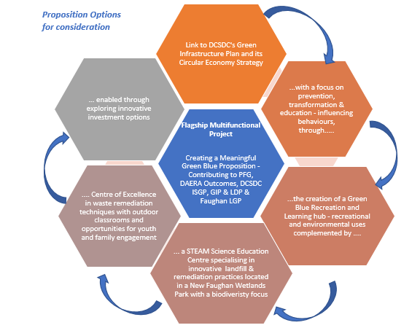
Vision Building Imagine

Slide 31
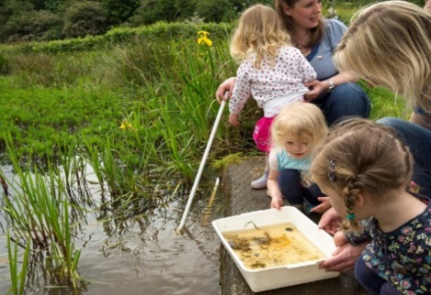
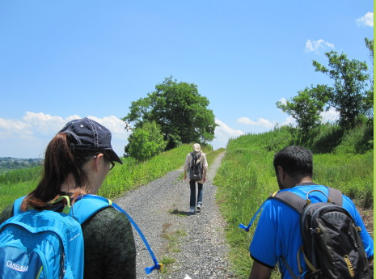
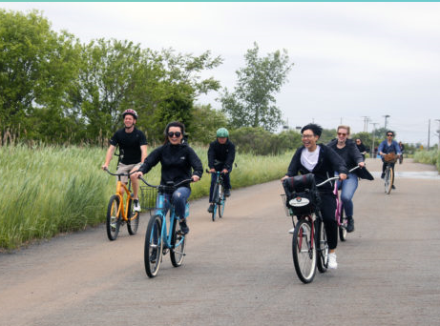
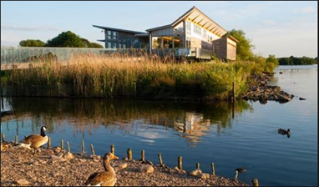

Slide 32
Stakeholder Engagement
Presentation of the vision paper to NIEA Board – early Jan 2020
Presentation of the vision paper to DAERA Permanent Secretary – mid Jan 2020
Presentation of the vision to Derry City & Strabane District Council’s Officials
Presentation of the vision paper to Derry City & Strabane District Council’s elected representatives – Late Jan 2020
Presentation of the vision paper to local stakeholders – Feb 2020

Slide 33
Envisaged Responsibilities for different parts of the Site on Completion
Surface Activities & Management – Other stakeholders & Council
Remediation Proposal- DAERA
Underlying sub surface of site - DAERA

Slide 34
Objectives
Council endorsement for integrated DAERA / NIEA Vision & Development plan
Site operation eventually by stakeholders and /or Council
An Integrated approach to the consultation and engagement process
Moving forward together

Slide 35
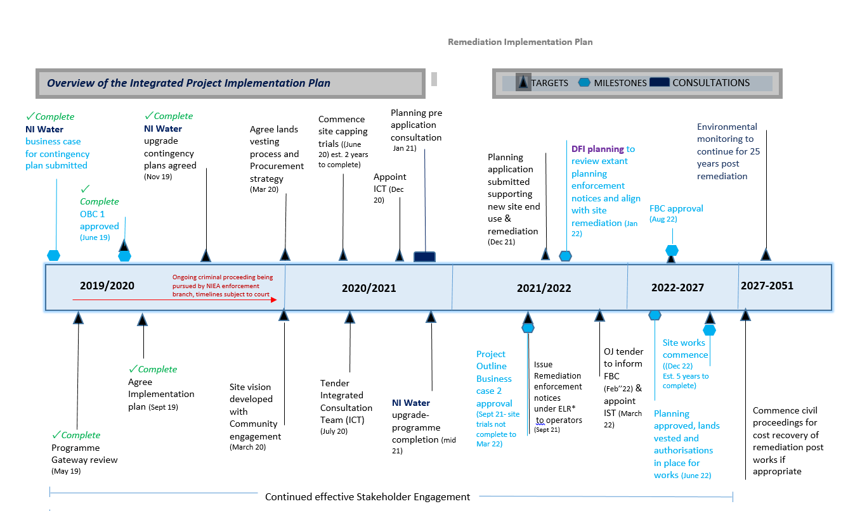
Project Timeline

Slide 36
Council Mobuoy Working Group- Summary of Queries
1. Provide an explanation of what happened & the extent of investigation; Knowledge of extent and type of waste present | ✓
2. Provide an update on the proposed Public Inquiry into all illegal waste in N. Ireland, but What was done? | ✓
3. How to ensure Polluter Pays Principle is adopted: | ✓
4. What are the plans to deal with waste . What Decisions have been taken in respect to Remediation of the site Has a preferred option been agreed? | ✓
5 Will water will be safe? can this be guaranteed without removing the waste? | ✓
6. Costs estimates appear to be wide ranging; Can the Department confirm the estimated costs to remediate the site | ✓
7.What would happen if the waste starts to leach | ✓
8. What are repercussions for the proposed A6 (Drumahoe to Stradreagh): | ✓
9. There are reports the water treatment plant has been moved up above Mobuoy | ✓

Slide 37
Next Steps
Ongoing environmental monitoring;
Develop site vision with community / Stakeholder engagement;
Appoint an ICT to develop remediation options & plans;
Secure planning permission and further update business case; and
Implement Remediation Strategy

Slide 38
Summary of Outcomes
Council Authority to proceed with Integrated Approach
An agreed programme and timetable for delivery of a robust co-designed Vision and Development/ Master Plan for the future use of the site

Slide 39
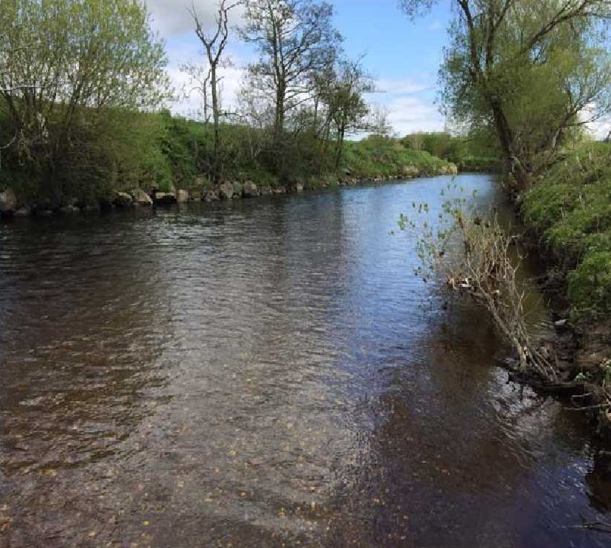
Faughan Wetlands Park?
Q&A

