Slide 1
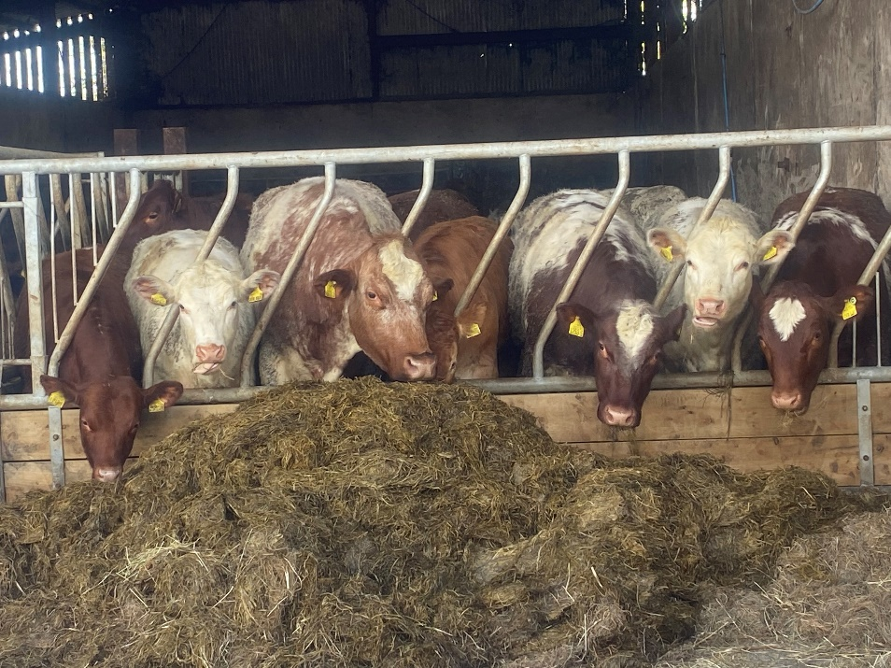
Update for aPVPs certifying cattle for export to other EU Member States
DAERA Trade & BVD Programmes
26 July 2022

Slide 2
Introduction
What has changed?
Options to export cattle to MSs with an approved BVD programme
Establishment Free from BVD status
Approved Quarantine Establishments
Communications to exporters
Further information for aPVPs
Notes:
Welcome to this short presentation on changes which need to be certified to export cattle to other EU Member States.
I will explain the background to these changes and describe the options which are available to export non-pregnant and pregnant cattle.
I will also cover Establishment Free from BVD Status and Approved Quarantine Establishments.
Finally I will explain the communications which will be going out to industry, where you can get more information and DAERA’s plans for further PVP training in the coming weeks.

Slide 3
What has changed?
EU Member States (MSs) can now apply to the European Commission for approval of their BVD Eradication Programme OR BVD Free Status
This can be at a national or regional level
MSs get ‘listed’ in Annexes of Commission Implementing Regulation 2021/620
To export cattle for Breeding & Production to a MS with an approved BVD Eradication Programme OR BVD Free Status BVD requirements have to be certified on the EHC
As of 18 July 2022:
Approved BVD programme – IRELAND, some regions of Germany
BVD Free Status – Austria, Denmark, Finland, Sweden and some regions of Germany
Before signing an EHC to any BVD Free Member State please contact DAERA for advice
Notes:
Recent European legislation enables Member States to apply for approval of voluntary control programmes for certain diseases such as BVD and IBR. This is a stepping stone to achieving official disease free status.
This presentation focuses on BVD and the impact on NI herds when other Member States get approval of their BVD eradication programme. Approval can be at national or regional level and this becomes official when the Member State gets listed in the European legislation. Once a Member State is listed, cattle have to meet the BVD requirements of the Export Health Certificate.
Currently Ireland and some regions of Germany have an approved programme and Austria, Denmark, Finland, Sweden, and some regions of Germany have BVD Free Status. Please contact DAERA if your clients wish to export to any country with BVD Free Status.

Slide 4
What has changed?
Cattle moving from NI to ROI for B&P now have to meet the BVD requirements on the EHC
Animals moving to ROI for Direct Slaughter do NOT have to satisfy BVD requirements
Animals moving to GB do NOT have to satisfy BVD requirements
This training is a summary of the changes to export to MSs with an approved BVD
programme
Notes:
Of greatest significance to us in Northern Ireland is the listing of the Republic of Ireland as having an approved BVD eradication programme. This occurred on 18 July and means that from now on cattle moving to the south for breeding and production have to meet the BVD requirements of the Export Health Certificate.
Please note that exports to the ROI for direct slaughter, and any exports to Great Britain will be unaffected.
This training covers only the requirements to move to a Member State with an approved programme. Requirements to export to a Member State with BVD Free Status will be covered at a later date.

Slide 5
Options to export cattle to MSs with an approved BVD programme
NON-PREGNANT animals
OPTION 1 – From an ESTABLISHMENT FREE from BVD and herd level serological testing
OPTION 2 – From an ESTABLISHMENT FREE from BVD and individual animal virus testing
OPTION 3 – From an establishment not free from BVD AND negative virus test AND 21 days in an APPROVED QUARANTINE ESTABLISHMENT
OPTION 4 - From an establishment not free from BVD AND negative virus test AND positive antibody test (within 30 days pre-export)
ESTABLISHMENT FREE from BVD and APPROVED QUARANTINE ESTABLISHMENT are defined in EU legislation
Notes:
The BVD testing requirements depend on the pregnancy status of the animal to be exported. For both non-pregnant and pregnant animals there are a number of options, one of which has to be certified on the export health certificate.
On this slide I have summarised the 4 options for non-pregnant animals.
The first 2 options require the farm of origin to have Establishment Free of BVD status, which I will explain further shortly.
Option 3 requires DAERA approved quarantine which I will also cover.
Option 4 avoids Establishment Free status or an AQE but requires a positive antibody test pre-departure. By pre-departure we want this done anytime in the 30 days before the date of export.
Both Establishment Free of BVD and Approved Quarantine Establishments are defined in European legislation.
Most exports will require certification of option 3 or option 4.

Slide 6
Options to export cattle to MSs with an approved BVD programme
PREGNANT animals
OPTION 1 – From an ESTABLISHMENT FREE from BVD and herd level serological testing
OPTION 2 – From an ESTABLISHMENT FREE from BVD and individual animal virus testing
OPTION 3 – From an establishment not free from BVD AND negative virus test AND 21 days in an APPROVED QUARANTINE ESTABLISHMENT AND negative antibody test taken not less than 21 days after start of quarantine
OPTION 4 - From an establishment not free from BVD AND negative virus test AND positive antibody test from a sample taken before insemination preceding current gestation
Notes:
For pregnant animals, again options 1 and 2 require the herd to have Establishment Free from BVD status.
Option 3 again requires DAERA approved quarantine.
Option 4 avoids either Establishment Free status or quarantine however it requires a positive antibody test before the start of the current pregnancy. This will mean that pregnant animals which are antibody positive either through natural exposure to BVD or by vaccination, will not be eligible for export if there has been no blood sample taken before conception.

Slide 7
Options to export cattle to MSs with an approved BVD programme
Important points
The exporter must sign an owner’s declaration to state if each animal is pregnant or non-pregnant. You must keep this declaration as supporting evidence of the pregnancy option selected. If pregnancy status is uncertain you must certify as pregnant.
Every animal in the exporting herd (and any associated herds) must have a direct or indirect negative virus test (BVDN or INDNEG status on APHIS) with the exception of calves <35 days old on the date of export. This is the case for the export of pregnant or non-pregnant animals and applies whichever of the 4 options is certified.
Where a negative virus test is required, this can be the statutory tissue sample test taken when the animal was a calf.
Notes:
As you have seen on the previous 2 slides the options for pregnant and non-pregnant animals are slightly different. The requirements for exporting pregnant stock are more demanding in order to prevent the spread of BVD via the unborn calf. It is critical that the necessary steps are taken to ensure pregnant animals are not exported under one of the ‘non-pregnant’ options. To do this the exporter is required to declare if each animal is pregnant or non-pregnant on the ‘owner’s declaration’. You may be asked to help determine pregnancy status. If there is any doubt over the pregnancy status you must certify one of the ‘pregnant’ options.
One further and important point is that every animal in the exporting herd AND any associated herds must have a negative virus test result. This can be a direct or an indirect negative result. An exception is made for calves less than 35 days on the date of export.
Note this is a requirement for all exports to the ROI from now on under any of the testing options.
Where the certificate asks for a negative virus test result this can be the statutory tissue sample test taken when the animal was a calf.

Slide 8
ESTABLISHMENT FREE from BVD
Most herds in NI will NOT meet the requirements of ESTABLISHMENT FREE from BVD due to the conditions which have to be met for animals moving into the herd in the previous 12 months
If a keeper believes they meet the requirements of ESTABLISHMENT FREE from BVD and wishes to export cattle under this option, the keeper can apply to DAERA for a letter to confirm the conditions have been met
If successful, DAERA will issue a letter awarding ESTABLISHMENT FREE from BVD status which acts as a Veterinary Support Certificate to enable you to certify this option on the EHC.
It is likely that only herds which have had no moves in over the previous 12 months will meet the requirements of ESTABLISHMENT FREE from BVD
Notes:
Establishment Free from BVD is precisely defined in European legislation. It requires the herd to have had no BVD positives for the past 18 months and all calves born in the past 12 months tested with negative results and also all animals currently in the herd to have a direct or indirect negative virus test result. In addition, conditions have to be met for animals which moved in to the herd in the previous 12 months. DAERA have set up a process where any keeper who meets the Establishment free criteria can apply to their local DAERA Direct office for a letter confirming this status. The application will be considered and if successful a letter will be issued awarding Establishment Free from BVD status. This letter can be used as a Support Certificate to enable the certifying PVP to select this option on the Export Health Certificate. The Establishment Free from BVD status will expire after 14 calendar days and subsequent exports will require the keeper to submit a new application.
Please note that most exporting herds will not meet the Establishment Free from BVD status, however this is not a requirement to export and as shown on the previous slides other options are available.

Slide 9
APPROVED QUARANTINE ESTABLISHMENT
Prospective exporters can apply to DAERA for an APPROVED QUARANTINE ESTABLISHMENT (AQE) by completing an application form
DAERA technical staff will visit to assess the proposed premises
If successful, DAERA will issue a letter awarding AQE status and the conditions of operation
This letter acts as evidence to enable the aPVP to certify this option on the EHC
The aPVP who certifies the export of cattle using an AQE is expected to have oversight of the proper operation of that AQE and provide advice to the keeper on good practice to prevent disease spread
AQE letter expires after 12 months and the keeper can re-apply again
Notes:
As you have seen, some options require the animal to be held in an Approved Quarantine Establishment for at least 21 days pre-export. DAERA have set up a process whereby an exporter can apply for an Approved Quarantine Establishment on part of his farm. DAERA staff will visit and assess the premises, and if successful this will be approved for a 12 month period. A letter awarding the Approved Quarantine Establishment will then enable the PVP to certify one of the AQE options on the Export Health Certificate.
The PVP who certifies the export is expected to have oversight of the proper operation of the quarantine establishment and provide advice to the keeper on good practice to prevent disease spread.

Slide 10
APPROVED QUARANTINE ESTABLISHMENT
AQE must be a building. An ‘isolation field’ is not acceptable.
Ideally a separate premises from other animals but it is recognised this will often not be possible
If the AQE is a building within a yard of other cattle it must be located and operated to minimise risk of disease spread from other stock
Separate air-space from other stock
Constructed so it can be easily C&D’d. Not of wooden construction.
Loading to export must be direct from the AQE
Special conditions will apply for milking of dairy cows in an AQE
C&D before animals to be exported enter the AQE
Full list of requirements is published on the DAERA website
Notes:
The full requirements of an Approved Quarantine Establishment are published on the DAERA website. This slide summarises some of the key points.
The AQE must be a building. Ideally this will be on an out-farm with no other stock on the same yard, however it is recognised that this will not be feasible in many cases. If the quarantine is in a yard with other livestock it must be located and operated to minimise the risk of disease spread from other stock. A separate airspace is essential and the building must be fully cleanse and disinfectable, which means it should not be of wooden construction. Cattle must be loaded directly from this building to export.
Special conditions will apply for the milking of dairy cows which are in quarantine.
The building must be cleansed and disinfected before animals to be exported are placed there. Records of animals moved in and out of the quarantine establishment, and of dates of cleansing and disinfection must be kept.
The building can be used for other purposes between periods it is needed for quarantining animals pre-export.

Slide 11
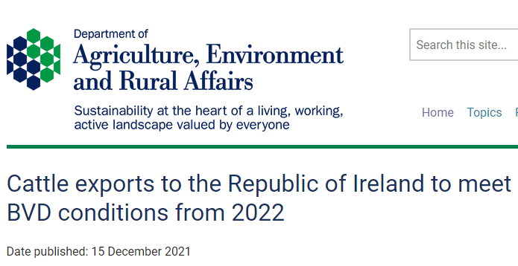
Communications to exporters
Press release and information on the
DAERA website in December 2021
Letter sent to all keepers who exported
to ROI for B&P in 2021
Press release 5 July 2022 and updated
information on the DAERA website
including detailed documents
on applying for ESTABLISHMENT FREE
from BVD and an APPROVED
QUARANTINE ESTABLISHMENT
Notes:
DAERA put out a Press Release in December of last year to highlight that these changes were coming and expected at some point in 2022 and in January a letter was sent to every keeper who had exported cattle in 2021 to Ireland for Breeding and Production to bring this to their attention.
A further Press Release went out in early July, and details of the new requirements including documents and application forms for both Establishment Free from BVD status and Approved Quarantine Establishments was put on the DAERA website then. A Press Release to inform industry that Ireland now has an approved BVD programme will go out this week. More information on the requirements to export to a Member State with BVD Free Status will be put on the DAERA website at a later date.

Slide 12
Further information for aPVPs
Latest information is on the DAERA website – Google search ‘DAERA BVD’ or click here
This will be updated as necessary to provide further clarifications
Notes for Guidance on how to complete the BVD sections of the EHC when exporting to a MS with a approved BVD programme are on the DAERA website here
aPVPs were informed via a Trade Bulletin on 21 July 2022 that the ROI BVD programme has been approved by the European Commission
DAERA Trade and BVD Programmes intend to host a Webex training for aPVPs as soon as possible (hopefully w/c 25 July)
Queries should be sent to DAERATradeExports@daera-ni.gov.uk
Notes:
The latest information on the requirements to export is on the BVD page of the DAERA website. There you will find detailed documents on Establishment Free from BVD status, Approved Quarantine Establishments, and Notes for Guidance on completing the Export Health Certificate. These documents may be updated if necessary to provide clarifications as vets and exporters adjust to these new export requirements so please refer to the latest versions on the DAERA website.
PVPs were informed on 21st July that Ireland has been listed as having an approved BVD programme. With immediate effect approved PVPs must ensure the BVD sections are correctly certified on Export Health Certificates for cattle going to Ireland for breeding and production.
DAERA Trade and BVD Programmes will host an online training as soon as possible. In the meantime if you have any queries please send these to the DAERA Trade Exports mailbox.

Slide 13
….and finally
Requirements to export will change again when the ROI get BVD Free status
This may happen in the next 1-2 years
The requirements to export to a MS with BVD Free Status are listed in the EHC
When the ROI get BVD Free status, animals which have been vaccinated for BVD cannot be certified for export
You are advised to discuss this with your clients when you are considering the use of BVD vaccination
Notes:
Finally, please be aware that the export requirements will change again when Ireland gets BVD Free status. This may happen over the next 1-2 years. You can read the requirements to export to a Member State with BVD Free status for yourself on the Export Heath Certificate. One point to note is that any animals which have been vaccinated for BVD will not be eligible for export. PVPs are therefore advised to discuss this with your clients when considering the use of BVD vaccination, particularly any clients who may wish to export to the south.
More details on the requirements to export to a Member State with BVD Free Status will be covered at a later date.
Thank you for listening.

