Slide 1
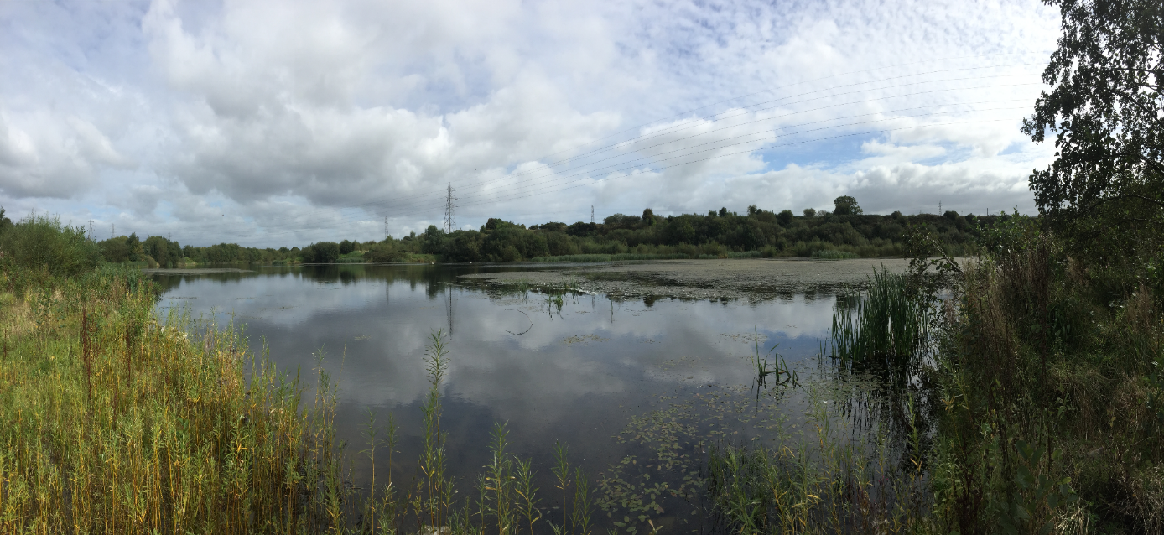
Mobuoy Remediation Project
Covid-19 Update

Slide 2
Thank you for attending today to meet with us today. Everyone here will be aware that the alleged operators of the site are currently being prosecuted before Belfast Crown Court for offences under the Waste and Contaminated Land Order. Therefore those criminal proceedings are active within the meaning of the Contempt of Court Act 1981.
Section 1 of the Contempt of Court Act 1981 provides that it is a contempt to publish any matter which creates a substantial risk of serious prejudice or impediment to the course of justice in legal proceedings, irrespective of the intention behind the publication.
Therefore, in order to ensure that the criminal prosecution can proceed to trial, can I please ask you to refrain from making any audio, audio-visual or photographic recordings of this meeting and to note that circulation of any recordings of this meeting prior to the trial may lead to proceedings being instituted for Contempt of Court.

Slide 4
Overview
Criminal Case / Enforcement
Update on the Remediation
Site Monitoring
Protecting Your Drinking Water- (NI Water)
DfI Roads Update
DfI Planning Update

Slide 5
Enforcement
Ongoing criminal proceedings
Environmental Liability Regulations
Trial date Unknown
Date of 8th September cancelled due to Covid-19 Pandemic and restrictions
Enforcement of site remediation
Notes:
NIEA Utilising all powers available-Two enforcement arms both enforcing polluter pays principle:
Criminal offence of waste deposits
Enforcement of remediation
Ongoing criminal case;
Trial date set for 7th Sept 2020;
Project information is evidence in the criminal case;
We remain limited in what information we are able to share at this point.
Remediation Enforcement Strategy
Cost Recovery Protocol and updated guidance
Enforcement Technical Advisory Group
Remediation enforcement through Environmental Liability (Prevention and Remediation) Regulations (NI) 2009 process

Slide 6
Protecting Water Quality
NIW Raw water alarms and testing
NIW Final water alarms and testing
NIW Customer taps
NIEA Mobuoy environmental monitoring programme
NIEA WFD Sampling River Faughan

Slide 7
Drinking Water Inspectorate
DWI regulates drinking water quality in NI
Protects Drinking water quality
Policy and regulation
Regulatory standards
Annual report
Detailed inspections
Enforcement
https://www.daera-ni.gov.uk/articles/duties-drinking-water-inspectorate-dwi

Slide 8
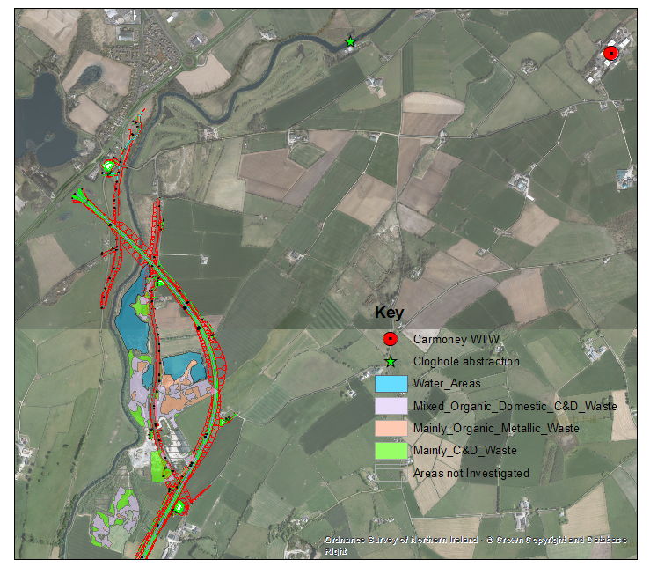
The Remediation Strategy

Slide 9
Key Targets for 2019/20 – 2020/21
2019 / 20 Actions - DAERA targets
OBC1 Approval – Achieved
Development of Procurement Strategy – On Target
Effective monitoring and protection of Drinking water
2020 / 21 Actions - DAERA targets
Complete Procurement Preparation
Complete Tender process for ICT
Complete Vesting Documentation
Development of Site Vision

Slide 10
Next Steps
Ongoing environmental monitoring;
Develop Site Vision with community / stakeholder engagement;
Appoint an ICT to develop remediation options & plans;
Secure planning permission and further update business case; and
Implement Remediation Strategy.

Slide 11
Dealing with the unforeseen challenges caused by the COVID-19 pandemic has taken a significant toll on people all across the world. Here in Northern Ireland social distancing was brought in during March, resulting in the closure of many Civil Service Buildings, including significant service restrictions at NIEA Water Management Unit Laboratories in an effort to keep people safe and prevent the spread of the disease.

Slide 12
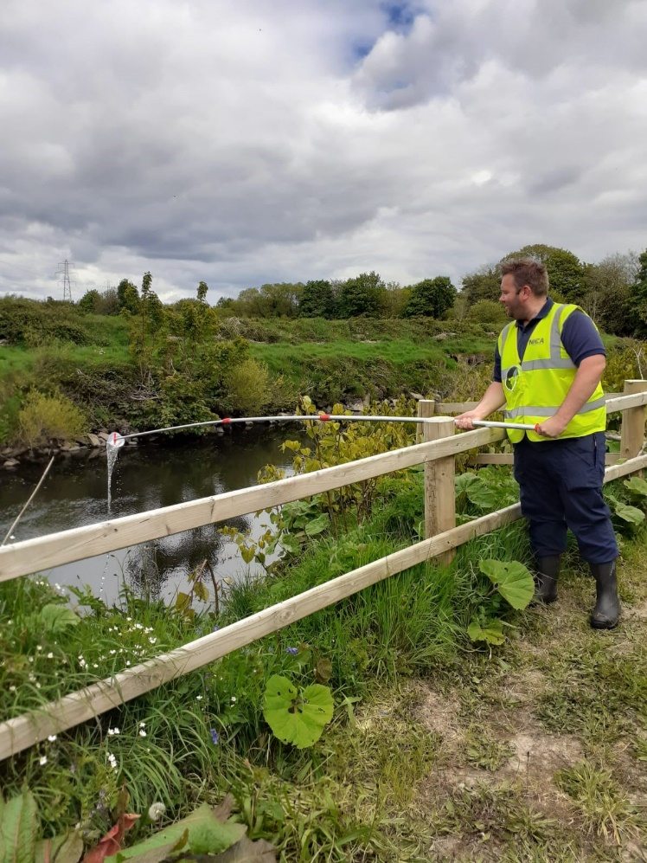
Mobuoy Remediation Team Response
to Covid Restrictions
Site Surveys twice a week
•Visually inspect raised areas and surface waters on the site, including the River Faughan, for indicators of pollution;
•Carry out field chemistry at surface water monitoring locations on and off the site including the tributary which flows adjacent to the site, the point at which the tributary discharges to the River Faughan, and upstream and downstream locations on the River Faughan;
•Collect and submit water samples weekly for qualitative testing at the laboratory (This testing is in addition to daily water quality monitoring carried out by Northern Ireland Water)

Slide 13
Presentation to Mobuoy Road Waste Community Stakeholder Meeting Drinking Water Quality – Carmoney WTW
August 2020

Slide 14
Drinking Water Quality Monitoring
The raw water quality is monitored continuously at the raw water abstraction point and at the inlet to the treatment works.
The abstraction will automatically shut down on alarm level for ammonia and oil on water.
The final water quality leaving the treatment works is continuously monitored at the WTW.
Samples of the raw water and final water are taken daily for analytical testing to monitor quality.
Samples are taken daily at customer taps to monitor the quality of water.

Slide 15
Assessment of Drinking Water Quality
Over 120 individual parameters are routinely monitored in the raw water and final water samples
Sample results are assessed against the requirements of the Drinking Water Regulations.
Where a regulatory limit is not specified in the drinking water regulations we assess the public health risk against World Health Organisation (WHO) guideline and or Health Based Suggested No Adverse Reaction Levels (SNARLs).

Slide 16
DWI
- Drinking Water Regulations
Carmoney WTW drinking water supply
Raw water abstraction
Alarms -24/7 monitoring
- immediate shutdown
Daily sampling & analysis
Treatment - Final water quality
Alarms - 24/7 monitoring
- immediate shutdown
Daily sampling & analysis
Distribution
&
Customer Tap
Samples taken at SRs & at customer taps
Drinking Water Safety plans
Safe Drinking water

Slide 17
Drinking Water Quality Graphs

Slide 18
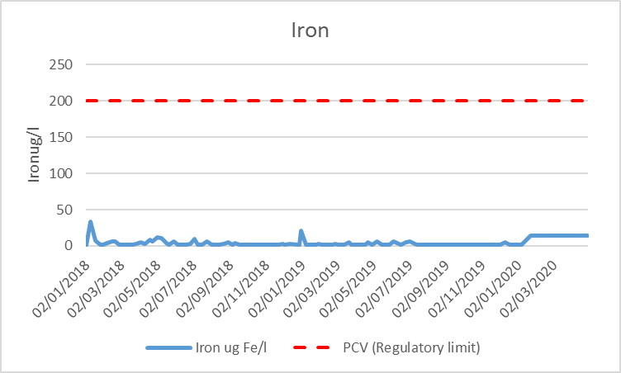
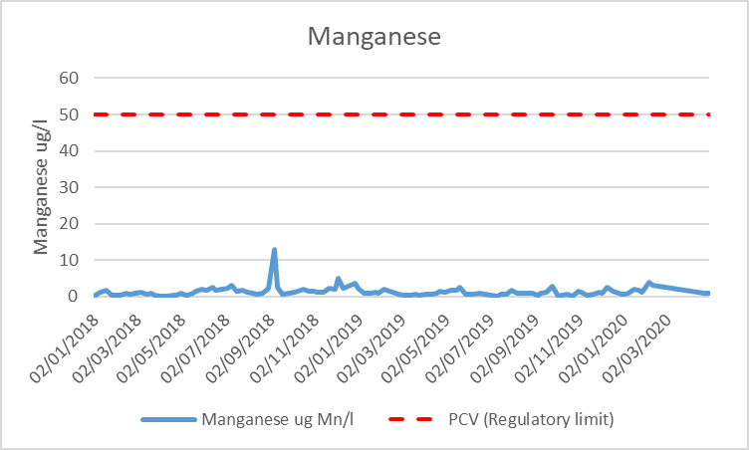
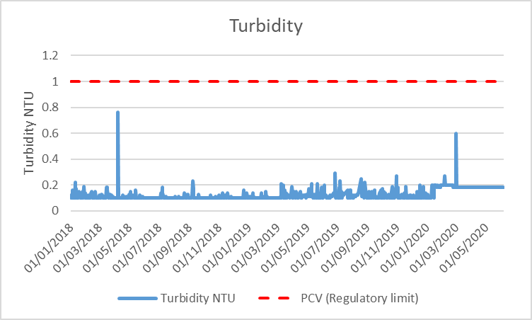

Slide 19
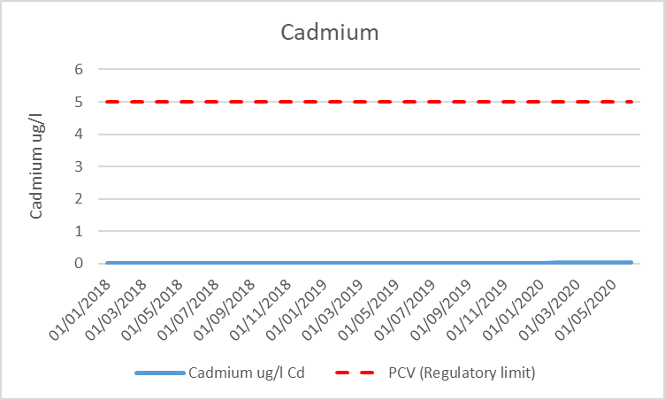
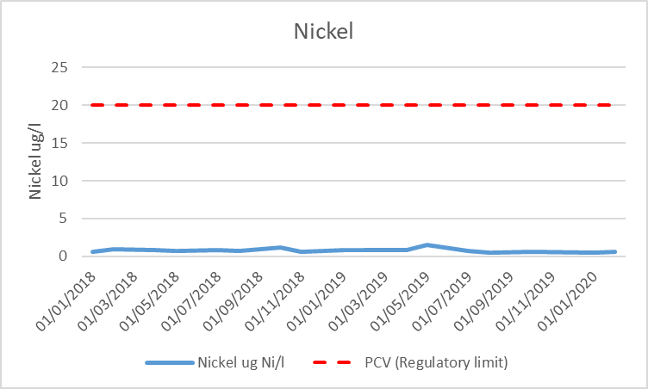
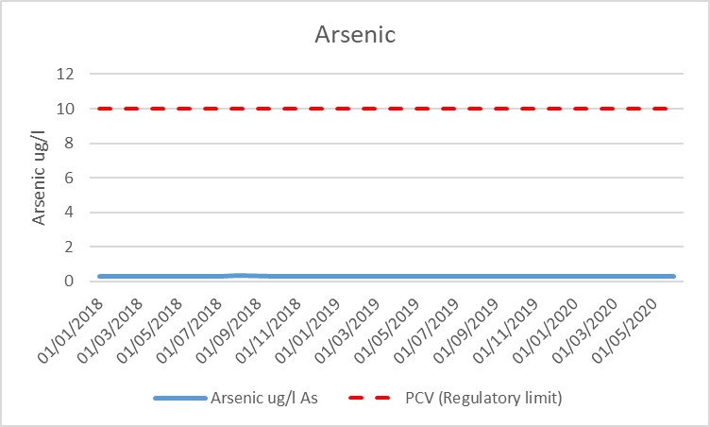

Slide 20
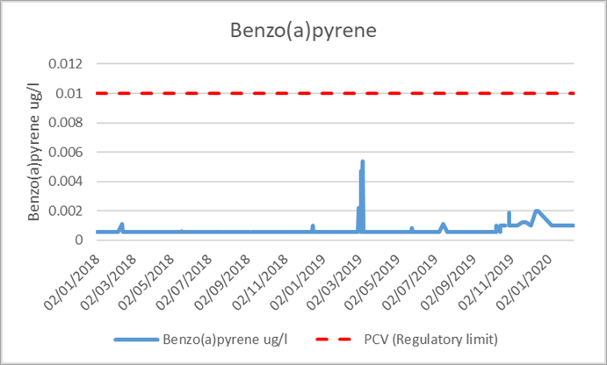
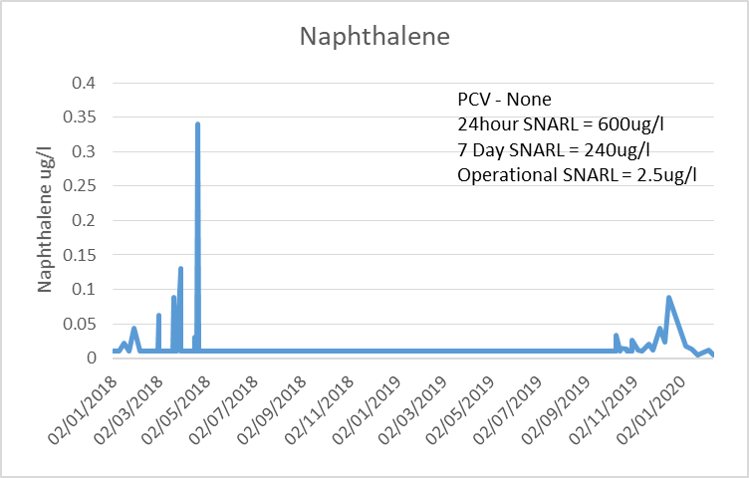

Slide 21
Contingency planning – maintaining the public drinking water supply to customers….
We have Contingency Plans in place for all of our WTWs
provide a framework for dealing with and limiting the impact of a total loss of supply from the WTW Treatment Works.
Carmoney WTW
interconnectivity to 2 other WTWs to maintain supply to customers.

Slide 22
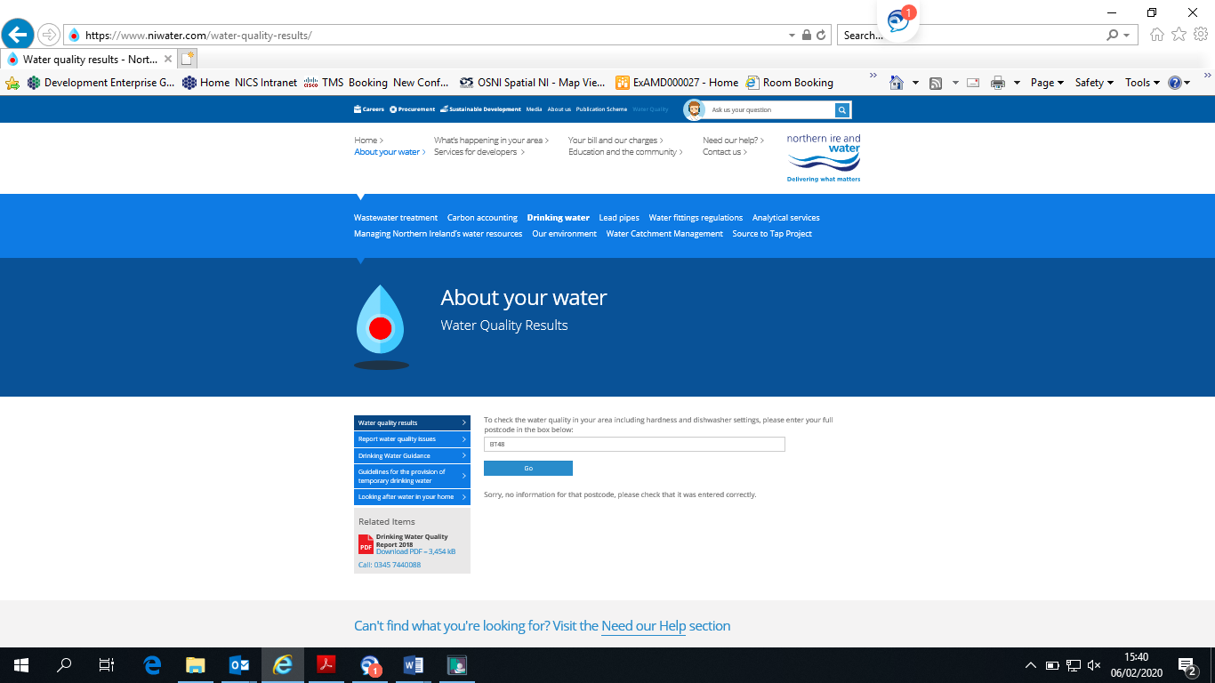
https://www.niwater.com/water-quality-results/

Slide 23
A6 Londonderry to Dungiven Dualling
Phase 2 Drumahoe to Caw

Slide 24
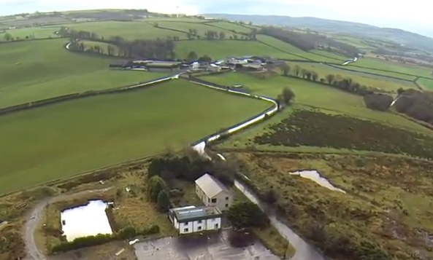
Scheme Description
Strategic Link
No central reserve crossovers
Grade separated junctions
Scheme will:
Reduce journey times
Improve road safety
Ease traffic congestion
Enhance connectivity

Slide 25
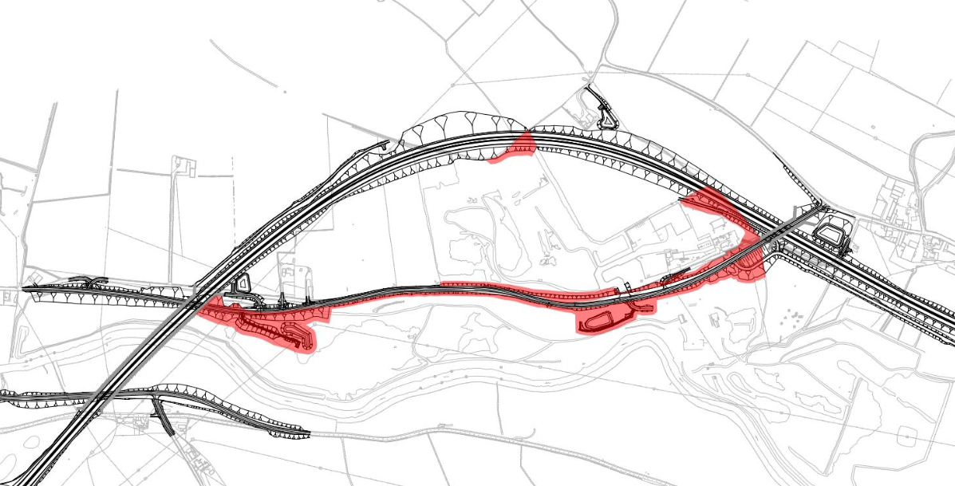
N
Interaction
Potential waste overlap with A6 scheme
N
A6 mainline
Mobuoy Road
overbridge
Faughan River bridge
Mobuoy Road

Slide 26
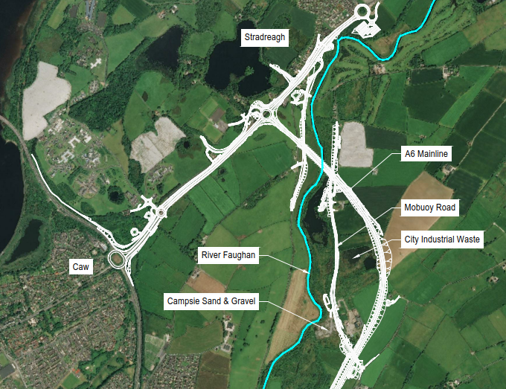
Summary
Areas of encroachment are under review as part of the ongoing design of the engineering works.
Phase 2 is not part of the current construction contract.
Delivery will depend on a range of factors, including the availability of funding.
DfI will continue to engage with NIEA.
N

Slide 27
The Planning Process

Slide 28
Determination of planning applications
Planning applications for local and major development are determined by a council.
Major applications for regionally significant development and called-in applications are determined by the Department for Infrastructure. The power of call-in is discretionary and will only be used by exception as the Department recognises the important role of councils in making decisions about the future development of their areas.
Process and procedural matters associated with planning applications are laid down in legislation, including pre-application community consultation; publicity arrangements and neighbour notification; consultation and decision making.
All major planning applications and regionally significant planning applications will be subject to pre-application community consultation (PACC) under Section 27 of the Planning Act (NI) 2011. PACC is the responsibility of the planning applicant in advance of the submission of a planning application. Any representations made to the applicant during the PACC period are not representations on the planning application itself.

Slide 29
In determining any application for planning permission the council or the Department must take into account any representations relating to that application.
The council or Department will consult with a range of statutory and non statutory consultees to assist in the determination of an application. The consultee comments will be taken into account before a decision is made.
In terms of decision making, regionally significant planning applications are subject to similar planning procedures and processing as for local and major applications up until the point of recommendation but differ somewhat thereafter.
Following completion of a planning report and recommendation to the Minister, two main options are open to the Department in determining the application.
Firstly, a Public Local Inquiry (PLI) can be called before the Planning Appeals Commission (PAC), or other person so appointed.

Slide 30
It is a matter of judgement for the Department on whether to hold a public local inquiry in each case. A key test in deciding to hold a public local inquiry will be whether it is considered necessary to have certain issues and material considerations aired and debated in a public forum in order to fully inform the decision making process. The volume of representations received in relation to a planning application will not be a reason, in itself, to hold a public local inquiry. The Department will consider if such an inquiry is necessary when making its recommendation to the Minister.
Where a Public Local Inquiry is not called, a Notice of Opinion to either grant or refuse planning permission will issue to both the applicant and the relevant council(s). Each will have not less than 28 days to request a hearing before the PAC, or other person so appointed, into the Department’s decision. If no hearing is requested, the final decision can issue.
In the event of a hearing or a Public Local Inquiry, the PAC or other person so appointed, will prepare a report for consideration by the Department. The planning decision will then be taken by the Department taking into account the report. The decision of the Department will be final.

Slide 31
Public Engagement

Slide 32
Proposed Stages for Public Engagement
Public Engagement
Short Term
Keeping people informed and following up on stakeholder questions
Short to Medium Term
the safe remediation of the site
Longer Term
future use of site for community benefit

Slide 33
Proposed Mobuoy Public Engagement Governance Structure
DAERA Mobuoy Project Board
Mobuoy Remediation, Engagement and Comms Team
Public Engagement Steering Group - Phase 2 Post Remediation
Medium to Long Term
Public Engagement Steering Group - Phase 1 Remediation
Short to Medium Term
Council ERC Committee
Ongoing
Mobuoy Task and Finish Working Group Ongoing
All stages - Support to other elements and ongoing Horizon Scanning
DAERA Stakeholder Updates
Short Term

Slide 34
Short term - Keeping People Informed
Update the Terms of Reference for the Mobuoy Task and Finish Working Group which will link with all stages of the stakeholder engagement process - short, medium and long term
Tasks for the DAERA Remediation and Comms Team as it relates to Stakeholder Engagement
to respond to questions posed by stakeholders and prepare content for DAERA updates and presentations
once approved distribute to key stakeholders
to prepare a draft paper on the stakeholder engagement process
Proposed Membership - DAERA Remediation Team and Council.
Meeting monthly in advance of Council ERC Meeting.
Further contributions from NI Water, DFI Roads, DfI Planning for updates (where relevant)
Suggested tasks for the Mobuoy Task and Finish Working Group in the short term:
to consider and comment on the content of the DAERA updates
to identify the range of stakeholders with whom the project needs to engage
to contribute to DAERA’s proposals on how best this engagement could be achieved
to agree appropriate stakeholder engagement options
to present the Stakeholder Engagement options to stakeholders for comments
to consider relevant papers from the Mobuoy Remediation & Comms Team as they relate to Council ERC
to ensure strategic fit and alignment with DAERA, Council and other relevant strategies
to research and scope options as appropriate as the project develops

Slide 35
Short to Medium Term – Public Engagement Steering Group - Phase 1 Remediation Stage
The role of the Mobuoy Task and Finish Working Group in Phase 1 Remediation would be to:
Agree a draft TOR for the Public Engagement Steering Group Phase 1 Remediation (PESGR)
Agree a process for selecting relevant stakeholders
Manage the establishment of the PESGR (coordinated by DAERA & supported by Council)
Maintain links with the new Steering Group on an ongoing basis
The DAERA Remediation Team and Comms/ Engagement Team would
Agree dates for and coordinate the meetings of the Public Engagement Steering Group Phase 1 Remediation
Develop and distribute agendas for the Forum
Facilitate meetings and maintain regular, two way open and transparent engagement about the remediation project with a Public Engagement Steering Group Phase 1 Remediation about the remediation process.
The Public Engagement Steering Group Phase 1’s main role will be to:
Ensure that concerns can be expressed, captured and addressed,
Promote sharing of information with all stakeholders and opportunities are afforded for input to discussions as appropriate
To contribute to discussions in addressing issues raised or ideas presented
Members:
Key stakeholders, councillors and the public alongside DAERA/ NIEA, NI Water, DFI Roads, DfI Planning (where relevant).and the Council
Supported by DAERA’s Remediation Team and Comms/ Engagement Team

Slide 36
Medium to Long Term – Public Engagement Steering Group - Phase 2 Post Remediation Stage
The role of the Mobuoy Task and Finish Working Group in Phase 2 Post Remediation is to:
agree a draft TOR for the Public Engagement Steering Group Phase 2 Post Remediation (PESGPR);
Agree a process for selecting stakeholders
establish the PESGPR (coordinated by DAERA & supported by Council)
Maintain links with the new Steering Group on an ongoing basis
The DAERA Remediation Team and Comms/ Engagement Teams would
Agree dates for and coordinate the meetings of the Public Engagement Steering Group Phase 2 Post Remediation
Develop and distribute agendas for the Forum
Agree an engagement strategy with appropriate engagement techniques and timelines for this stage with a focus on co-design
Facilitate meetings and maintain regular, two way open and transparent engagement about the vision and community benefit element of the project post remediation
The Public Engagement Steering Group Phase 2’s main role will be to:
Ensure that concerns can be expressed, captured and addressed,
Promote information sharing with all stakeholders and opportunities are afforded for input to discussions as appropriate
To contribute to discussions on how to address issues raised or ideas presented
All parties would work together with a focus on co-design of any future use and community benefits that can be realised post remediation, within a common understanding of the parameters of what is possible on the remediated site.
Members:
Representatives from key stakeholders, councillors and the public from the area alongside DAERA/ NIEA, NI Water, DFI Roads, DfI Planning (where appropriate) and the Council. The focus will be on Vision Building, Future Use and Community Benefit of the Site.
Supported / serviced by the DAERA Remediation team & Comms/ Engagement Team

Slide 37
Draft Principles for the co-design process post remediation
Inclusive – all key stakeholders in the room; Bring people with you
Respectful – everyone’s input is valued and respected
Participative - the process is open, empathetic, and responsive and includes conversations, dialogue, engagement meetings etc. The focus is to identify shared meaning based on expert knowledge and lived experiences
Shared Vision and Goals - the future vision is built on a shared vision, goals and outcomes
Iterative – Ideas and solutions are constantly tested through the dialogue process
Outcomes focused – it is designed to achieve outcomes for or deliver positive benefits
Realistic – design proposals need to be practicable and deliverable within the resources available for their implementation. They need to reflect what is achievable on the site, are based on evidenced need, take account the parameters of the remediation process and the technical feasibility of ideas.
Membership of the Steering groups will be as broad and inclusive as possible
Commitment - in order for the process to be a success, consistency of membership and attendance by members at meetings is paramount. This will help build trust and relations, key ingredients to the success of the vision building process.
Flexibility - the process needs to be flexible to take account of any unforeseen circumstances

Slide 38
Q&A

