Slide 1




Mobuoy Remediation Project
NIEA Mobuoy Remediation Options Appraisal – Criteria & weighting Briefing & Workshop
31 May 2022
A living, working, active landscape valued by everyone

Slide 2




Thank you for attending today. Everyone here will be aware that the alleged operators of the site are currently being prosecuted before Belfast Crown Court for offences under the Waste and Contaminated Land Order. Therefore those criminal proceedings are active within the meaning of the Contempt of Court Act 1981.
Section 1 of the Contempt of Court Act 1981 provides that it may be a contempt to publish any matter which creates a substantial risk of serious prejudice or impediment to the course of justice in legal proceedings, irrespective of the intention behind the publication.
Therefore, in order to ensure that the criminal prosecution can proceed to trial, can I please ask you to refrain from making any audio, audio-visual or photographic recordings of this meeting and to note that circulation of any recordings of this meeting prior to the trial may lead to proceedings being instituted for Contempt of Court.

Slide 3
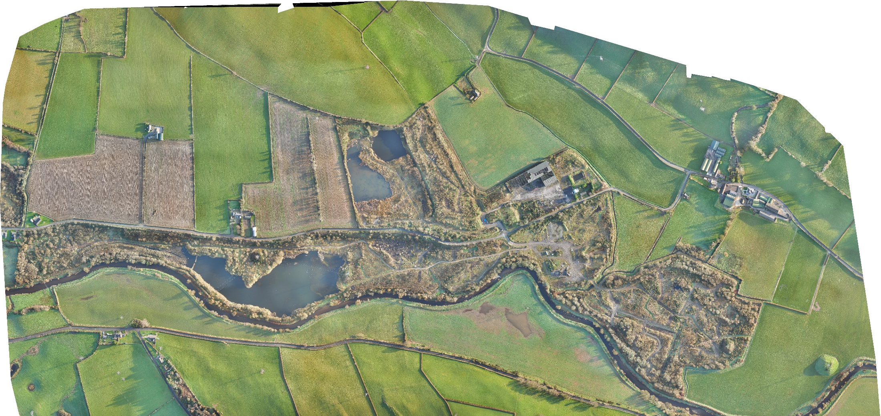

Mobuoy Remediation Project

Slide 4



Aims
Looking forward
not looking back
Deliver an
agreed site
vision and Community Asset
Ensure actions do not impact on criminal case
AIMS
Partnership
and collaborative working
Site Remediation Do nothing
not an option

Slide 5


Objectives
Protection of
Public Health
Deliver Optimum Remediation
for the Site
Protection of
the Environment

Slide 6
Ask of you today?
Listen to presentation on criteria & weightings
Feedback on the criteria & weightings
Welcome feedback on any additional criteria you would like included

Slide 7





The Land Contamination Risk Management (LCRM) Process
We are here
Pre-Construction
Contractor Procurement
Planning Application
Remedial Options Appraisal
Optimum
Remediation
Strategy + A6
Further
GI & DQRA
Business Case, Planning, Statutory Approvals
Nearing completion
Feb to
Jul-22
Aug to
Oct 22
2023
STAKEHOLDER ENGAGEMENT AND COLLABORATION
GI – Ground Investigation DQRA – Detailed Quantitative Risk Assessment * Timescales could be subject to change due to external factors

Slide 8
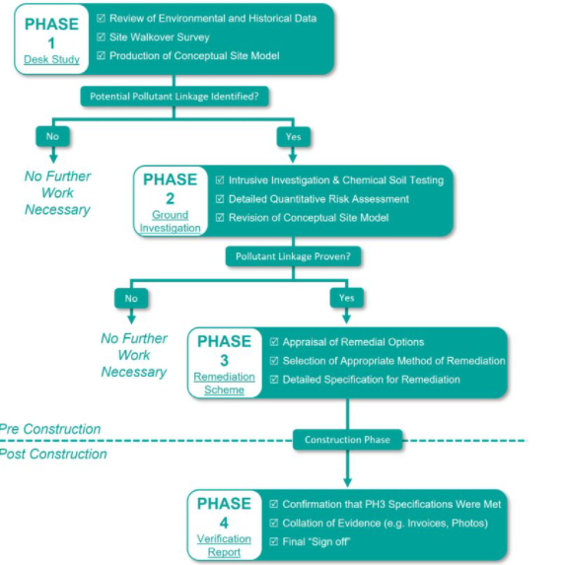
Land Contamination Risk Management (LCRM) Flow Chart
We are here
Optimum remediation strategy will take account of the findings of the 2017 remediation strategy
(UK Government Guidance, October 2020)

Slide 9

Remedial Scheme - Strategic Objectives
Protection of River Faughan water quality
Protection of NIW Drinking Water Supply
Improve groundwater quality
Reduce Landfill Gas to acceptable level to protect site users
Wider integration with other public interests (e.g. NI Water & A6)

Slide 10

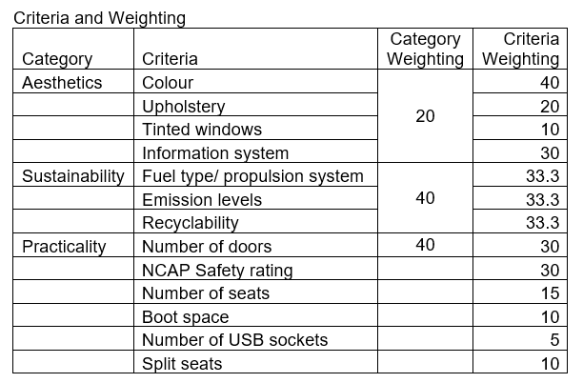
Where do the Criteria & Weightings fit in?
Analogy for the process we are undertaking:
Aim: Define Evaluation Criteria and Assessment Approach (including Weighting) before the decision making (Remedial Options Appraisal)

Slide 11
Key Principles of Sustainable Remediation
1: Protection of human health and the wider environment
2: Safe working practices
3: Consistent, clear and reproducible evidence-based decision making
4: Record keeping and transparent reporting
5: Good governance and stakeholder involvement
6: Sound science
(CLAIRE, March 2010)

Slide 12
Sustainability will underpin the Remediation Strategy
(CLAIRE, March 2010)

Slide 13
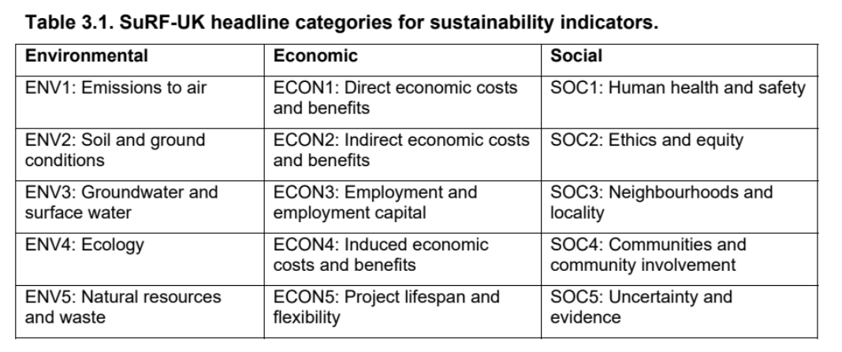
Categories & Sustainability indicators for Remediation
(CLAIRE Supplementary Report 1 & 2, July 2020)

Slide 14
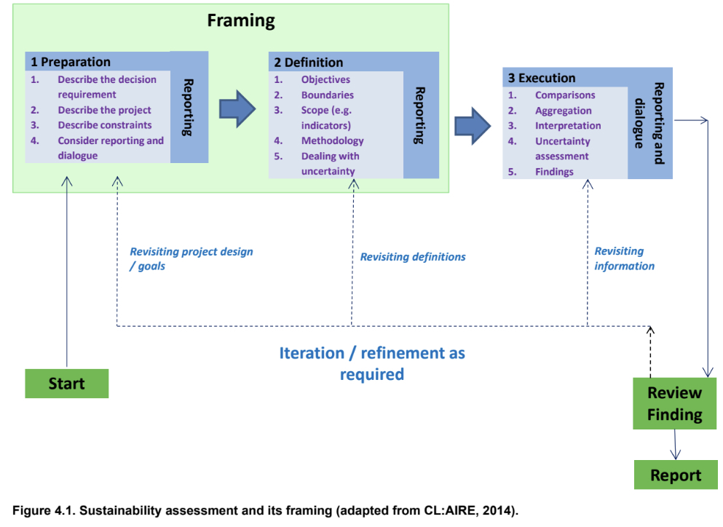
SuRF-UK Approach
Preparation
Definition
Execution

Slide 15
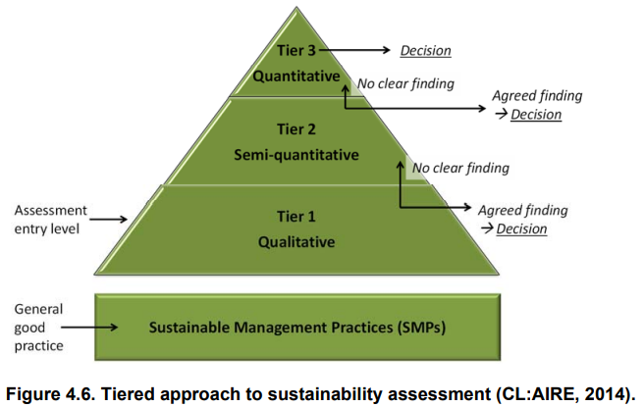
Weighting & Scoring
Tier 1: Initial Screening of Criteria - in or out
Tier 2: Professional Judgment on Weighting *
Tier 3: Detailed Numerical Scoring / Modelling
* Wide range of stakeholder feedback will be taken into consideration when setting criteria weightings

Slide 16
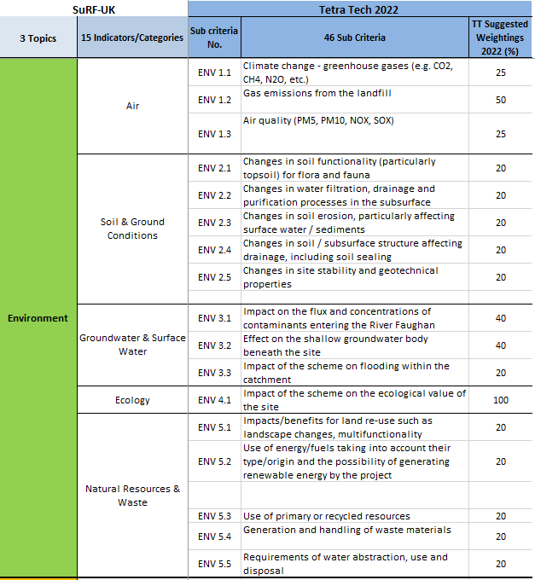
Draft Criteria for Stakeholder Consideration
Review Draft Criteria (spreadsheet)
Discuss Weightings
Feedback on Criteria & Weightings

Slide 17




Next Steps
We Are Here
Options for Assessment
Evaluation
Criteria &
Weighting
Scoring of
Criteria
Share Draft Evaluation Criteria & Weighting (Mobuoy Website)
Feedback will inform ‘Framing’ & Methodology
Options Selection based on Detailed Quantitative Risk Assessment Findings
Score & Share Scored Options with Stakeholders (Workshop Date TBC)

Slide 18
Questions
See Attached Document

Slide 19
Ask of you today?
Listen to presentation on criteria & weightings
Comment on the criteria & weightings
Provide feedback on any additional criteria you would like included

Slide 20
Thank you
A living, working, active landscape valued by everyone

Slide 21
Web links
LCRM: Stage 1 risk assessment - GOV.UK (www.gov.uk)
LCRM: Stage 2 options appraisal - GOV.UK (www.gov.uk)
Landfill developments: groundwater risk assessment for leachate - GOV.UK (www.gov.uk)
Claire Guidance on Sustainable Remediation

