Slide 1
Importing and Exporting Fishery Products under the NI Protocol
Welcome and Introductions

Slide 2
How this event will work
Who is this event aimed at?
How Webex works
Everyone muted
Please turn cameras off
How the chat function works and Q & A
Written questions already submitted
Further planned stakeholder engagement events

Slide 3
Food Standards Agency, Port Health Authorities and DAERA Fisheries Transition Team Importing and Exporting Fishery Products under the NI Protocol
Agenda
Welcome and introductions
Mark O’Neill, NI Imports Lead, FSA
Timothy McKillen, Senior Port Health Officer, Belfast City Council
Question and Answer session
Heather Boyd, DAERA Veterinary Service Animal Health Group
Sinead Murphy, Head of Environmental Health – Commercial, NM&D
Ciaran Cunningham, DAERA Fisheries Transition Branch
Question and Answer session
Closing Remarks

Slide 4
Moving Fishery Products (POAO) from GB to NI – Roles and Responsibilities
DAERA is the Central Competent Authority responsible for imports of POAO into NI
Food Standards Agency is the Central Competent Authority responsible for food safety matters of fishery products imports
DAERA is the Central Competent Authority responsible for fish health/IUU matters of fishery products imports
District Council are the Competent Authority for fishery products imports and authorised council staff will conduct checks at the POEs on fishery products imports
This Photo by Unknown Author is licensed under CC BY-SA

Slide 5
MORE INFORMATION ON FISH IMPORT REQUIREMENTS

Slide 6
Further information
FSA website – https://www.food.gov.uk/business-guidance/imports-exports#subject-imports-to-northern-ireland
Gov.uk guidance on fish exports and requirements - https://www.gov.uk/guidance/exporting-or-moving-fish-from-the-uk
TRACES NT - https://webgate.ec.europa.eu/tracesnt/login

Slide 7
Contact Details
Mark O’Neill, FSA, NI Imports Lead - mark.oneill@food.gov.uk
Keith Minnis, FSA, EU Transition Team – keith.minnis@food.gov.uk

Slide 8
Movement of Fish and Fishery products into Northern Ireland from outside the EU
Timothy McKillen, Senior Port Health Officer.

Slide 9
Point of Entry (POE)
Points of Entry are designated and approved by the EU for carrying out checks on agri-food goods
Fish and Fishery products must entry NI via a designated Point of Entry.
The EU have designated the following as Points of Entry in NI:
Belfast Port (XIBEL1-BCC)
Larne Port (XILAR1-MEA)
Warrenpoint Harbour (XIWPT1-NMD)

Slide 10
Point of Entry Facilities
Located within the Ports
Direction signage
This is in place at all Points of entry into NI from GB

Slide 11
Point of Entry
Import checks at the POE are an EU requirement to verify that the consignment entering NI from GB meets all the EU import requirements.
Three part process:
Documentary,
Identity
Physical

Slide 12
You will need
Official Documentation/Certification
Official Certificate (known as a Export Health Certificate) for all fishery products imported from non EU countries.
&
Catch certificates for wild caught marine fish imported from non EU countries.
These certificates are issued by authorised officials before leaving GB
It is also recommended that you submit
Commercial travel documents/invoices that can be of assistance in documentary check

Slide 13
You will need to have:
Completed a CHED-P on TRACES-NT (online).
Pre notified the consignments arrival at the POE
(by submission of CHED-P on TRACES)

Slide 14
For those of you who have not yet imported fish or fishery products. What steps can you take to prepare now?
Familiarise yourself with certification required and the competent authorities in Great Britain who can supply it.
Register on TRACES.NT
Follow HMRC guidelines and obtain XI EORI number
Register with the Trader Support Scheme (Customs)

Slide 15
Register on TRACES NT
You must create an EU Login Account if you are not already registered
Then you can Request a new user access profile in TRACES.NT
The profile you create must reflect your role and associated activities.
Businesses or agents are normally registered as Economic Operators
Economic operators must choose the Point of Entry to which they wish to be associated for registration purposes.
Once registered you will be able to import through any POE

Slide 16
Register on TRACES NT
More information and how to register can be found online: https://webgate.ec.europa.eu/tracesnt/login
Training videos found here: https://www.youtube.com/watch?v=Ketbp2q4VxA

Slide 17
TRACES NT definitions
The “Operator Responsible for the consignment”
Indicate the name and address, country and ISO code of the natural or legal person in the Member State who is in charge of the consignment when presented at the POE. The Operator Responsible for the consignment can be the importer.
The Operator Responsible for the consignment signs the CHED and takes responsibility to comply with the Official Controls (OC) including payment for OC’s, re-dispatch, disposal and storage if necessary.

Slide 18
TRACES NT definitions
The “Consignee/Importer”
Indicate the name and address, country and ISO code of the natural or legal person to whom the consignment is destined.
ISO country code:- XI
Country:- United Kingdom (Northern Ireland)
The consignee/importer should appear on the official certificate

Slide 19
Pre-notification process
Pre-notification is done by completion of Part I of the CHED-P on TRACES NT
When you complete Part 1 and submit the CHED-P, this will pre-notify the POE of the arrival of the consignment
Notification legally required 24 hours in advance
(4 hours in exceptional circumstances) but checks are
required before product can be cleared into NI)
Part 2 is completed by the authorised officer at the POE to indicate the checks on the product have been completed.

Slide 20
Three part process carried out at Point of entry
Documentary checks
These are specific to the commodity.
This check will be carried out at the POE on electronically submitted documents (COVID-19 Easement)
This involves the examination of the official certificates, official attestations, Catch Certificates and other documents (including documents of a commercial nature), which are required to accompany the consignment

Slide 21
Identity Check
This is to confirm that the goods listed within the official documents, describe those goods carried
An ID check can be carried out through the checking of an Official Seal carried out in GB ports prior to sailing.
In the absence of an official seal on the consignment the ID check can occur at the POE. The check can be a visual inspection to verify that the goods and the labelling of a consignment correspond to the information provided in the Official documents.

Slide 22
Physical Check
These are carried out at a frequency described in EU legislation at the facilities provided at the Points of Entry.
Goods shall be partially or fully unloaded where necessary.
This is a check on the product, eg checks on packaging, the means of transport, labelling and temperature, possible sampling for analysis, testing or diagnosis and any other check necessary to verify compliance.

Slide 23
Physical Check
If selected for further inspections road signage will direct you to a DAERA inspection facility when you disembark the ferry.

Slide 24
CHED’s key issues when completing EU 2019/1715
Box 1.3 “Local reference”
Please put “Fish” in this box please as it would help us identify fish consignments

Slide 25
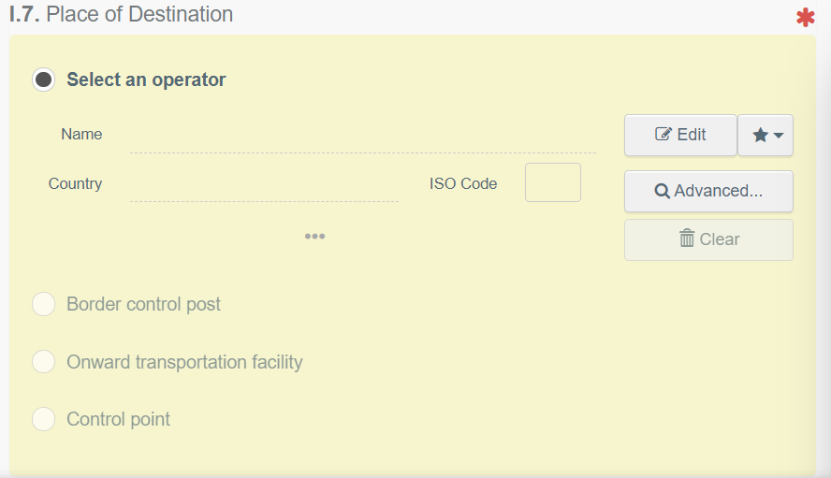
CHED’s key issues when completing EU 2019/1715
Box 1.7 “Place of destination”
This is the place where the consignment is being delivered for final unloading.

Slide 26
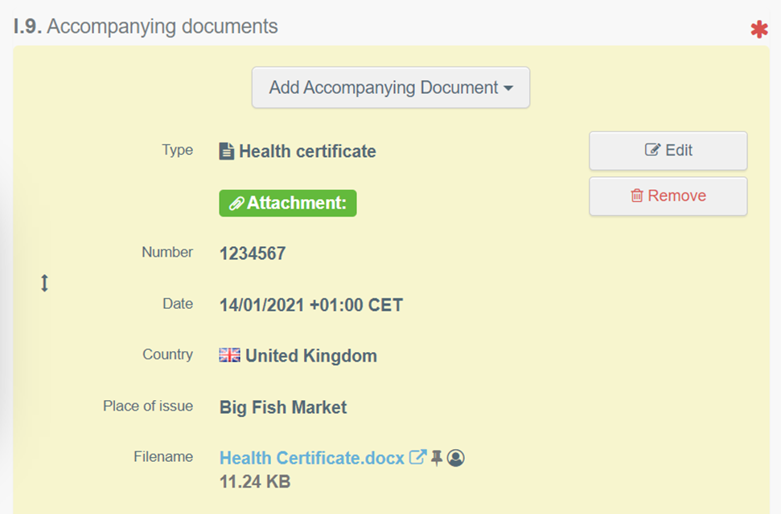
CHED’s key issues when completing EU 2019/1715
Box 1.9 “Documents”
Ensure the whole Health
certificate is uploaded and
is listed first.
Catch Certificates
should be uploaded under
“Type” other until EU
catch can be used.

Slide 27
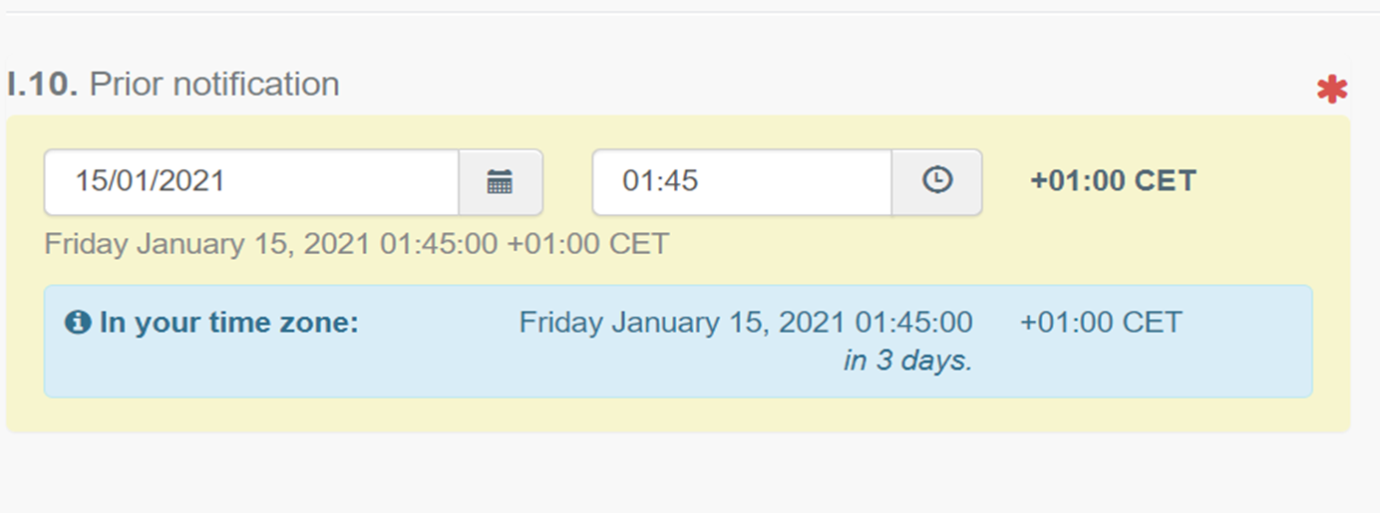
CHED’s key issues when completing EU 2019/1715
Box 1.10 “Prior notification”
This is the notification of when the consignment will arrive at the POE. You should enter the date and time of arrival of the ferry into the NI port. For example the 23.30 Cairnryan ferry tonight you should enter 15/01/2021…………….01.45

Slide 28
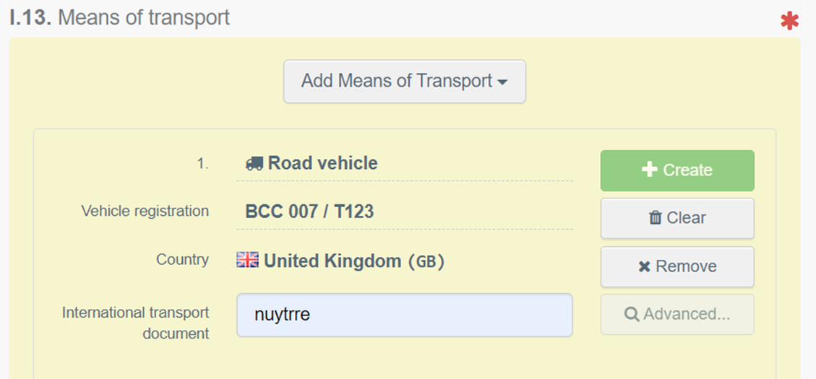
CHED’s key issues when completing EU 2019/1715
Box 1.13 “Means of Transport”
If arriving by ferry this should be only be completed as Road Vehicle with the reg and trailer number

Slide 29
CHED’s key issues when completing EU 2019/1715
Box 1.17 “Container No. / Seal No.”
In this box under “container number” put in the Lorry reg and trailer number, under “Seal Number” put in the official seal number applied to the consignment by the certifying officer and appearing on the Health Certificate. In addition tick the box marked official seal.

Slide 30
CHED’s key issues when completing EU 2019/1715
Transport Boxes 1.27, 1.28, & 1.29.
These boxes should be left blank by the importer

Slide 31
COVID-19 Easements
Until the 1st February 2021 EU has permitted the following:
POE inspectors can clear consignments on electronic copy certificates.
This means signed CHED-P’s and original paper EHC’s don’t have to be presented to the POE with the consignment.
However the original signed CHED-P part 1’s and original EHC’s should be forwarded to the POE as soon as possible.

Slide 32
DAERA Roles and Responsibilities Exports
Defra
Central Competent Authority in UK for Trade and for exports of live animals, animal and plant products
DAERA
Competent Authority in NI for exports of live animals, animal and plant products
DAERA Trade Programme:
Trade Implementation: technical support, training, trade / certificate queries
Trade Certification & Standards: regulatory standards, authorisation, policy
Trade Certification Governance : audit, training
All: Market Access, third country audits, Defra / UK liaison
Sustainability at the heart of a living, working, active landscape valued by everyone.

Slide 33
Movement of Fishery Products from NI to EU via GB
Sinéad Murphy
Head of Environmental Health (Commercial)

Slide 34
This presentation will cover…
Documentation required to move fishery products from NI to EU via GB….
Risk based fish export certification, Certifying away from place of origin and Groupage Export Facilitation Scheme
Certification & Labelling requirements
How to get the documentation….
Completing an application for a Support Health Attestation

Slide 35
Documentation required…
Support Health Attestation (SHA) or Support Attestation (SA)
Where product of animal origin (POAO), originating in NI and moving to GB, is intended for further export from GB to the EU (or for movement back to NI)
A SHA provides assurance that the Sanitary and Phytosanitary (SPS) requirements for export from GB to EU are met.
It allows a Certifying Officer in GB to complete the final export EHC in GB.

Slide 36
How can I apply for a Support Attestation?
You can obtain a SHA via the DAERA SHA On Line application process (linked from the DAERA Homepage) where you will find guidance, ‘Frequently Asked Questions’ and templates to help you make your application.
Applications should be made at least 2 working days in advance of the date of export. This is the date of loading of your consignment, from premises of dispatch.

Slide 37
Who will provide a Support Health Attestation?
Depending on your product commodity and business type, a SHA will be provided by Certifying Officers as follows:
DAERA – in premises where DAERA has a permanent on-site presence
Authorised Veterinary inspector (AVI) – all commodity types
Local Authority Environmental Health Officer (EHO) – fish, fishery products
Notes:
SHA for RBFEC is coming soon

Slide 38
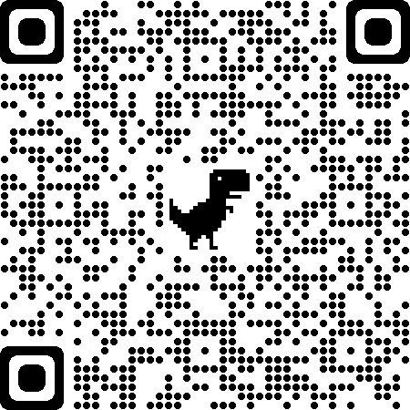
Risk Based Fish Export Certification
Enables relevant exports to be certified on the basis of risk assessments undertaken in line with the principles of the Food Law Code of Practice, supported by declarations from Food Business Operators
Applies to movements of product from NI to GB for onwards export to EU/ back to NI via hub -SHA
For exports from premises of production/ approved premises
Cannot be issued after the consignment has left
http://apha.defra.gov.uk/external-operations-admin/library/documents/exports/ET196.pdf

Slide 39
Risk Levels and Minimum Inspection Frequency
Outcome of last inspection by Local Authority determines frequency of auditing inspections of export consignments
Random inspections of export consignments and associated evidence to be carried out
Individual score/Risk | Frequency of inspection
High | Every consignment or a complete refusal to service and issue EHCs
Medium | 1 per 10 exporting days
Low | 1 per 60 exporting days
Low to Very Low | 1 per 180 exporting days (max 6month interval)
Notes:
Check with your local authority for details of your individual score and exports risk rating. They can talk you through any compliance issues and steps you need to take to reduce your risk rating.

Slide 40
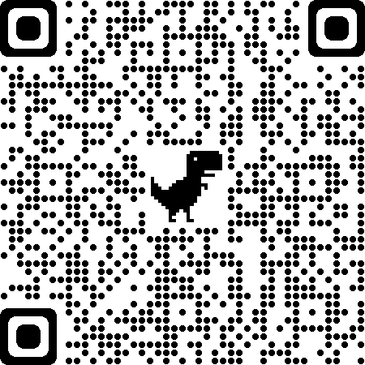
Certifying Away from the Premises of Origin
Enables relevant exports to be certified away from Premises of Origin, e.g. via an EC Approved logistics hub
Fills the gap in the evidence required between the place of origin and the place of dispatch, to facilitate the certifying goods
The CO in GB will require supporting information from NI COs to permit certification of the goods and completion of the relevant EHC for movement to EU/NI
http://apha.defra.gov.uk/external-operations-admin/library/documents/exports/ET197.pdf
Notes:
It sets out how FBOs and Certifying Officers (COs) can fill the gap in the evidence required between the place of origin and the place of dispatch, to facilitate the provision of information that the CO responsible for certifying the goods requires to issue the relevant EHCs

Slide 41
Consolidation at the hub
The original supporting attestation must be sent to the logistics hub
A number of batches of product can be consolidated into a single consignment, which would be covered by a single Export Health Certificate (EHC).
This could cover:
multiple product lines of the same commodity type (e.g. composite products) from the same supplier; or
multiple batches of the same commodity type (e.g. fishery products) from different suppliers
Notes:
Consolidation of consignments (as referred to in point 19) results in fewer EHCs that need to be checked at Border Control Posts (BCPs) and therefore reduces the potential for delays at BCPs. However, it is important to note that if one batch of products within a consignment (covered by a single EHC) fails inspection at the BCP all associated batches will fail, meaning the entire consignment will either be required to be returned, destroyed or re-purposed. However, if there were other consignments on the same transport (covered by other EHCs), these could be released for onward movement but may require logistics to provide additional transportation options.

Slide 42
Fishery products from Direct Landings
For direct landings transported directly to a logistics hub, supporting information from another CO will not be required to issue the Export Health Certificate (EHC).
A commercial document and the required food chain information; and
The necessary controls and processes to ensure the safety of the product would have to be undertaken at the logistics hub and verified by the CO at the logistics hub
Approved vessels (freezer, Factory or reefer vessels) require:
Attestation in line with Risk based approach, or
For non-UK flagged vessel, a Common Health Entry Document from the BCP of entry
Notes:
When fishing vessels (registered or approved) catch and land fresh fish that is limited to primary production and transport them directly to a logistics hub, the Certifying Officer (CO) at the logistics hub will not require supporting information from another CO to issue the Export Health Certificate (EHC). Instead, the following will allow the CO at the logistics hub to issue the EHC: a. A commercial document and the required food chain information; and b. The necessary controls and processes to ensure the safety of the product would have to be undertaken at the logistics hub and verified by the CO at the logistics hub
Suppliers should discuss and agree what food chain information they need to provide to the COs at logistics hubs, to ensure that their products can be certified.

Slide 43
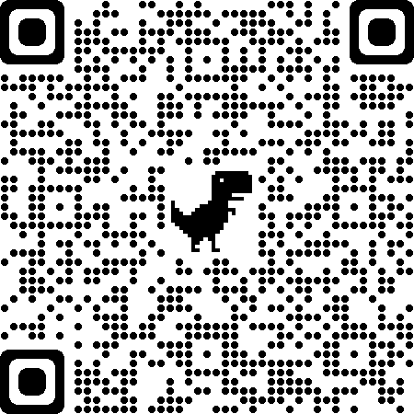
Groupage Export Facilitation Scheme (GEFS)
Must be member of the scheme
Restricted to exports from GB using supporting attestations from suppliers in the UK
30 day Support Attestations provide information to Certifying Officers for specific categories of products which are fully packaged for the final consumer (or to be re-packaged directly at the point of sale) and produced by a stable network of known suppliers.
They may be used for fish/fishery products
http://apha.defra.gov.uk/external-operations-admin/library/documents/exports/ET193.pdf

Slide 44
Certification Requirements
Caught, landed and handled onboard registered or approved vessel
Compliance with EU Regulations on Hygiene, Traceability and Microbiological criteria
Compliance with labelling requirements, including on landing
ID mark must be applied prior to leaving the approved establishment
Will be checked at Border Control Post in EU and Points of Entry in NI

Slide 45
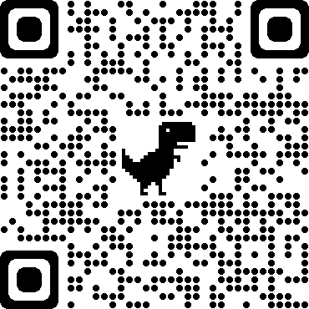
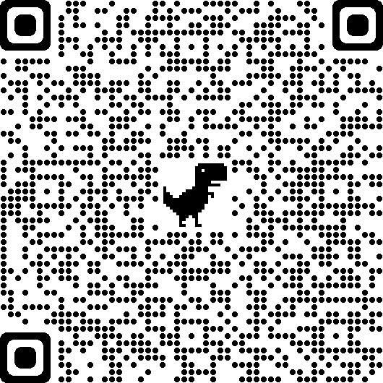
Labelling requirements
NI will continue to follow EU rules for labelling,
https://www.gov.uk/guidance/food-standards-labelling-durability-and-composition
but there may need to be some labelling changes in the following areas:
Food Business Operator (FBO) address (pre-packaged)
Country of origin labels (NI products – ‘EU Origin)
EU health and identification marks
Traceability and Labelling guidance:
https://www.gov.uk/government/publications/how-to-trace-weigh-and-distribute-fish-products/traceability-and-labelling-information

Slide 46
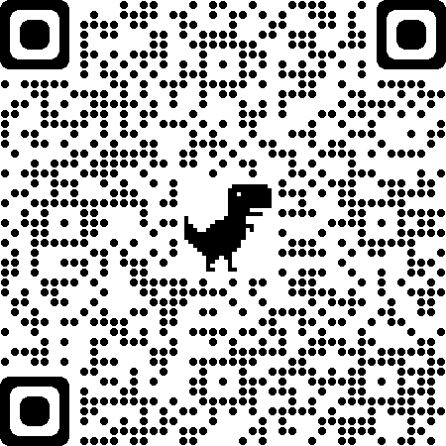
ID Marks
Northern Ireland
(District Council approvals)
https://www.food.gov.uk/business-guidance/guidance-on-health-and-identification-marks-that-applies-from-1-january-2021
Or

Slide 47
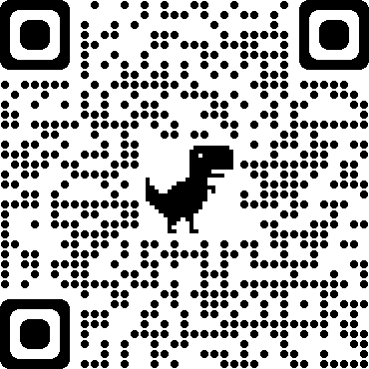
Head to the DAERA Website Homepage www.daera-ni.gov.uk

Slide 48
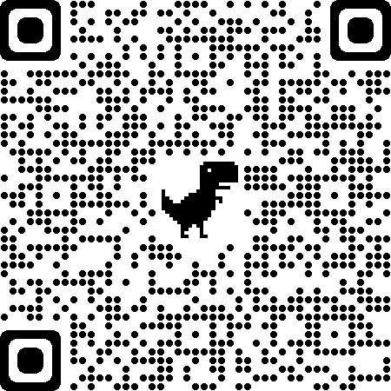
Select and Complete SHA
https://www.daera-ni.gov.uk/publications/sha-templates
Select Risk-based Fish Export Certification (RBFEC) template
Complete details and save to upload to SHA Online

Slide 54
Select required Attestation type

Slide 55
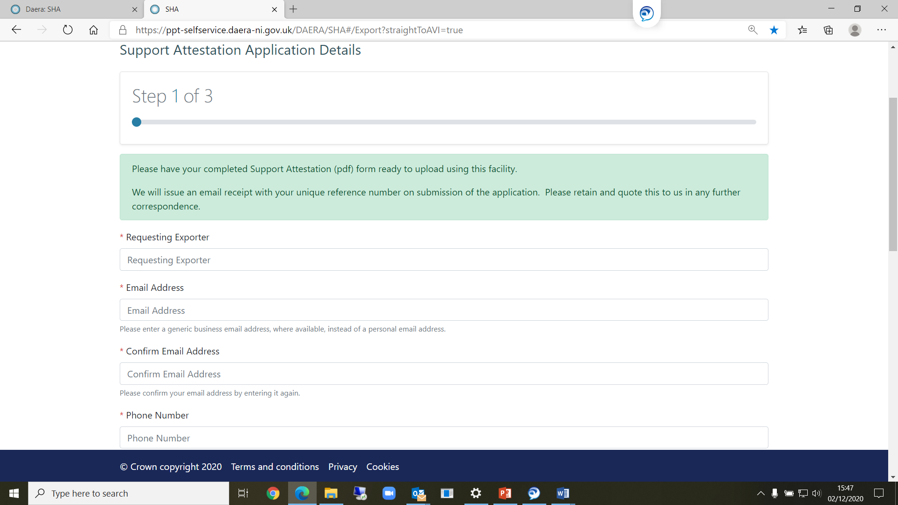
Click ‘Next’ to view Step 1 of 3

Slide 56
Enter details as appropriate

Slide 57
SHA Destinations:

Slide 58
Select your Certifying Officer

Slide 59
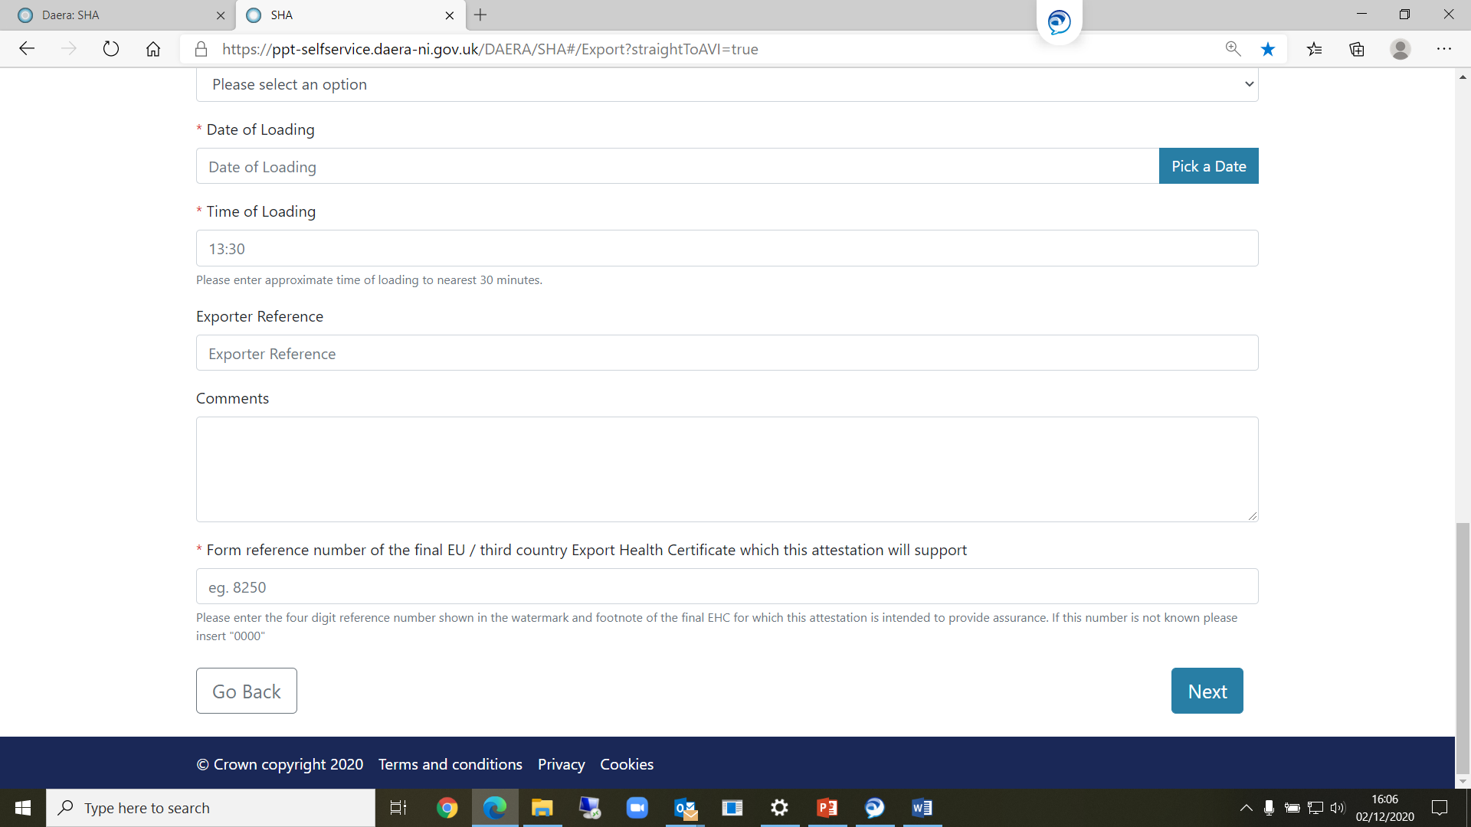
Enter remaining details and click ‘Next’

Slide 60
Step 2 – Click ‘Add’ to upload SHA pdf and Supporting Documentation

Slide 61
Select your file and click ‘Open’

Slide 62
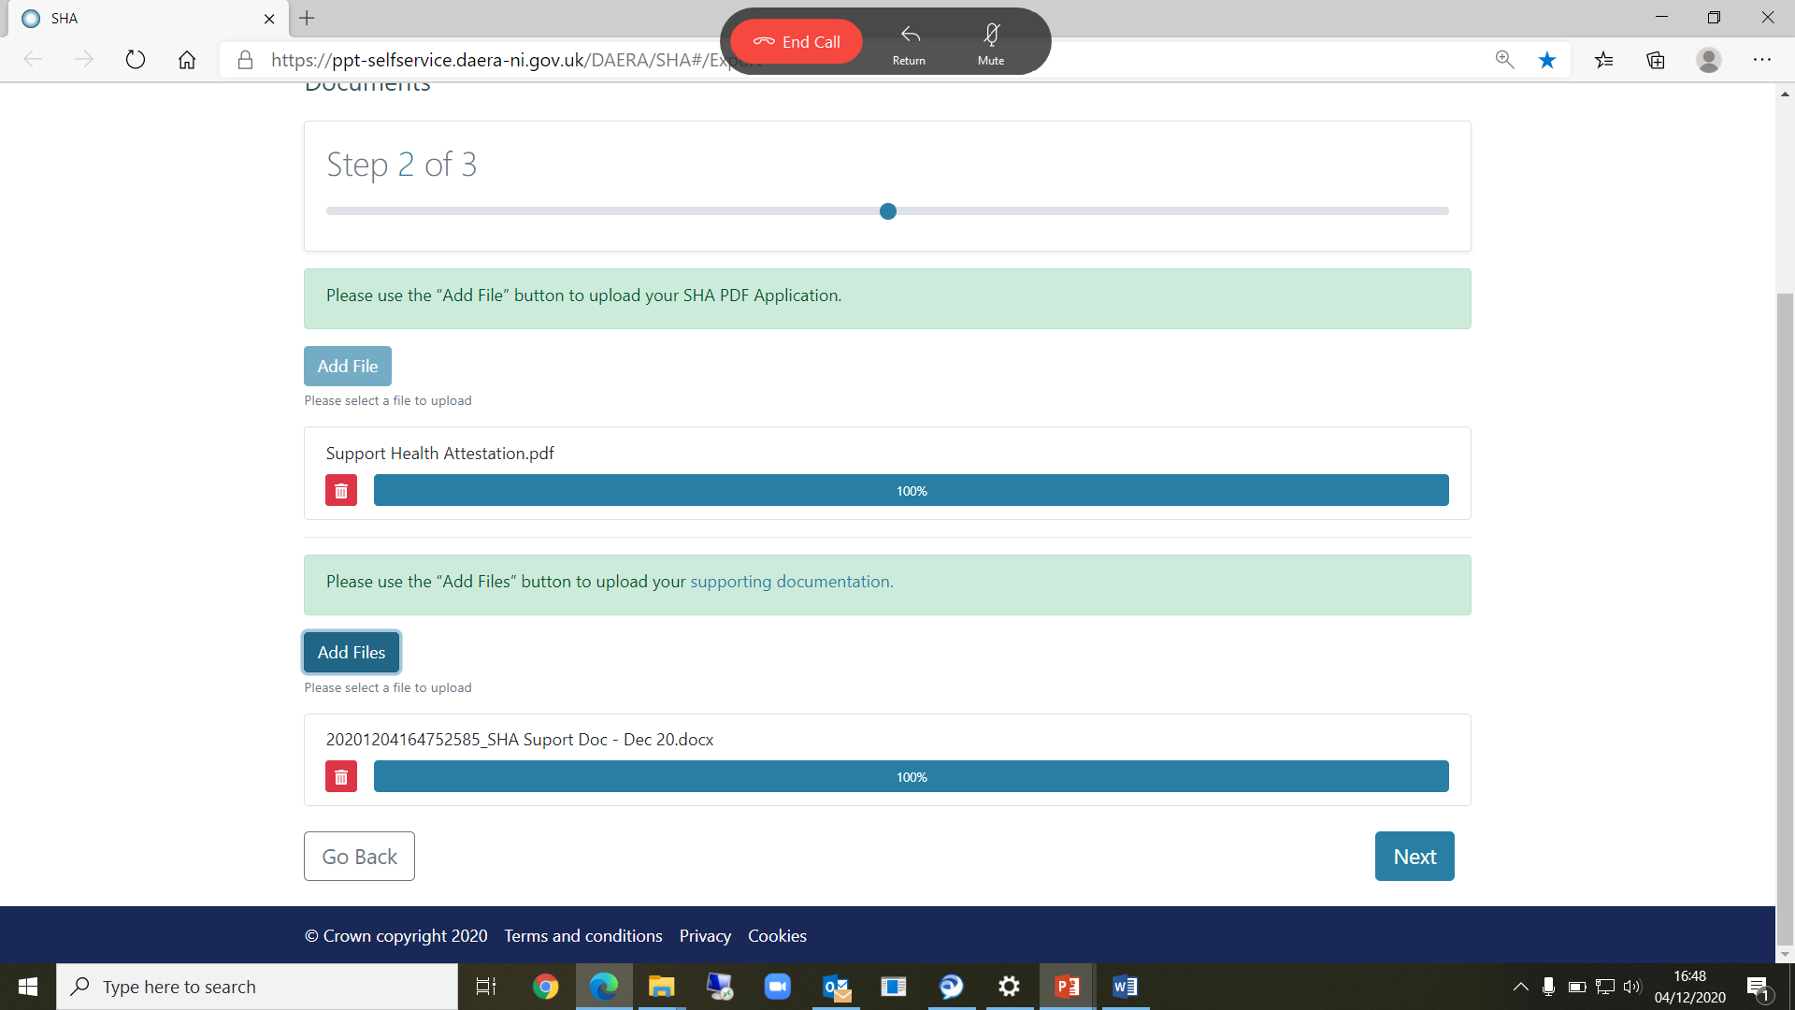
Once documents are uploaded, click ‘Next’

Slide 63
Step 3 - Declarations

Slide 64
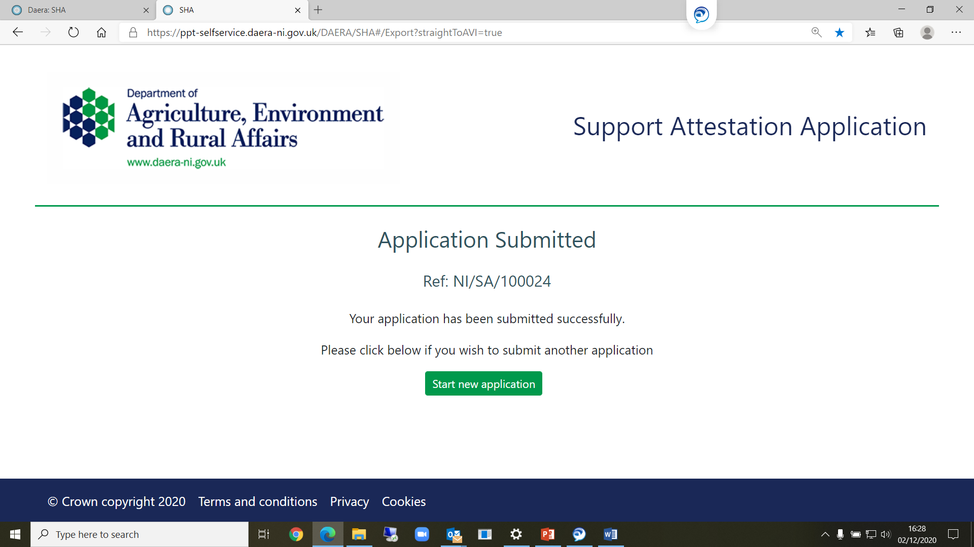
On screen confirmation – unique reference number:

Slide 65
What do I need to do now?
Engage with your GB businesses – find out if your product will require a SHA to allow onward export from GB;
Check out the relevant commodity Export Health Certificates on DEFRA Form Finder – familiarise yourself with the requirements set out in the EHC and Notes for Guidance;
Head to the DAERA Website and familiarise yourself with:
information on certification schemes and further NI-specific guidance available;
the templates to use in your application, and;
where you can begin an application.
Engage with your Certifying Officer prior to making your first SHA application.
www.daera-ni.gov.uk/publications/daera-poao-ni-gb-trade-faqs
Do I need to register to apply?
No – you do not need to register to apply using the SHA On Line application system.

Slide 66
Questions and Answers
Visit the DAERA Website for the most up to date EU Exit information.
After the event, you can also send your queries to your Local Council

Slide 67
DAERA Role
Central Competent Authority in NI in relation to IUU (Illegal, Unregulated & Unreported) activity
24th December - EU/UK Agreement Signed
At that point - Know that we will use catch certificates
This is why there was a delay with TRACES NT and CATCH
Formalities of correct approvals
Sustainability at the heart of a living, working, active landscape valued by everyone.

Slide 68
What is a Catch Certificate?
Catch certificates prove that fish have been caught legally under
the Illegal, Unreported and Unregulated (IUU) regulation (EC) No
1005/2008.
Who caught it, where and when - (E-log/logbook submissions)
What species, what product - (Commodity code)
Weight of product - (Landing Declaration, 1st Sales note)
Validated by Flag State

Slide 69
Data an exporter must have in order to obtain a Validated Catch Certificate
Vessel Name (registered in RSS)
Species Name(s) , State & Presentation
Landing Date(s) of Catch
Catch Area(s)
Actual Weight of Consignment (Export Portion)
Where is it Exporting from
Method of Transport – container, road or air

Slide 71
Question and Answer

Slide 72
Closing Remarks

