Slide 1
Fisheries Transition –
What we know now…
Fisheries Transition Branch

Slide 2
Ireland/Northern Ireland Protocol (I/NIP) Aquaculture and Products of Animal Origin (POAO) (fishery products)
Business as Usual
Movements from NI to EU (including ROI) for both imports and exports.
Where products stay within the EU regulatory zone there will be:
no change at the land border
no new paperwork
no tariffs or regulatory checks
no Catch Certificates required (IUU – Illegal, Unregulated & Unreported)
Aquaculture Intra-trade (internal EU) Export Health Certificates (EHCs) will continue to be required.
Sustainability at the heart of a living, working, active landscape valued by everyone.
Notes:
Mention Landbridge: still part of negotiations
NI will continue to have access to EU's online TRACES system (for imports and exports) as an EU entity, therefore for Day 1, you should ensure you are registered to use TRACES NT.

Slide 3
Ireland/Northern Ireland Protocol (I/NIP) Products of Animal Origin (POAO Aquaculture)
Movements from GB to NI:
Export Health Certificates (EHCs) (TRACES (Trade Control and Expert System), minimum of 24hrs notice to Point of Entry (POE)
All consignments must enter a designated POE
(live fish - Belfast or Larne, POAO – Warrenpoint, Foyle)
No airport Point of Entry
All consignments of live fish from GB will be subject to a
physical inspection at the Point of Entry, in compliance with Official Control Regulations.
Image courtesy of Seafish
Sustainability at the heart of a living, working, active landscape valued by everyone.
Notes:
Will also need an EORI number
What will happen with Rest of the World Trade via GB to Northern Ireland post transition?
Imports from the Rest of the World to Northern Ireland via a GB airport will have to clear through a GB Border Control Post (BCP). The consignment will then have to be recertified by the Competent Authority in GB. The consignment will then have to enter Northern Ireland through a POE designated for live fish (Belfast or Larne ports).

Slide 4
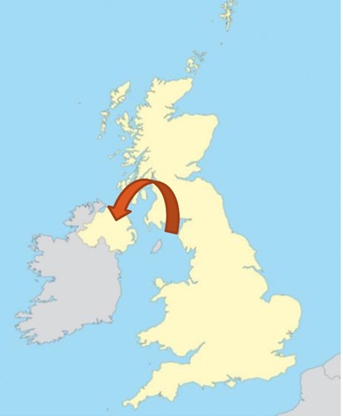
Ireland/Northern Ireland Protocol (I/NIP) Products of Animal Origin (fishery products)
POAO Movements from GB to NI
This trade will need to enter via a NI Point of Entry (POE)
and be accompanied by the following information:
An EORI (Economic Operators Registration
and Identification) number (both GB & NI(XI))
An Export Health Certificate (EHC)
A Catch Certificate
A UK Processing Statement
(if the product was processed in UK)
A UK Storage Statement
(if the product was stored for more than 12hrs)
Image courtesy of Seafish
Sustainability at the heart of a living, working, active landscape valued by everyone.
Notes:
EORI number: HMRC issues these, need to have GB EORI to get an XI EORI. (Some may get this automatically, best to apply now)
Export Health Certificate (EHC): Uploaded to TRACES-NT, 24hrs notice to POE
Catch Certificate: Currently, 72hrs notice-containerized (ship), 4hrs (air), 2hrs(road) (road/ferry?)
Website links:
An EORI number (Link to https://www.gov.uk/eori)
An Export Health Certificate (EHC) (Link to https://www.gov.uk/guidance/get-an-export-health-certificate)
A Catch Certificate (Link to https://www.gov.uk/guidance/create-a-uk-catch-certificate)
A UK Processing Statement, if the product was processed, before transporting to NI (Link to https://www.gov.uk/guidance/create-a-uk-processing-statement)
A UK Storage Statement, if the product was stored for more than 12 hrs, before transporting to NI (Link to https://www.gov.uk/guidance/create-a-uk-storage-document)

Slide 5
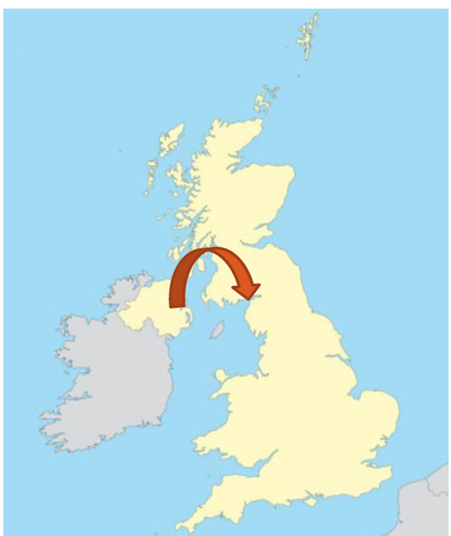
Ireland/Northern Ireland Protocol (I/NIP)
Business as Usual
Movements from NI to GB:
Unfettered access for all fishery products
– if the product remains in GB
If onward movement to EU (inc. ROI)
then IUU Catch Certificates, Export Health Certificates
No change to the rights and responsibilities of NI registered
vessels fishing in UK waters and landing in GB ports
but…
If transported back to NI, then requirements as for GB-NI
movements
Image courtesy of Seafish
Sustainability at the heart of a living, working, active landscape valued by everyone.
Notes:
Mention Survey

Slide 6
Labelling
Products of Animal Origin (POAO) Fisheries
Changes to the labelling requirements in NI
Labelling is still subject to EU/UK negotiations, but…
there are some changes that we know now:
For NI Products of Animal Origin (POAO) sold in GB and NI:
EU health and identification marks will change to reflect that NI will
continue to follow EU rules for labelling.
Applies from 11pm on 31st December 2020.
Sustainability at the heart of a living, working, active landscape valued by everyone.
Notes:
Combination of info from FSA and Gov.uk
Insert Label graphics x2

Slide 7
Labelling continued…
Products of Animal Origin (POAO) Fisheries
Changes to the labelling requirements in NI
For NI fishery products exported to EU:
NI will continue to follow EU rules for labelling,
but there may need to be some labelling changes in the following areas:
Food Business Operator (FBO) address (pre-packaged)
Country of origin labels (NI products – ‘EU Origin)
EU health and identification marks
Further guidance for placing goods on the Northern Ireland market will follow.
Sustainability at the heart of a living, working, active landscape valued by everyone.
Notes:
FBO address: Pre-packaged food and caseins must have an EU or Northern Ireland (NI) address for the FBO, or an address of the EU or NI importer
Country of Origin labels: Food from NI can continue to use ‘origin EU’.
EU health and identification marks: The identification mark applied to POAO by food businesses to show it’s produced in an approved establishment. (GB proposes to allow a 21-month adjustment period for goods placed on the market in GB.)
Changes reflect that NI remains in EU regulatory zone

Slide 8
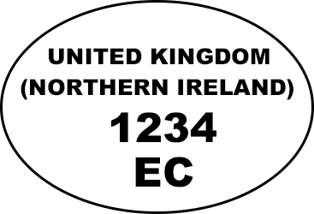
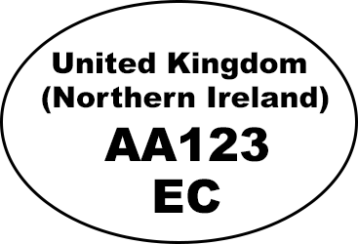
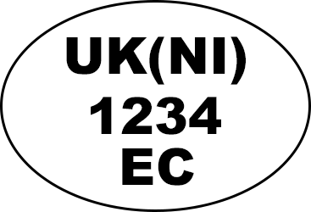
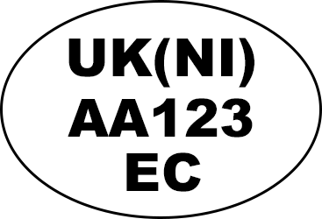
Labelling Options…
Identification marks
Northern Ireland
(FSA approvals)
Northern Ireland
(District Council approvals)
Or
Or

Slide 9
Question & Answer Session

Slide 10
Closing Remarks Claire Vincent

