Slide 1
Live Aquaculture
Stakeholder Engagement Event
3rd December 2020
Fisheries Transition

Slide 2
Welcome and Introductions
Claire Vincent
Acting Director – Marine and Fisheries Division

Slide 3
How this event will work
Who’s here – representatives from across the industry
How Webex works
How the chat function works and Q & A
Written questions already submitted
Further planned stakeholder engagement events

Slide 4
Live Aquaculture Stakeholder Engagement Event 3rd December 2020
Agenda
Welcome and introductions
Understanding of The Ireland/Northern Ireland Protocol (I/NIP)
Live Aquaculture Movements Post Transition
New rules GB – NI (under the I/NIP)
Pre Notification/Documents and Points of Entry (POE)
Covid-19 impacts
Question and Answer session
Closing Remarks

Slide 5
Understanding the Ireland/Northern Ireland Protocol (I/NIP)
Applies from the end of the Transition period
If implemented; (No Trade agreement is reached)
While the whole of the UK will leave the Customs Union,
NI will remain aligned with EU Regulations for;
SPS measures
Marketing standard’s
Environmental regulations
And customs…

Slide 6
Understanding the Ireland/Northern Ireland Protocol (I/NIP)
Slide courtesy of HMRC
Notes:
NI protocol kicks in regardless of the negotiations – dig out lines to take from Brexit policy – EU exit landing page.

Slide 8
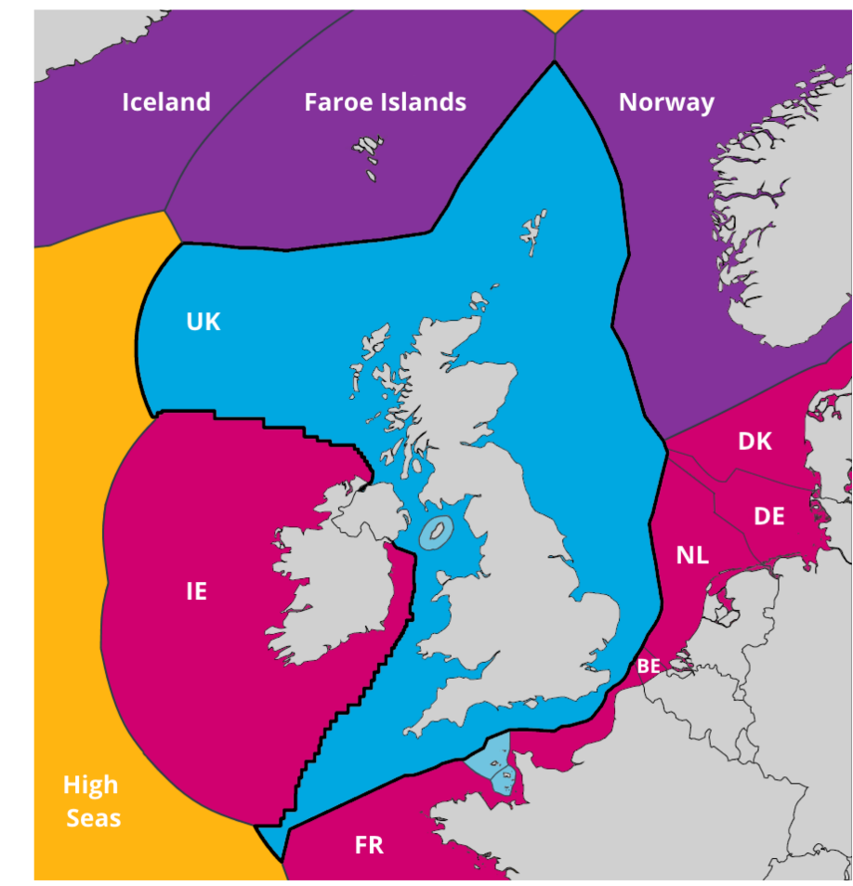
Understanding the Ireland/Northern Ireland Protocol (I/NIP)
Specific areas described in the I/NIP for Aquaculture:
EU Tariffs
Customs formalities
SPS Checks

Slide 9
Live Aquaculture Movements Post Transition NI to GB Business as usual
Movements from NI to GB
This falls under the unfettered access agreement for all fishery products (if the product remains in GB).
This will be business as usual, using the same certification.
Notification will be organised between DAERA and the GB Competent Authority.

Slide 10
Live Aquaculture Movements Post Transition NI to EU & EU to NI - Business as usual
Movements from NI to EU (including ROI) &
EU (including ROI) to NI
Where products stay within the EU regulatory zone there will be:
no change at the land border
no new paperwork (using the same certificates and notification as now)
Aquaculture Intra-trade (internal EU); Export Health Certificates (EHCs) will continue to be required.
Sustainability at the heart of a living, working, active landscape valued by everyone.
Notes:
NI will continue to have access to EU's online TRACES system (for imports and exports) as an EU entity, therefore for Day 1, you should ensure you are registered to use TRACES NT.

Slide 11
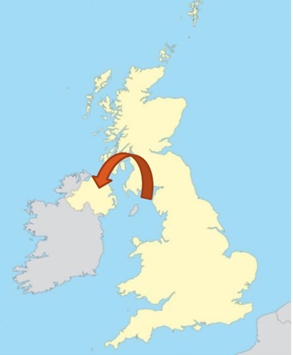
New rules for movements of Live Fish from GB – NI under the NIP
Under the I/NIP, Northern Ireland will remain in the same Sanitary and Phytosanitary (SPS) zone as the EU. Therefore any consignments of live fish entering NI from GB post transition will be treated as entering the EU SPS zone from a Third Country.
This means that all imports of live fish from GB post transition will have to be inspected as per the Official Control Regulations (OCR) at a NI Point of Entry (POE).
The current rate of inspection for all live animals, including live fish, from a third country is 100% documentary, identity and physical checks.
Image courtesy of Seafish

Slide 12
Designated Points of Entry (POE) for Live Fish Consignments Post Transition GB – NI under the I/NIP
Border Control Post (GB) & Point of Entry (NI)
Belfast Harbour
Larne Harbour
There will be no airport live fish Points of Entry (POE) in NI.
Notes:
This means that any live fish arriving in GB from the Rest of World for onward transport to NI will have to pass through a GB Border Control Post and be re-certified by the competent authority in GB for onward travel to NI

Slide 13
Pre Notification and Document Submission GB – NI under the NIP
The importer is responsible for the advance notification of the arrival of the consignment into NI.
Minimum pre-notification notice period of at least 24 hours notice in advance of the consignments arrival.
Pre-notification is given by the submission of Part 1 of the Common Health Entry Document (CHED) through the online TRACESNT system. (This has to be done by the importer).
Each consignment will need to be accompanied by an Export Health Certificate (EHC).
Notes:
1. The person responsible for the load being imported (the Importer in Northern Ireland) must give the Northern Ireland Point of Entry (POE) advance notification of the arrival of the consignment.
2. There is a required minimum pre-notification notice period of at least 24 hours notice in advance of the consignments arrival. Failure to submit correct documentation within this timeline may result in significant delays in the consignment being processed through the Point of Entry (POE).
3. Pre-notification is given by the submission of Part 1 of the Common Health Entry Document (CHED) through the online TRACESNT system accompanied by all supporting documentation associated with the consignment which should be submitted at this time as well. (This has to be done by the Importer).
4. Each consignment will need to be accompanied by an Export Health Certificate (EHC), drawn up in conformity with the model under EU law for the particular product, completed and signed by the competent authority for the exporting country. For England and Wales this is CEFAS and for Scotland this is Marine Scotland. The inspection and certification of the consignment must be completed by the competent authority within 72 hours of loading the consignment.

Slide 14
What happens at Point of Entry (POE)? GB – NI under the I/NIP
On arrival the consignment will be inspected by a member of Portal Operations Branch from the Veterinary Services Animal Health Group (VSAHG) of DAERA.
All consignments of live fish are subject to documentary, identification and physical inspections at a 100% inspection rate.
If there are any anomalies your consignment may be refused entry into Northern Ireland.
Notes:
On arrival at the NI Point of Entry (POE) the consignment will be inspected by a member of Portal Operations Branch from the Veterinary Services Animal Health Group (VSAHG) of DAERA.
All consignments of live animals, including live fish, trout eggs and molluscs will be subject to documentary, identification and physical inspections at a 100% inspection rate as per the Official Controls Regulations (OCR).
If there are any anomalies your consignment may be refused entry into Northern Ireland and re-exported, destroyed or allowed to enter for permitted alternative use (e.g. pet food) under the Trade in Animals and Related Products Regulations (Northern Ireland) 2011 (TARP).

Slide 15
Completed forms should be emailed to Fish.Health@daera-ni.gov.uk

Slide 16
Covid-19 Impacts
Aquaculture Financial Assistance Scheme.
Payments totalling £126.4K to 15 undertakings.
Potential for Future Covid-19 Support?
Must have identified need.
Impact must be quantified.
Business Case developed and approved by Economists.
Case to Minister to consider.
Decision whether to make funding available.
Next Steps.
Notes:
Aquaculture Financial Assistance Scheme: Launched by Minister on 26 May 2020. The funding was to help operators recover a portion of the ‘income foregone’ associated with their operations as a result of the pandemic.
Funding was based on 50% of an undertaking’s ‘income foregone’ (income lost) from the sales of aquaculture products during the 3 month period, 1 March 2020 to 31 May 2020. The amount granted was based on the average monthly revenue from the sales of aquaculture products over the 3 year period, 2017 - 2019.
Absolute maximum available to an undertaking of £27,600.
Eligibility for oyster, trout (not salmon) and rope grown mussels.

Slide 17
Question & Answer Session

Slide 18
Closing Remarks Claire Vincent

