Slide 1
McLintock Syringe Maintenance between Manufacturer services
Approved Veterinary Surgeon Annual TB Training
Enzo Ascenzi

Slide 2
A precision instrument
The McLintock syringe is a precision instrument which is also very robust.
It is pre-set to deliver up to 20 doses of tuberculin, each of 0.1ml, per fill.
Regular cleaning and lubrication will maintain the syringe's smooth and efficient operation and can help to extend its useful life almost indefinitely.
Maintenance of good seals helps ensure that the right amount of tuberculin is delivered each time.

Slide 3
Regular maintenance between annual services
Maintenance should be carried out once a month or any time you feel the McLintock syringe is dirty or not working properly.
You may notice that the injection action is too stiff
You may notice that tuberculin dribble out of the needle after injection or that you are not achieving a ‘pea’.

Slide 4
Regular maintenance between annual services
The syringes should be serviced annually by the manufacturers and the seals should be replaced at the service.
This short presentation will show you how to maintain your McLintock syringes between the annual manufacturer services.

Slide 5
The Parts of the McLintock Syringe

Slide 6
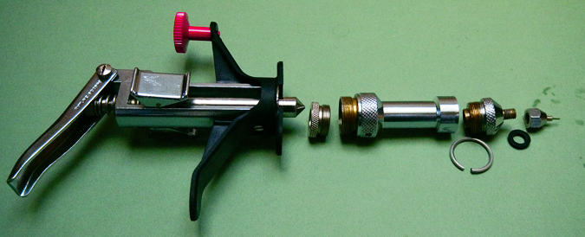
The Main Parts
Thumb Rest
Piston/
Plunger
Schimmel
Nozzle
Schimmel
Needle
Pressure
Lever
Main Nozzle
Pawl
Gland
Barrel
Needle
Nozzle
Washer
Finger
Bar
Holster
Ring

Slide 7
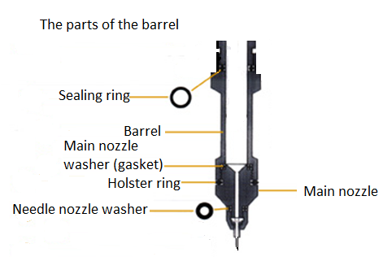

Slide 8
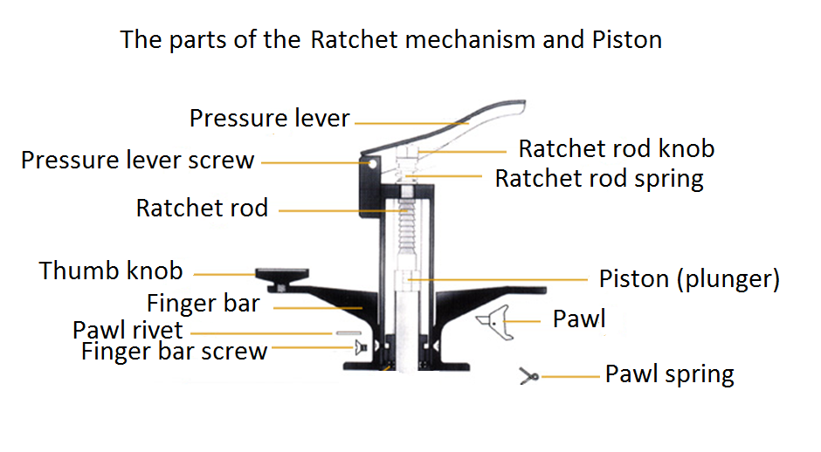

Slide 9
With the Ratchet mechanism broken down

Slide 10
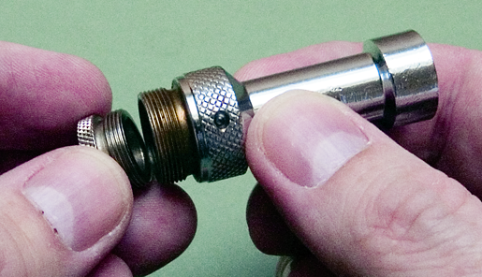
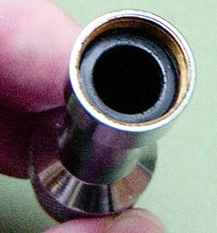
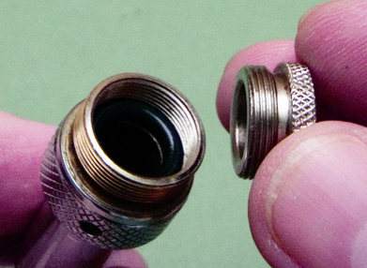
The gland and the sealing rings of the barrel
Sealing ring at
top of barrel
Gland at base of barrel
Sealing ring at base of barrel

Slide 11
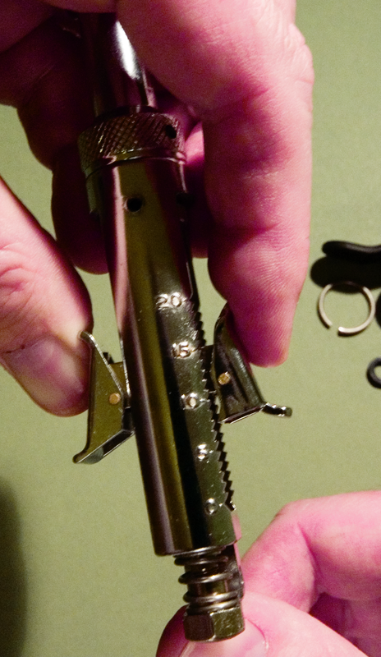
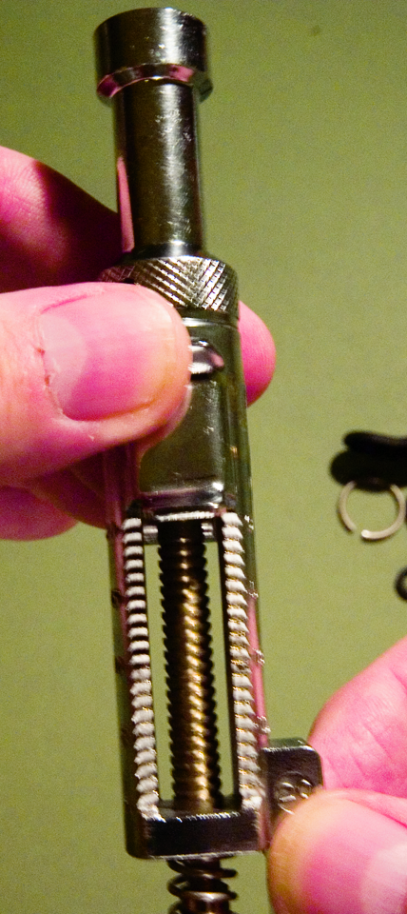
The Ratchet mechanism
Doses used
Scale
Ratchet Rod
Ratchet Rod Spring
Ratchet Rod Knob

Slide 12
Taking apart the barrel

Slide 13
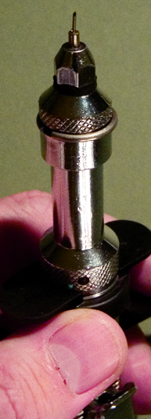
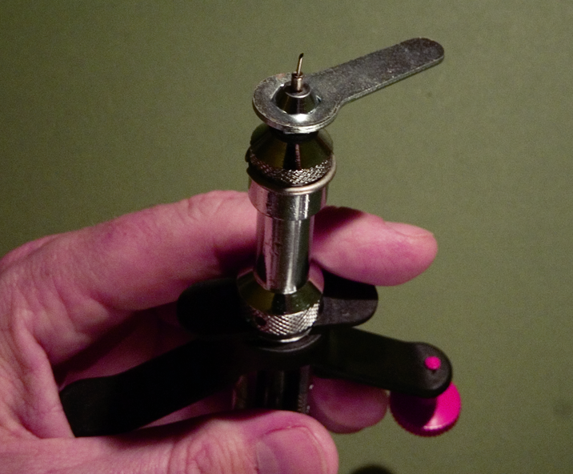
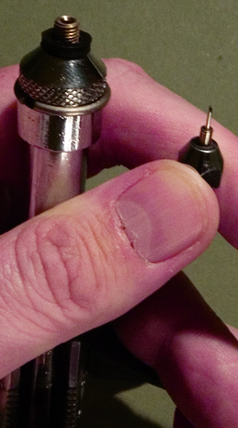
Taking apart the barrel
Hex spanner

Slide 14
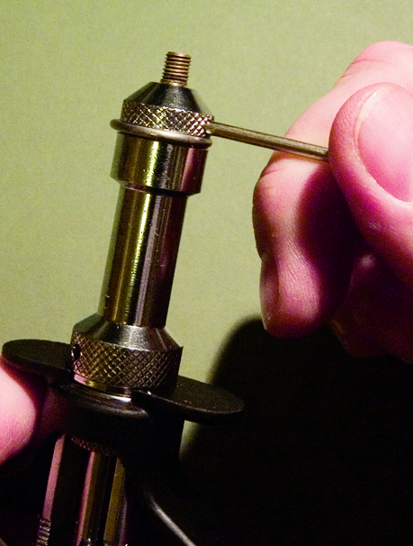
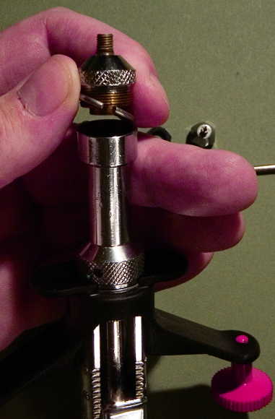
Removing the main nozzle
Tommy bar

Slide 15
Main Nozzle Seal
Using the Tommy bar, unscrew the Main Nozzle from the barrel and remove the Holster ring.
By removing the top flange you can visually inspect the main nozzle seal for the presence of crystals of tuberculin which develop when tuberculin is left in the barrel for a long period.

Slide 16
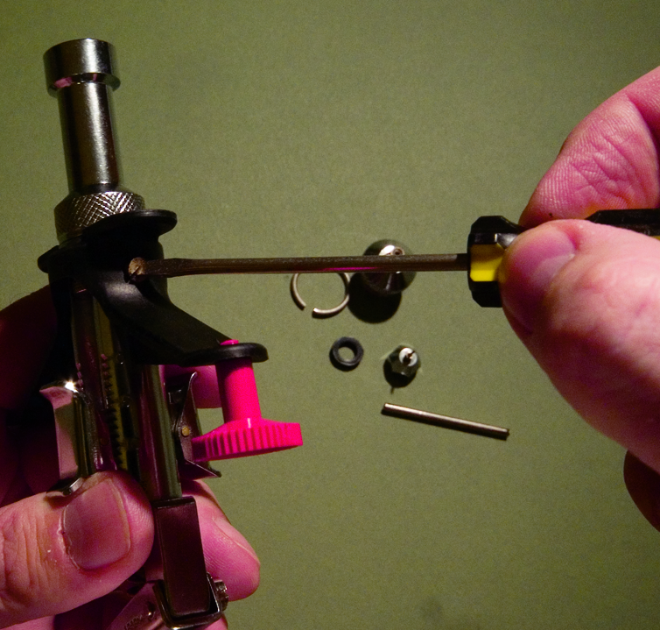
Taking off the finger bar
Finger bar screw.
One on each side

Slide 17
Cleaning the barrel and plunger

Slide 18
Cleaning the barrel and plunger
Once the barrel has been removed, it can be cleaned using cotton wool soaked in methylated spirit to remove any dirt or crystallised tuberculin.
Clean to remove gross external contamination, and remove leftover tuberculin – draw up clean water and expel repeatedly.
Cotton wool and methylated spirit are also used to clean the plunger.

Slide 19
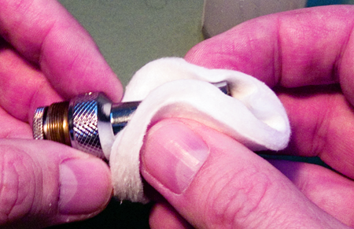
Cleaning the barrel
Cotton Wool and Methylated Spirit
Barrel

Slide 20
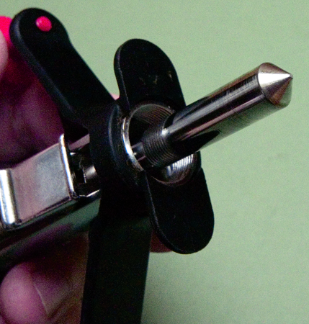
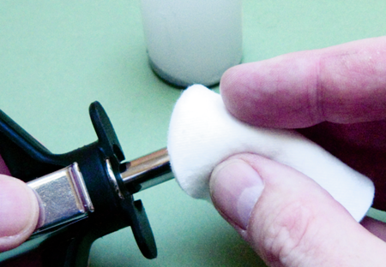
Cleaning the plunger
Piston/Plunger
Cotton Wool & Spirit

Slide 21
Care of the barrel
Keeping the tuberculin in the syringe for a period will result in crystallisation of the tuberculin.
Crystallised tuberculin will accumulate on the rubber sealing ring between the piston and the barrel and damage it
This will result in loss of injecting pressure.
To avoid crystallisation, expel the tuberculin from the syringe at the end of the working day and withdraw the piston.
Always store the syringe with the plunger fully withdrawn i.e. at stop 1 (NOT stop 20).

Slide 22
Removing the Gland
Remove the gland by twisting with your hand

Slide 23
The Sealing Ring at the base of the barrel
Once the barrel has been removed and the Gland removed, you can visually inspect the sealing ring at the base of the barrel.
This is the seal that ensures that the plunger and the barrel are watertight and there is no loss of injecting pressure.
The Gland at the bottom of the barrel is the only part of the McLintock that has to be tightened and loosened by hand, to avoid damaging the sealing ring.

Slide 24
Lubricating the plunger

Slide 25
Lubricating the plunger
Once both the inside of the barrel and the plunger have been cleaned, put a few drops of McLintock Syringe lubricant on the plunger.

Slide 26
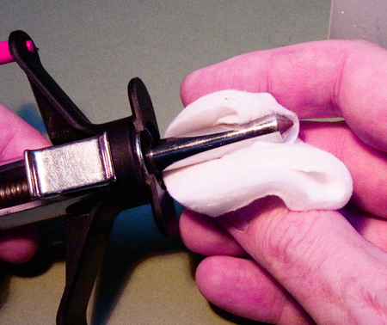
Lubricating the Plunger
Cotton Wool and McLintock Syringe lubricant

Slide 27
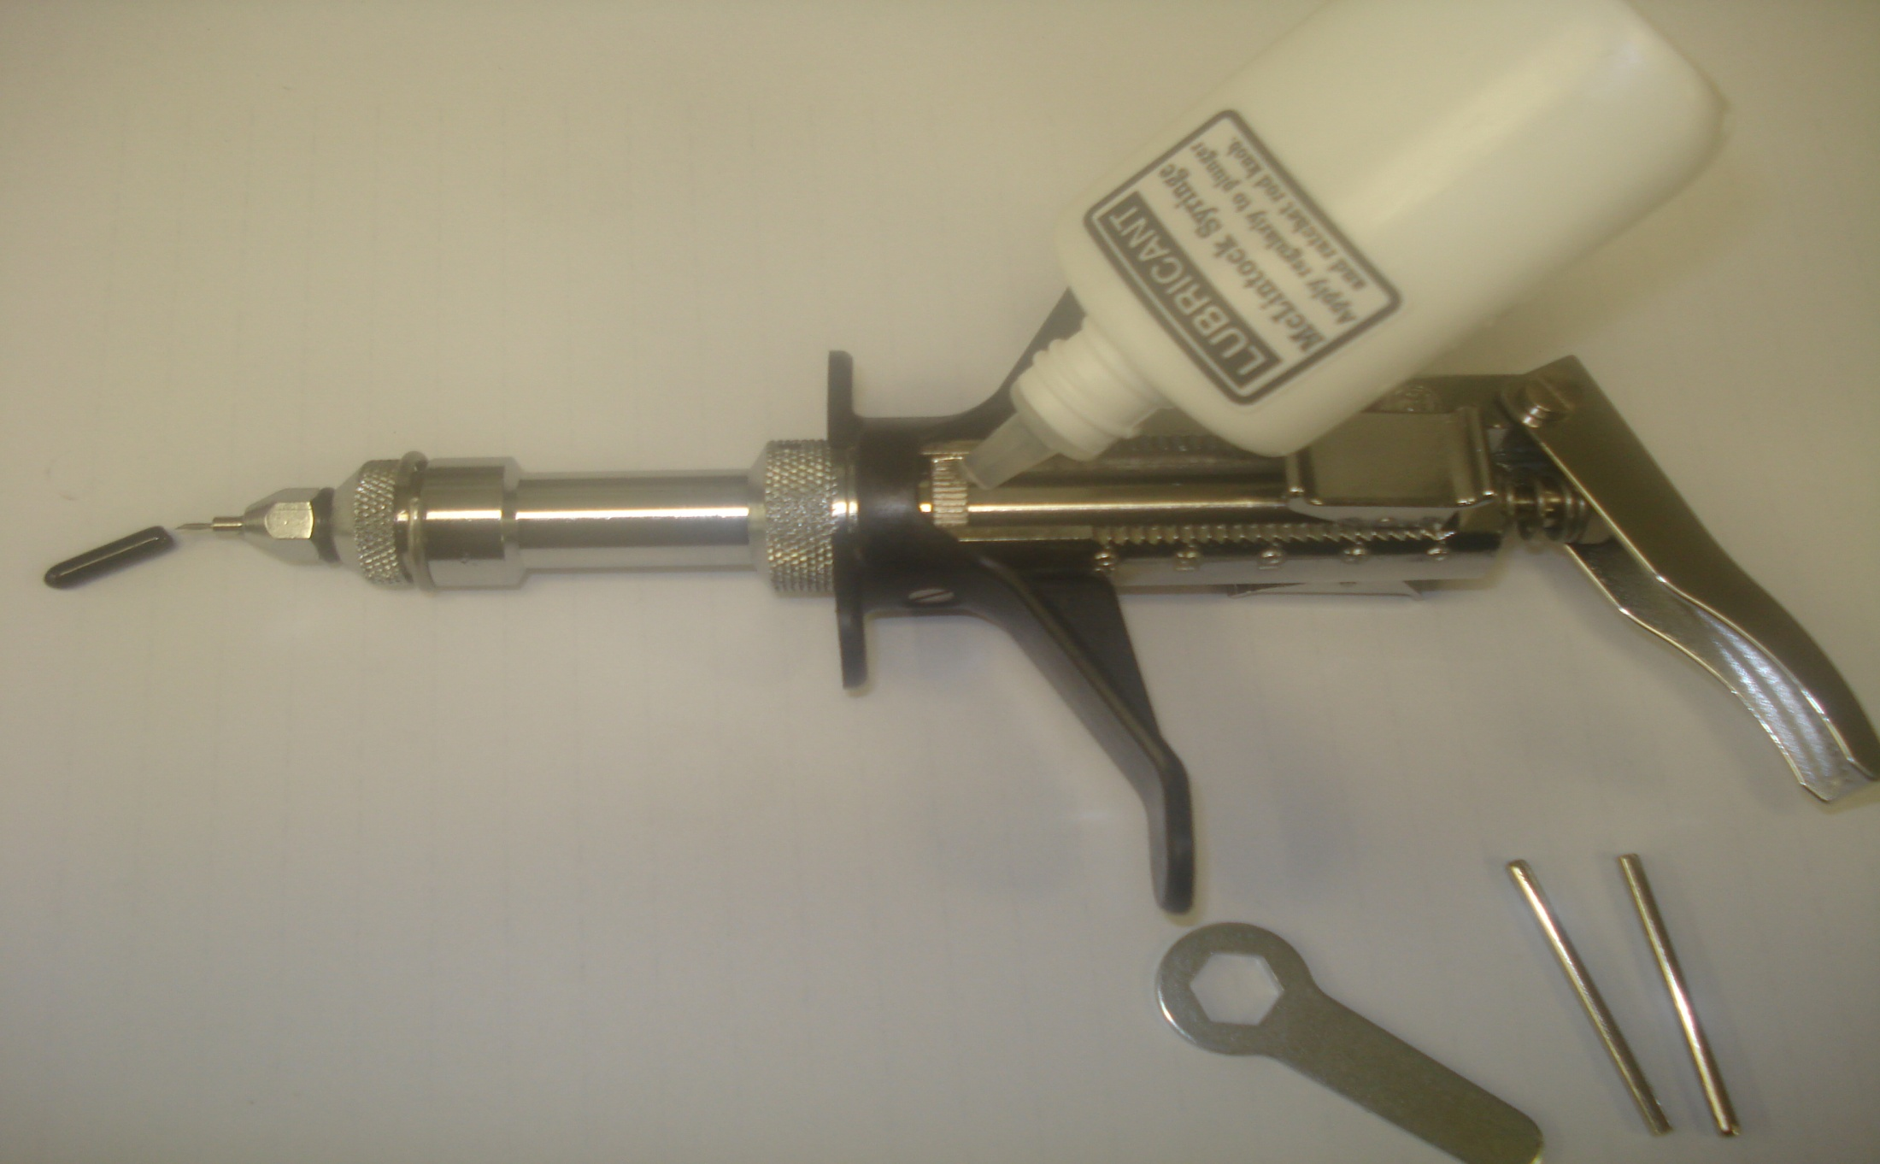
Do not lubricate the Ratchet Rod

Slide 28
You may lubricate the Ratchet Rod Knob using Vaseline

Slide 29
Reassembling the barrel

Slide 30
Reassembly of the syringe
Screw back on the Gland at the bottom of the barrel, paying attention not to tighten it too much.
If it is tightened too much, the plunger will not fit back into the barrel because the sealing ring at the end of the barrel has been compressed so that it protrudes too much into the barrel.
If it is too tight, slightly unscrew the Gland and try again to insert the plunger into the barrel until you can feel that the plunger fits neatly into the barrel so that it is watertight.

Slide 31
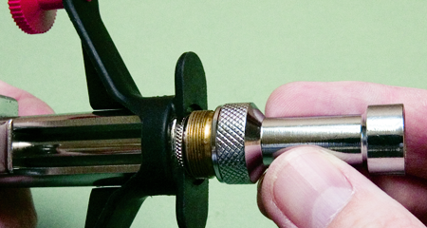
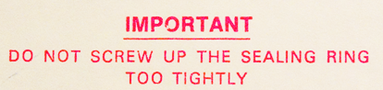
Reassembling the barrel

Slide 32
Reassembling the barrel
Screw back on the barrel and tighten it by using the Tommy bar.
Screw back on the top flange tightly
Put back the needle nozzle washer and screw the nozzle back on, being careful not to do it too tightly to avoid damaging both the needle and the washer.
Use minimum torque in order to form a seal between the needle nozzle and the main nozzle

Slide 33
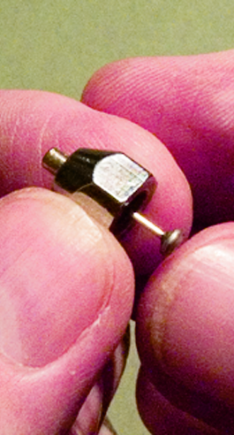
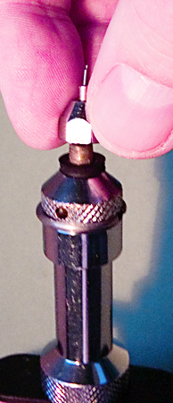
Reassembly

Slide 34
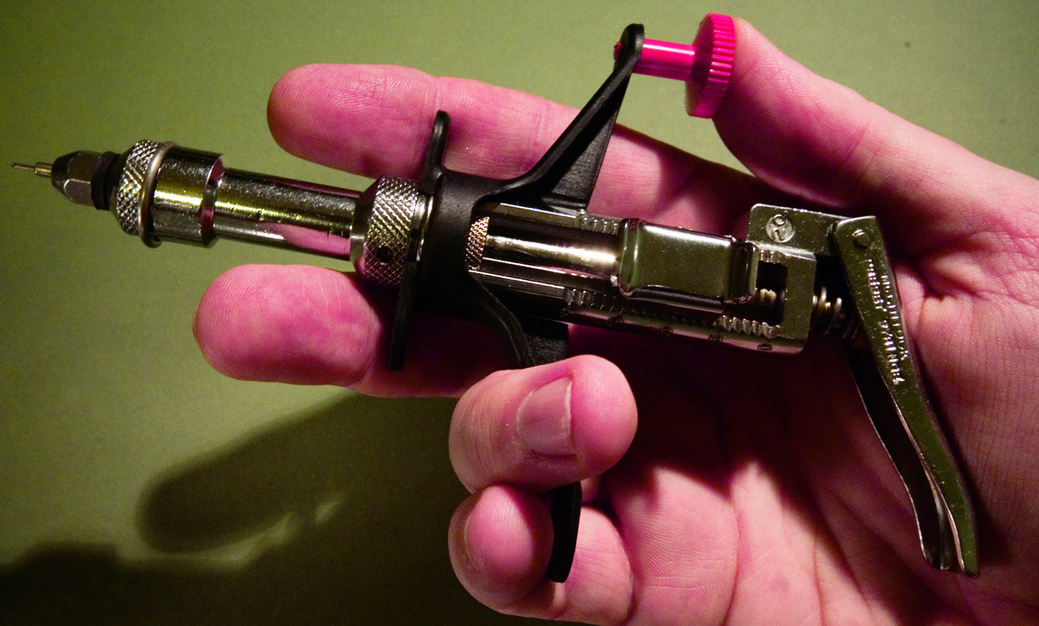
Reassembly
Hex Spanner
Finished

Slide 35
Checking that it works

Slide 36
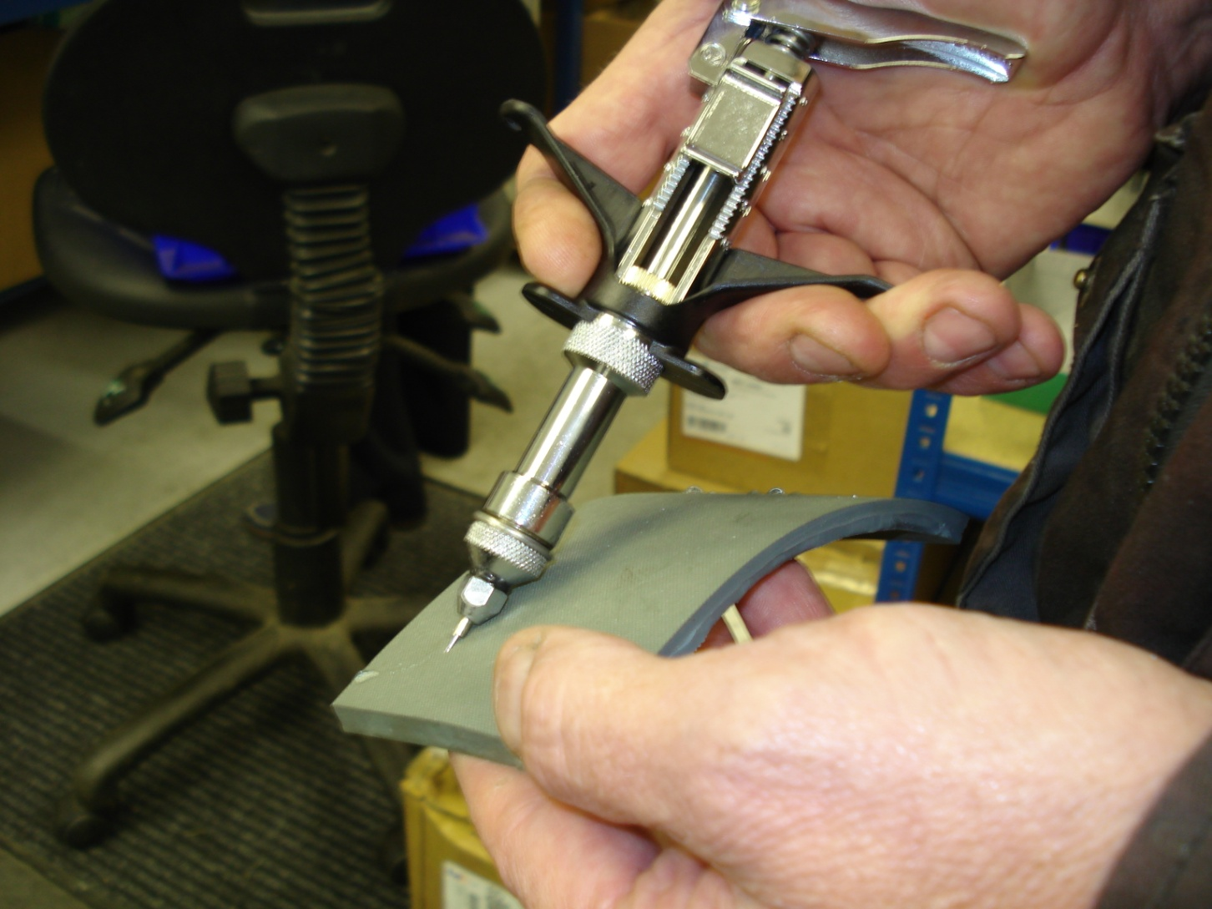
Testing the syringe
To test the syringe after this maintenance, you can fill the McLintock with water for injection, stick the needle in soft rubber and squirt a dose into the rubber.
There should be no leakage from any part of the syringe.
If leakage happens, tighten again the part where there is leakage repeat as required until the syringe is watertight.

Slide 37
Filling the syringe

Slide 38
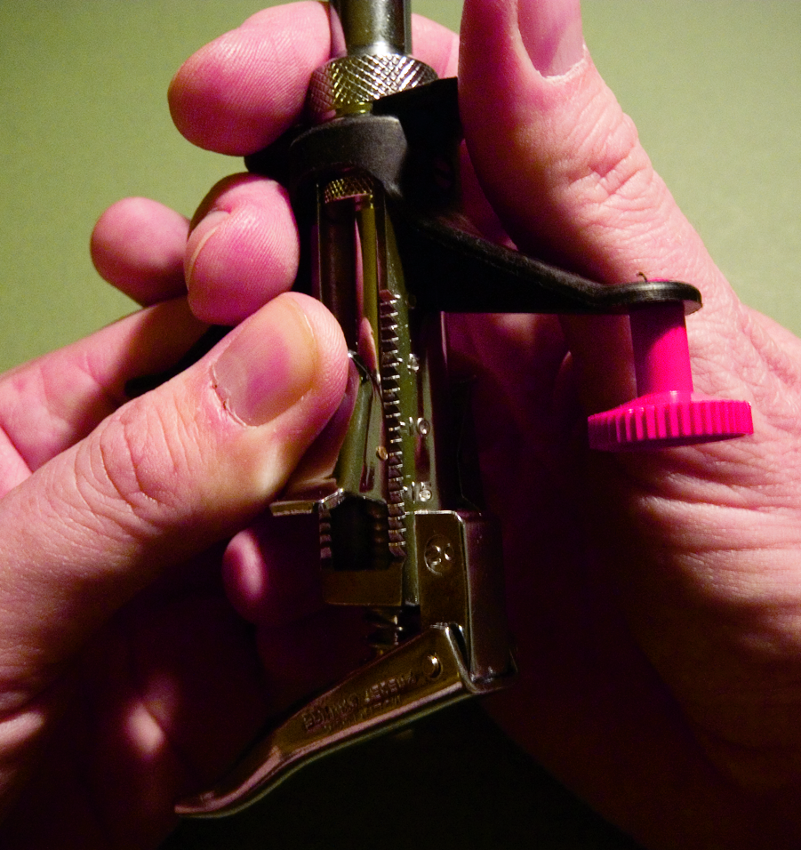
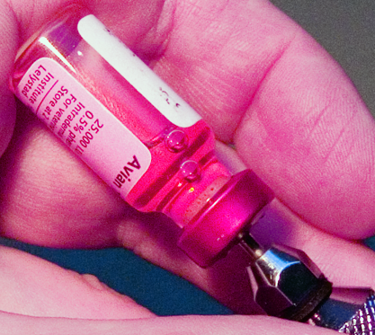
Filling
Check no air is left in syringe

Slide 39
Needles

Slide 40
Two types of needle

Slide 41
Record and Schimmel needles

Slide 42
When to change a needle
It is good practice to
Change the needle every time you drop your syringe
Change the needle after testing very dirty animals
Change the needle after testing animals with skin conditions

Slide 43
How to change a needle
Unscrew the nozzle using the Hex spanner and remove it from the syringe.
Be careful not to drop the needle nozzle washer which sits between the nozzle and the syringe.
In case you do not have available a Hex spanner in field conditions, you can use the handles of your scissors to unscrew the nozzle.
Please do not use the callipers as this would damage the callipers.

Slide 44
How to change a needle
Remove the old needle and replace it with a new one.
Make sure not to lose the needle sleeve, if one is being used, at this stage.
Screw back the nozzle.
Avoid screwing on the nozzle too tightly to avoid damaging either the new needle or the needle nozzle washer.

