Slide 2
The NI Food Strategy Framework aims to be a cross government unifying framework, with
a shared long term vision,
set of 8 principles and
6 priority areas
to guide long term food decision making.

Slide 3
Key Drivers for Change
Diet-related Health & Wellbeing
Global Trends EU Exit
- Opportunities
Sustainability
- Environmental
- Economic
- Social
Covid-19
Unique opportunity to shape the future direction of our food system in ways that will benefit generations to come.

Slide 4
The Journey So Far ……..
Summer 2019 DAERA began to explore with the DfE, and other NI Departments and interested parties, the merits, scope and content of a possible Food Strategy Framework to:
develop strategic alignment across NI Departments and help shape a future food system for Northern Ireland.
provide a structure within which government, industry, voluntary and community organisations can operate.
allow autonomy with guidance on the direction of travel, but the flexibility to adapt to changing global trends, policy mandates, and marketplace needs.
Development of a draft Vision by officials from across all government departments.

Slide 5
Vision
“A transformed food system that protects natural resources for future generations, is economically and environmentally sustainable and provides safe, nourishing, accessible food to people, who make informed healthy choices”.

Slide 6
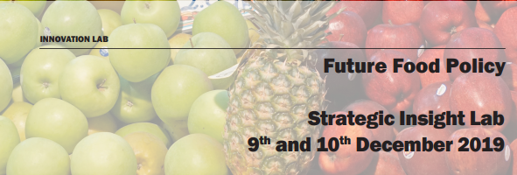
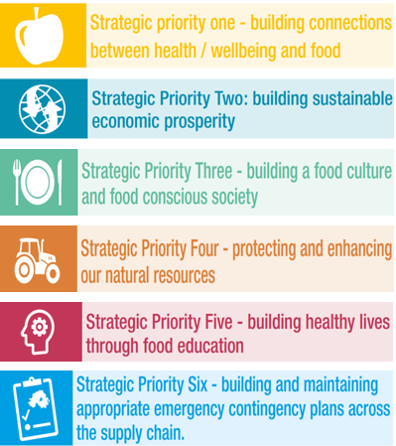
Co-Design Process
This Vision was tested in a follow-up Strategic Insight Lab.
Food & Farming Representatives
Environmental NGOs
Health
Draft Vision
Local Government
Consumer Interests
Academics
Government
Education

Slide 7
OVERVIEW – PHASE ONE – March 2022
Start of the journey.
Framework to build future policy decisions around food.
Food Systems Approach
Executive approval in principle for the Food Framework approach
Seeking your views - Is this the right approach?
Consultation period – closes on 19 November 2021

Slide 8
PHASE TWO (Post Publication of agreed framework)
Development of Implementation plans & Metrics - Informed by the Green Growth Strategy, recommendations from the Kendall Review, and alignment with other interconnected strategies.
Proposing 5 year rolling action plans
Ongoing engagement with stakeholders / co-design
Formal Review - in 2030

Slide 9
The Aim is to be
a cross government unifying strategy, with a shared vision, principles and priorities to guide long term food decision making.
THE VISION
“A transformed food system that protects natural resources for future generations, is economically and environmentally sustainable and provides safe, nourishing, accessible food to people, who make informed healthy choices”.

Slide 10
The NI Food Strategy Framework aims to be a cross government unifying framework, with a shared vision, principles and priorities to guide long term food decision making.

Slide 11
Guiding Principles

Slide 12
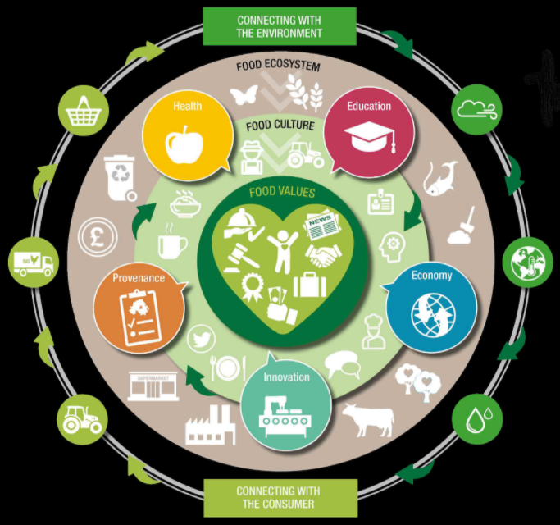
The Food Strategy Framework signals a significant change in approach.
Reflecting the different strategic drivers anticipated during the coming decades, the Framework seeks to build a food system that will address economic, environmental and social sustainability.
It places a significant focus on the changing values and behaviours of consumers.

Slide 13
What is a Food Systems Approach?
We propose a Food Systems approach embracing all the elements and activities that are involved in feeding a population – the production, processing, packaging, distribution, marketing, consumption and disposal of food.
A ‘whole of government’ approach which will align policies that affect the food system.

Slide 14
This new approach on food is part of wider policy development agenda underway on strategic issues such as Circular Economy, Climate, Environment, Farming, Health, Education, Skills & Science.
Food cuts across the policy responsibilities of a number of NI Ministers, Agriculture, Environment and Rural Affairs, Economy, Communities, Health, Education, Finance and Justice.
Although led by DAERA, the proposed Food Strategy Framework has been developed in collaboration with the other NI Departments, the Food Standards Agency NI, Invest NI, and key stakeholders.
It will ensure coherence across food policies that affect all our lives and help to improve economic, environmental, health and social outcomes for Northern Ireland.

Slide 15
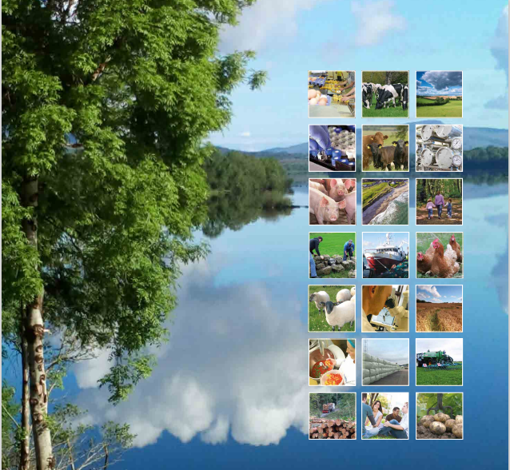
LINKS WITH OTHER STRATEGIES
DAERA, on behalf of the NI Executive, are developing a Green Growth Strategy and associated Climate Action Plan which will be the initial route map to climate action, green jobs and a clean environment.
The Executive has agreed in principle to the cross-departmental approach under Green Growth.
Within DAERA, a ‘sister’ strategy on agriculture is dealing with
increased productivity,
environmental sustainability,
improved resilience, and
supply chain integration.
The new agriculture strategy will be closely linked to the Food Framework through the supply chain pillar.

Slide 16
Northern Ireland Food Strategy Framework - Strategic Priorities
The proposed Framework highlights six strategic priorities to achieve the Vision.
Five were identified from the work with NI Departments and key external stakeholders.
A sixth was added to take account of experience of the COVID-19 pandemic.
These six priorities will provide a focus and direction to NI Departments for future policy interventions on food.

Slide 17
Strategic priority one will build on the connections between health, wellbeing and food, with a focus on making healthy, nutritious and sustainable food the ‘food of choice’, and
ensuring food is produced to the highest quality, safety and ethical standards.
enhance collaboration around policy agendas such as obesity, nutritional standards, food poverty, and the principles of One Health (which recognises that the health of humans, animals and ecosystems are interconnected).
What would success look like?
A society where everyone has access to safe and nutritious food, where food insecurity and dietary related diseases are in decline, resulting in improved societal health and wellbeing.
Key Partners
Department of Health, Department of Communities, Department of Justice, DAERA,
Food Standards Agency
Notes:
Could you put something about One Health? Wonder should we focus on the aspiration piece in the consultation document – “Strategic priority one will build on the connections between health, wellbeing and food, with a
focus on making healthy, nutritious and sustainable food the ‘food of choice’, and ensuring food
is produced to the highest quality, safety and ethical standards. It will enhance collaboration
around policy agendas such as obesity, nutritional standards, food poverty, and the principles
of One Health (which recognises that the health of humans, animals and ecosystems are
interconnected).

Slide 18
Strategic priority two will build on the connections between the economy, environment and food, with a focus on innovation.
It will enhance collaboration around policy agendas such as circular economy and economic development, innovation, skills and education, rural communities, and tourism.
What would success look like?
A sustainable food system which is populated by successful, adaptable businesses with increased levels of productivity, circularity and innovation, which are competitive and able to maximise opportunities both in NI and on the global stage.
The NI agri-food sector is a major source of economic prosperity recognised for its quality, safety and knowledge driven approach, and for fairness and transparency in the supply chain.
Key Partners
Department for Economy, DAERA,
DoJ,
Invest NI, Tourism NI, Food Standards Agency,
Local Councils
Notes:
Again maybe the aspiration - Northern Ireland will have a sustainable food system which is populated by successful,
adaptable businesses with increased levels of productivity, circularity and innovation, which are
competitive and able to maximise opportunities both in the NI marketplace and on the global
stage. The NI agri-food sector is a major source of economic prosperity recognised for its quality,
safety and knowledge driven approach, and for fairness and transparency in the supply chain.

Slide 19
Strategic priority three will build on the connections between the economy, environment, and food, with a focus on creating a healthy food culture, reconnecting people with knowledge of where their food comes from, building a food citizenship movement and promoting our quality produce.
It will enhance collaboration around policy agendas such as economic prosperity, environment, rural communities, and tourism.
What would success look like?
Northern Ireland will have a culture of civic pride as the home of good food, where the social value of food is nurtured and celebrated. The food sector will be more resilient as a result of increased local, national and international demand encouraged by co-ordinated NI agri-food market awareness and promotion.
Key Partners
Department for Economy, Department of Communities, DAERA, Tourism NI, Invest NI, Food Standards Agency,
Local Councils.
Notes:
Northern Ireland will have a culture of civic pride as the home of good food, where the social
value of food is nurtured and celebrated. The food sector will be more resilient as a result of
increased local, national and international demand encouraged by co-ordinated NI agri-food
market awareness and promotion.

Slide 20
Strategic priority four will build on the connections between agricultural primary production, environment, and food, enhancing collaboration around policy agendas such as future agriculture support, environment, biodiversity and land use, reduction in food waste, carbon reduction and Green Growth.
What would success look like?
Northern Ireland will become a low carbon society where natural resources deployed in food production are responsibly managed and associated environmental costs/benefits are appropriately valued and reflected across the food supply chain. There will be a strong emphasis on circular economy, nature friendly farming practices, and opportunities to create profitable and shorter supply chains, minimise food waste, and redistribute surplus where possible.
Key Partners
Department for Economy, DAERA, Invest NI.
Notes:
Northern Ireland will become a low carbon society where natural resources deployed in
food production are responsibly managed and associated environmental costs/benefits are
appropriately valued and reflected across the food supply chain.
There will be a strong emphasis on circular economy, nature friendly farming practices,
and opportunities to create profitable and shorter supply chains, minimise food waste, and
redistribute surplus where possible.

Slide 21
Strategic priority five will build on the connections between health, education, farming, environment, and food. It will enhance collaboration around policy agendas such as food in schools, obesity, healthy eating, and nutritional standards.
What will success look like?
School food education will create a strong foundation for a healthy lifelong relationship with food, encouraging and supporting children to eat well, understand where and how their food is produced and processed, and how food choices impact on their health and the environment.
In addition, this priority focuses on education throughout life to also improve adult education in healthy foods and nutrition.
Key Partners
Department of Education, Department of Health, Education Authority, DAERA,
Food Standards Agency.
Notes:
School food education will create a strong foundation for a healthy lifelong relationship with
food, encouraging and supporting children to eat well, understand where and how their food is
produced and processed, and how food choices impact on their health and the environment.
In addition, this priority focuses on education throughout life to also improve adult education in
healthy foods and nutrition. There are particular links to strategic priorities one and three.

Slide 22
Strategic priority six will build on the connections between food supply security, food poverty, safety and integrity of food and protection of the food system economy.
What will success look like?
The Northern Ireland food system (industry, Government, voluntary and community sectors) will proactively manage risk along the entire food chain. It will include accessibility to food by people who live here, the safety and integrity of food, and protection of the food system economy.
This priority will aim to ensure that emergency contingency plans will be ready to operate in any future crisis to ensure a continued supply of safe food for all the people of Northern Ireland.
Key partners Department of Communities, Department of Health,
Food Standards Agency, DAERA, Department for Economy, Invest NI
Notes:
This priority will aim to ensure that emergency contingency plans will be ready to operate
in any future crisis to ensure a continued supply of safe food for all the people of Northern
Ireland. There is a significant role for industry to maintain robust contingency plans to deal with
disruptions to food supplies. Government has a role in co-ordinating the response to crises
affecting food systems. It will encourage partnerships with industry and the voluntary and
community sector to mitigate risks to consumers. The lessons learnt from previous pandemics/
disease outbreaks will inform the plans for dealing with future emergencies.

Slide 23
Proposed Governance Structures
A new Food Programme Board will oversee the implementation of the Northern Ireland Food Strategy Framework.
A cycle of five year action plans.
To encourage collaborative working across organisational boundaries the Framework will identify a number of early Foundation Projects.

Slide 24
Pilot Implementation Projects
Foundation Project - a cross departmental task force will investigate the opportunity to increase the amount of food sourced locally by government
Another potential early Project will explore how to encourage children in schools to eat more fruit and vegetables, including seasonal local produce. This Project will seek to promote health, socio-economic, environmental and education objectives. It will aim to help to connect children with where their food comes from and encourage them to make healthy eating choices.

Slide 25
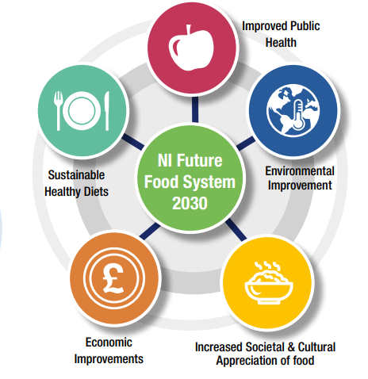
Benefits to be realised
A Food Systems approach provides an opportunity to work together to achieve health, environmental and economic goals in synergy.
Contribution to NI PfG and UK commitment to the UN Sustainable Development Goals.

Slide 26
Next Steps
Public Consultation
Analysis & Publication of Response Results
Finalise Framework
Executive Approval
Publish Framework
Sustainability at the heart of a living, working, active landscape valued by everyone.

